Slide 1
Online Exam Review – June 2022
Level 3 Health and Social Care: Principles and Contexts
Unit 5: Supporting individuals at risk to achieve their desired outcomes

Slide 2
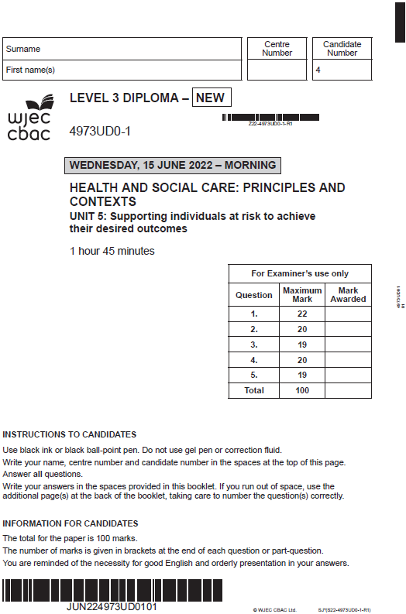
Unit 5: Supporting individuals at risk to achieve their desired outcomes
Online examination review (OER)

Slide 3
Question 1 (e)
Evaluate the positive and negative impact of respite care for Gareth, Wayne and Rhodri. [6]

Slide 4
Question 1 (e) Candidate 1 answer

Slide 5
Question 1 (e) Candidate 1 answer with examiner’s comments
This candidate did not evaluate any positive or negative impacts of respite care for Gareth, Wayne and Rhodri. Therefore, this would come under ‘response not creditworthy’.
The answer did not make clear the positive and negative impact of respite care.
The candidate would have been awarded some marks if they were able to have at least listed some positive or negatives such as: Gareth and Wayne could spend more alone time; and a negative for Rhodri could be that, due to his learning disabilities, a change of environment could trigger some further behavioral difficulties.
0 marks awarded.

Slide 6
Question 1 (e) Candidate 2 answer

Slide 7
Question 1 (e) Candidate 2 answer with examiner’s comments
This candidate has evaluated positive and negative impact of respite care for Gareth, Wayne and Rhodri.
The candidate did give good evaluation points looking at the positive and negative impact of respite care for Rhodri. However, the candidate did not consider the negative impact of respite care for Gareth and Wayne so therefore could not reach band 3.
Additional marks could have been awarded for evaluating the negative impact of respite for Gareth and Wayne, such as: they may feel they are not good parents and letting Rhodri down.
4 marks awarded.

Slide 8
Question 1 (e) Candidate 3 answer

Slide 9
Question 1 (e) Candidate 3 answer with examiner’s comments
This candidate has considered some evaluation of the positive impact of respite care.
The candidate did consider that the positives would stop Gareth and Wayne becoming stressed, therefore providing early intervention – this could have been developed further. However, there was no mention of any negative impact on Gareth, Wayne and Rhodri so therefore could not get into band 2.
The other points being made were not explicit enough and not focusing on the positive or negative impact of respite care on Gareth, Wayne and Rhodri. The last point on eligibility was inaccurate.
2 marks awarded.

Slide 10
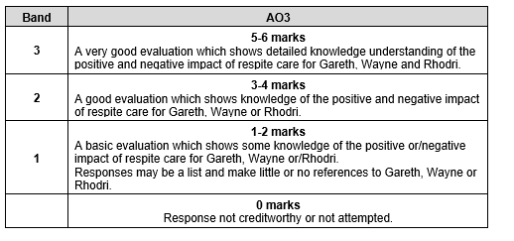
Question 1 (e) mark scheme

Slide 11
Question 2 (c)
Explain two ways in which Safeguarding Adult Boards (SAB) protect adults and prevent potential risk of abuse and neglect. [4]

Slide 12
Question 2 (c) Candidate 1 answer

Slide 13
Question 2 (c) Candidate 1 answer with examiner’s comments
This candidate confused Safeguarding Adult Boards (SAB) with inspectorates, which was a common error for this question.
The candidate’s first point was not credited as inaccurate; however, the second point was awarded 1 mark as candidate did identify that SAB works with other services – however, the candidate did not expand on how this would therefore protect adults from abuse and neglect.
The candidate would have been awarded more for explaining how working together would protect adults, for example, professionals working together with SAB could enable multi-agency reviews which bring in all different areas of expertise and can inform future practice and learn from previous mistakes which, as a result, would more likely protect adults from risk of harm.
1 mark awarded.

Slide 14
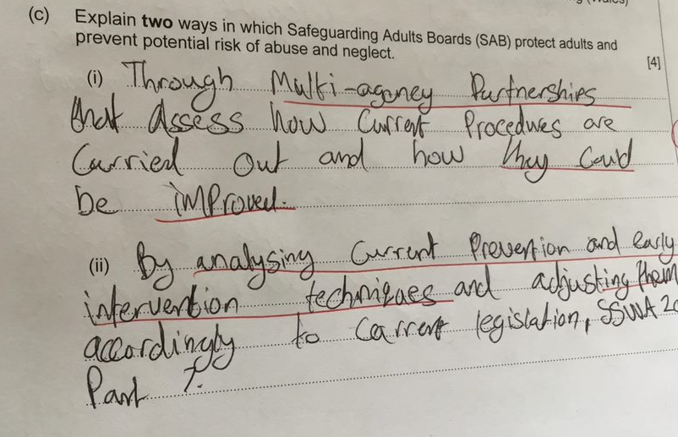
Question 2 (c) Candidate 2 answer

Slide 15
Question 2 (c) Candidate 2 answer with examiner’s comments
This candidate repeated back the question stem on multi-agency partnerships – they could have been clearer on this – such as carry out multi-agency reviews – but the first point was given a mark for briefly expanding on what would happen.
The second point was given 1 mark; however, further explanation on how this would protect adults would have been useful.
The candidate could have been clearer on the second point, such as: could report back to Welsh Ministers on current techniques, which could therefore change legislation in order to learn lessons and roll this out across Wales to ensure abuse is prevented.
2 marks awarded.

Slide 16
Question 2 (c) Candidate 3 answer

Slide 17
Question 2 (c) Candidate 3 answer with examiner’s comments
This candidate did give two points within their answer; however, only the top point was given a mark – the candidate made clear that SAB work with other professionals to discuss greater ideas, however the candidate did not explain how this may then protect adults from abuse and neglect.
The candidate could have been clearer on the second point, such as: recommending to the Welsh Government how safeguarding policies could be amended to secure individuals’ right to stay safe from harm and abuse which would protect individuals' well-being.
1 mark awarded.

Slide 18
Question 2 (c) mark scheme

Slide 19
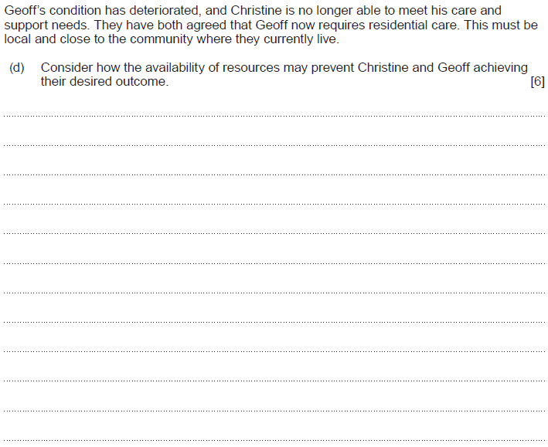
Question 2 (d)

Slide 20
Question 2 (d) Candidate 1 answer

Slide 21
Question 2 (d) Candidate 1 answer with examiner’s comments
This candidate did respond to the potential impact of how the availability of resources may prevent Christine and Geoff achieving their desired outcome; however, did not specifically mention what availability of resources may prevent Christine and Geoff achieving their desired outcome. Therefore, the candidate could not reach band 2 as did not meet the requirement under the mark scheme of ‘some’ consideration of the availability of resources.
The candidate could have considered the following resources: financial constraints, geographical constraints, long waiting lists, availability of specialist staff, lack of transport.
2 marks awarded.

Slide 22
Question 2 (d) Candidate 2 answer

Slide 23
Question 2 (d) Candidate 2 answer with examiner’s comments
This candidate did give one detailed consideration of how ‘availability in a residential care home may not be available’. The candidate then considered the impact this may have on their situation, using some useful points such as ‘may feel isolated’ and ‘diagnosis to worsen’.
The candidate could have improved the answer by considering further availability of resources such as specialist staff being unavailable or may not be able to financially afford the local care.
3 marks awarded.

Slide 24
Question 2 (d) Candidate 3 answer

Slide 25
Question 2 (d) Candidate 3 answer with examiner’s comments
This candidate was able to consider at least two detailed points regarding how the availability of resources may prevent Christine and Geoff achieving their desired outcome.
The first point considered a ‘a lack of staff’, and then the second point considered ‘remote area and therefore not enough transport’.
The candidate could have been clearer on a lack of specialist staff rather than just staff, however this answer did enough under the time constraints and the marks available to achieve full marks.
6 marks awarded.

Slide 26
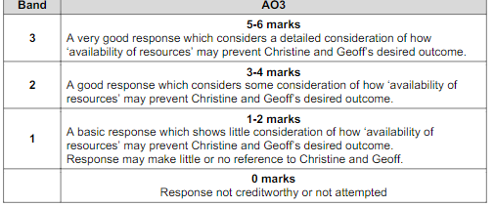
Question 2 (d) Mark scheme

