Slide 1
Online Exam Review – January 2022
Level 3 Health and Social Care: Principles and Contexts
Unit 5: Supporting individuals at risk to achieve their desired outcomes

Slide 2
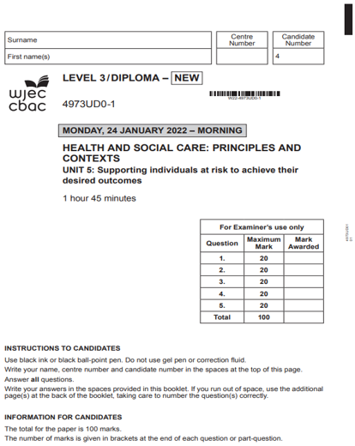
Unit 5: Supporting individuals at risk to achieve their desired outcomes
Online examination review (OER)

Slide 3
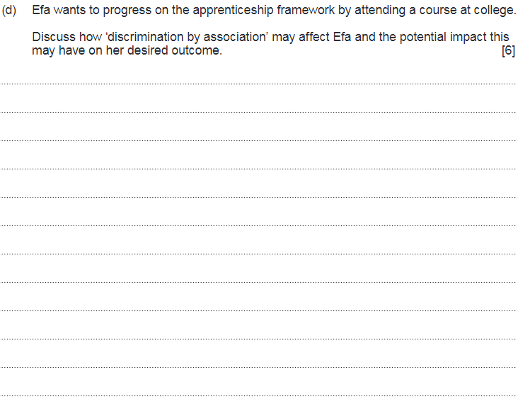
Question 3 (d)

Slide 4
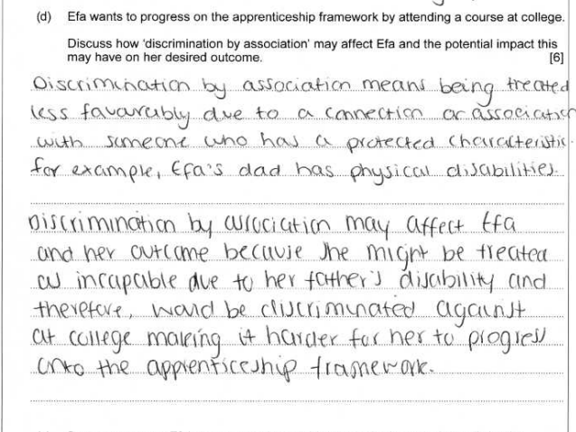
Question 3 (d) Candidate 1 answer

Slide 5
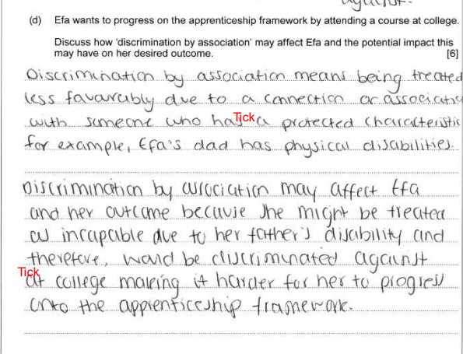
Question 3 (d) Candidate 1 answer with examiner’s comments
A basic discussion showing limited understanding of how ‘discrimination by association’ may affect Efa and/or the potential impact this may have.
The candidate begins by clearly defining what is meant by ‘discrimination by association’ and making it clear it is treating an individual unfavorably due to a connection to an individual with a protected characteristic, such as a Efa's dad’s physical disability. There was limited discussion on the impact this may have; however, candidate did make clear it would be difficult to progress onto the apprenticeship scheme.
Additional marks were available for discussing the impact this may have, such as: disempowerment, low-self-esteem, low self-confidence, improved resilience.
2 marks awarded – band 1

Slide 6
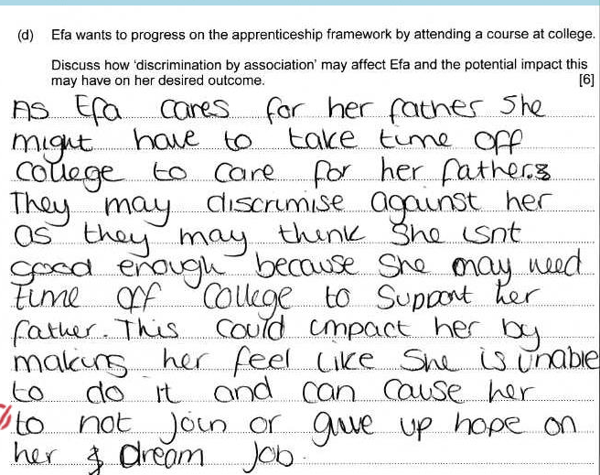
Question 3 (d) Candidate 2 answer

Slide 7
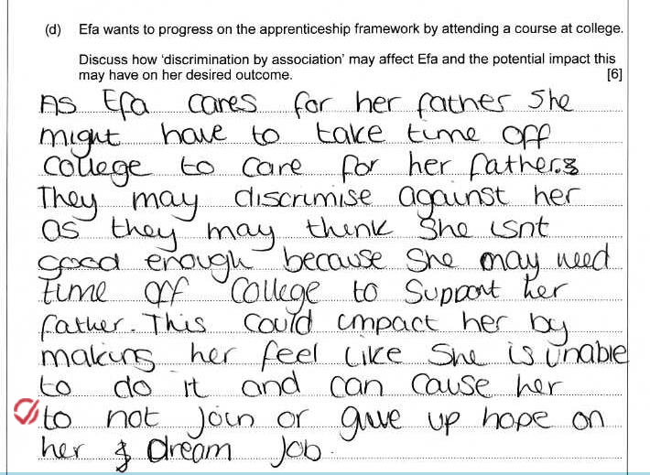
Question 3 (d) Candidate 2 answer with examiner’s comments
A basic response which demonstrates limited knowledge and understanding of how ‘discrimination by association’ may affect Efa and the potential impact this may have on her desired outcome.
The candidate picked up a mark by stating that this may cause her to not join or give up, but further discussion into how discrimination may affect Efa would have developed the discussion further.
Additional marks were available for discussing the impact this may have, such as: disempowerment, low-self-esteem, low self-confidence, improved resilience.
1 mark awarded – band 1

Slide 8
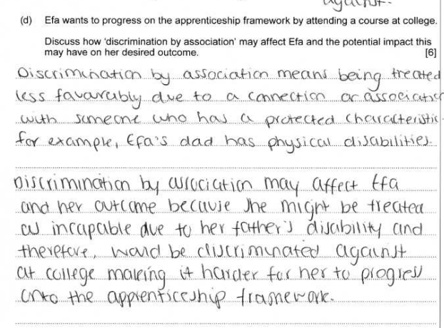
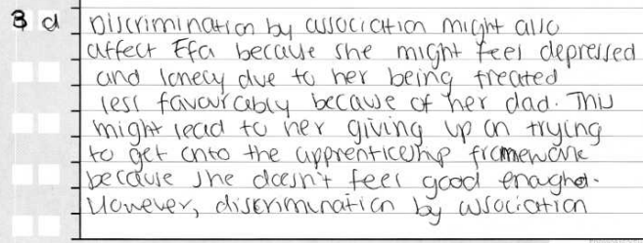
Question 3 (d) Candidate 3 answer

Slide 9
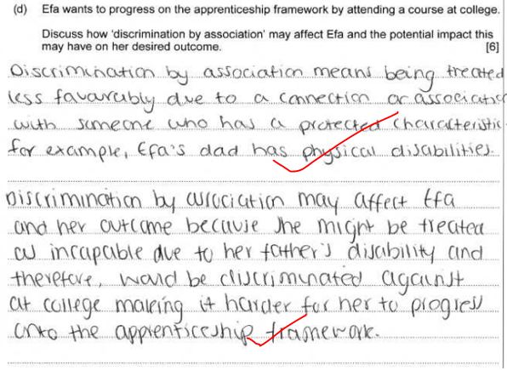
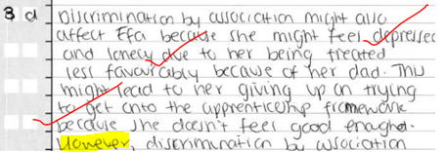
Question 3 (d) Candidate 3 answer with examiner’s comments
A very good response demonstrating detailed knowledge and understanding of how ‘discrimination by association’ may affect Efa and the potential impact this may have on her desired outcome.
The candidate clearly defined what was meant by ‘discrimination by association’, linking to Efa, and then suggested different ideas of how Efa may be affected and the potential impact this may have on her.
The candidate did well to consider negative effects on Efa, for example, ‘depression’ and ‘lonely’, but also considered a different idea such as how it could affect Efa in a positive way, for example, may motivate Efa. This was illustrated with a lovely sentence starter, although it would have been useful for the candidate to have used the term ‘improved resilience’ when discussing the positive impact on Efa. However, this was a very good discussion.
6 marks awarded – band 3

Slide 10
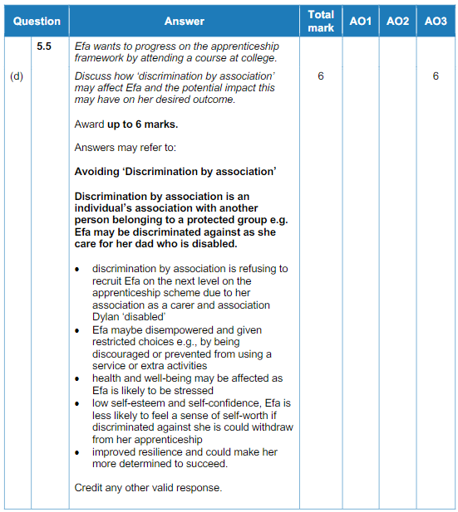
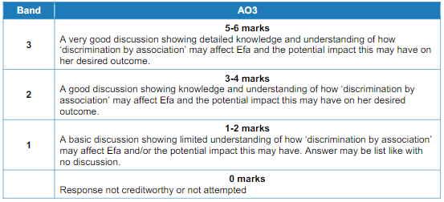
Question 3 (d) Mark scheme

Slide 11
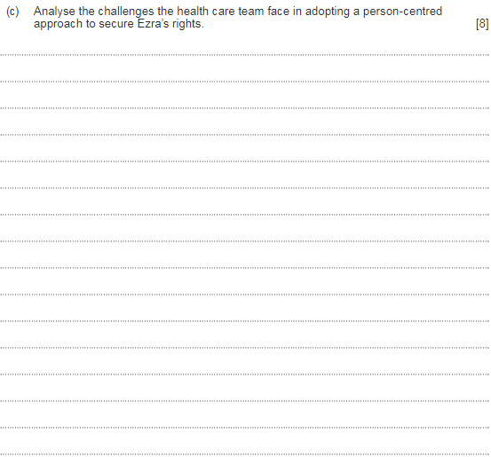
Question 4 (c)

Slide 12
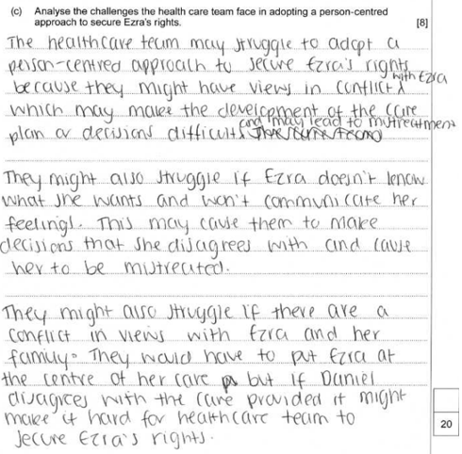
Question 4 (c) Candidate 1 answer

Slide 13
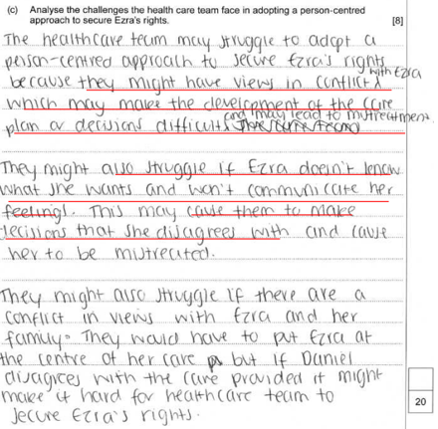
Question 4 (c) Candidate 1 answer with examiner’s comments
A basic analysis showing some knowledge and understanding of the challenges the health care team face in adopting a person-centred approach to secured Ezra’s rights.
The candidate begins by identifying that there be may be conflicting views but should have developed this by further interpretation of the challenge: why, for example, would this lead to the development of the care plan being difficult?
The second paragraph focused on Ezra not knowing what she wants and won’t communicate her feelings; again, this needed to be developed further: why Ezra won’t communicate her feelings, and development of personal traits or being in pain due to her diagnosis would have been useful. The third paragraph was undeveloped – conflict was repeated – but further analysis into Ezra and not Daniel would have been useful.
Additional marks were available for challenges such as: attitudes of health care team, lack of staff training, availability of resources, difficult to respect choices.
4 marks awarded – band 2

Slide 14
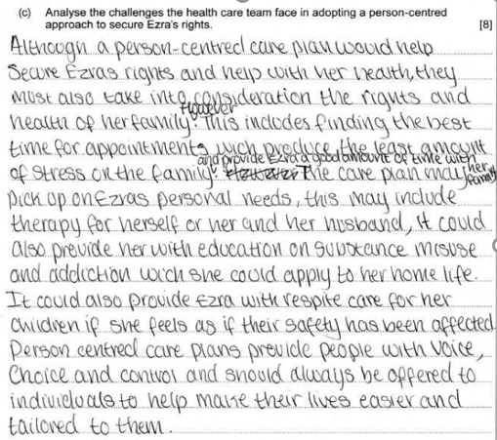
Question 4 (c) Candidate 2 answer

Slide 15
Question 4 (c) Candidate 2 answer with examiner’s comments
A limited analysis showing little knowledge and understanding of the challenges facing the health care team in adopting a person-centred approach to secure Ezra’s rights.
The candidate was awarded a mark for identifying there may be a challenge in finding the best time for appointments; however, this was undeveloped and focusing more on the family than specifically Ezra.
The remainder of the answer focused on what the health team could to support Ezra, and this, therefore, did not meet the demands of the question.
Additional marks were available for challenges, such as: attitudes of the health care team, lack of staff training, availability of resources, difficult to respect choices.
1 mark awarded – band 1

Slide 16
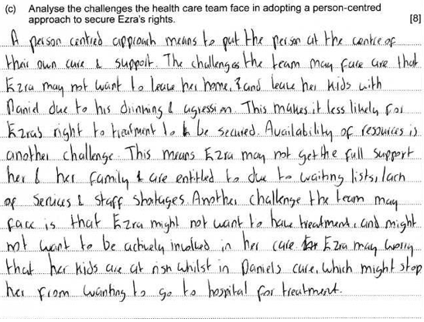
Question 4 (c) Candidate 3 answer

Slide 17
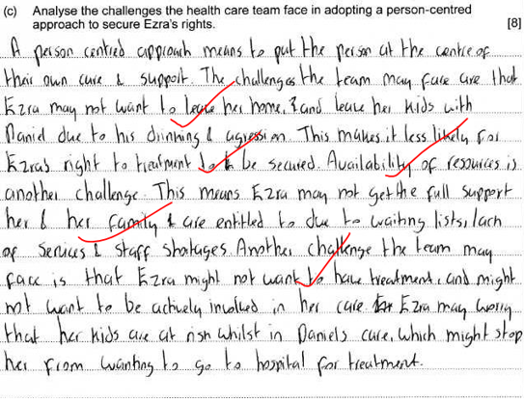
Question 4 (c) Candidate answer with examiner’s comments
A good response showing knowledge and understanding of the challenges the health care team face in adopting a person-centred approach to securing Ezra’s rights.
The candidate’s first challenge was developed; for example, Ezra not wanting to leave her home. The second challenge was a little underdeveloped as it did not make clear what rights would not be secured, for example, her fundamental right to healthcare, etc. The third challenge could have been developed further if the candidate had made the points a little clearer; however, it was a good analysis.
6 marks awarded – band 3

Slide 18
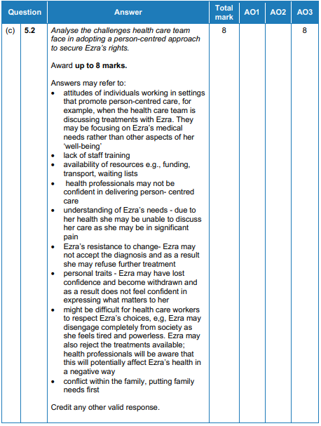
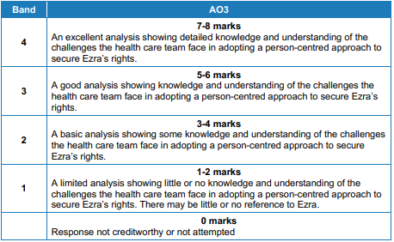
Question 4 (c) Mark scheme

Slide 19
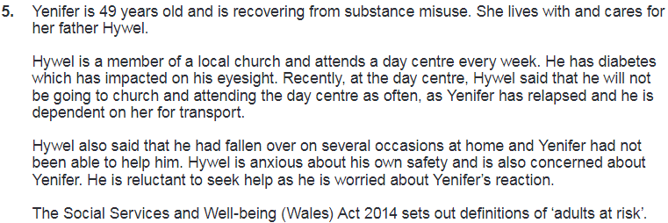
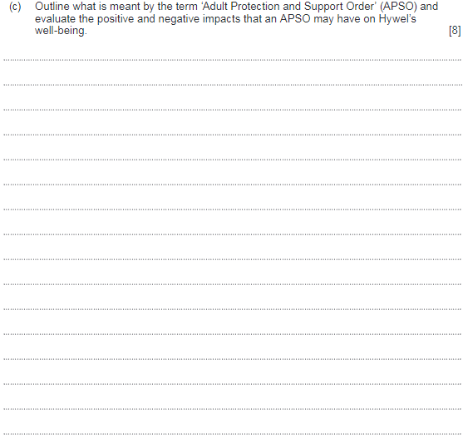
Question 5 (c)

Slide 20
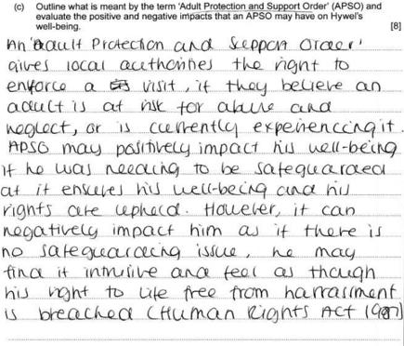
Question 5 (c) Candidate 1 answer

Slide 21
Question 5 (c) Candidate 1 answer with examiner’s comments
A limited outline demonstrating little knowledge and understanding of what is meant by an ‘Adult Protection and Support Order’. The candidate was awarded 1 mark for ‘the right to enforce a visit’, but additional marks were available for ‘having a private conversation with Hywel’, ‘gaining access to Hywel’s premises’, ‘legal order from a Justice of the Peace’.
A good evaluation which shows some knowledge and understanding of the positive and negative impact that an APSO may have on Hywel’s well-being, with some useful terms used, such as ‘intrusive’ and ‘harassment’, but could have given some further development into what rights would be upheld, for example, right to voice, choice and control regarding his situation.
5 marks awarded
1 mark awarded for AO1
4 marks awarded for AO3

Slide 22
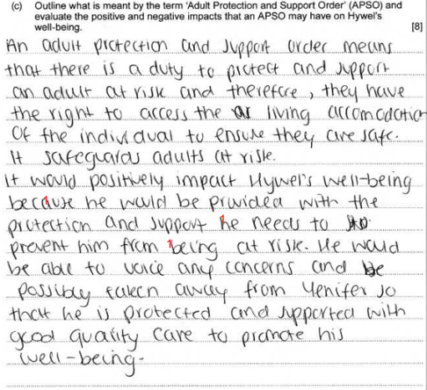
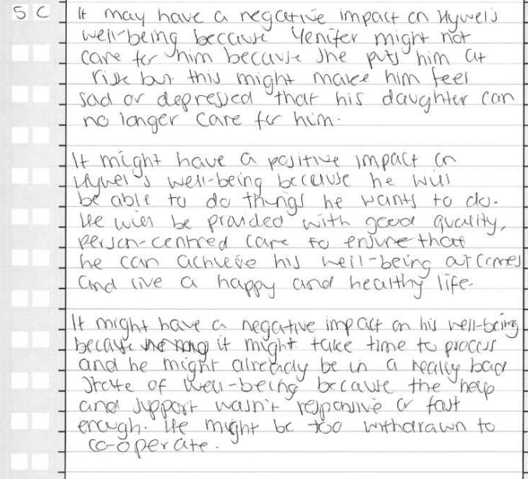
Question 5 (c) Candidate 2 answer

Slide 23
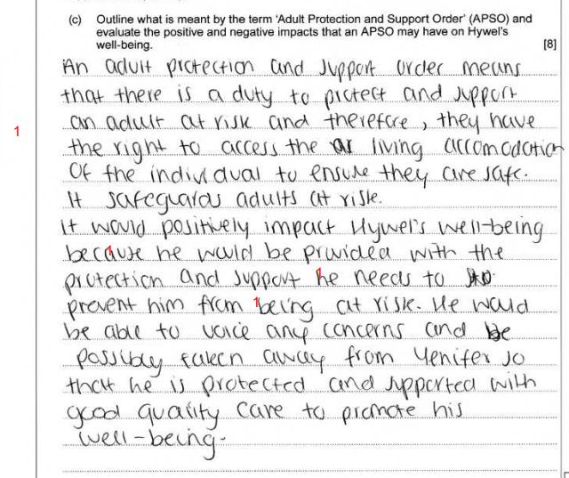
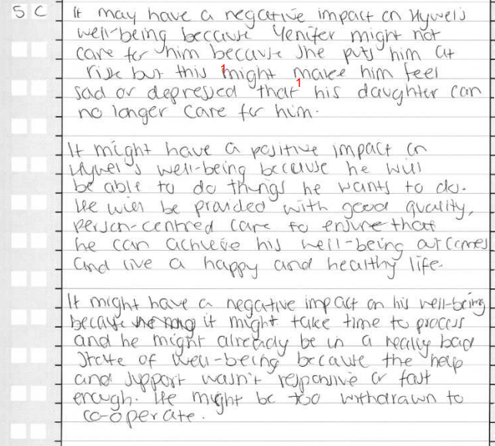
Question 5 (c) Candidate 2 answer with examiner’s comments
A limited outline demonstrating little knowledge and understanding of what is meant by an ‘Adult Protection and Support Order’ (APSO). The candidate did identify in the fourth sentence ‘right to access the living accommodation’ and this was awarded a mark, but additional marks were available for outlining some further main points of APSOs such as: legal order, can have a private conversation with adult at risk, APSOs cannot be used at a prison, or other secure estate building.
The candidate gave a very good, well-developed evaluation which showed detailed knowledge and understanding of the positive and negative impacts that an APSO may have directly on Hywel’s well-being.
6 marks awarded
1 mark for AO1
5 marks for AO3

Slide 24
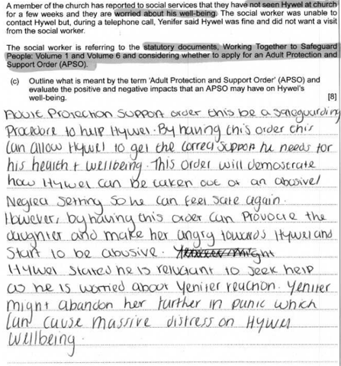
Question 5 (c) Candidate 3 answer

Slide 25
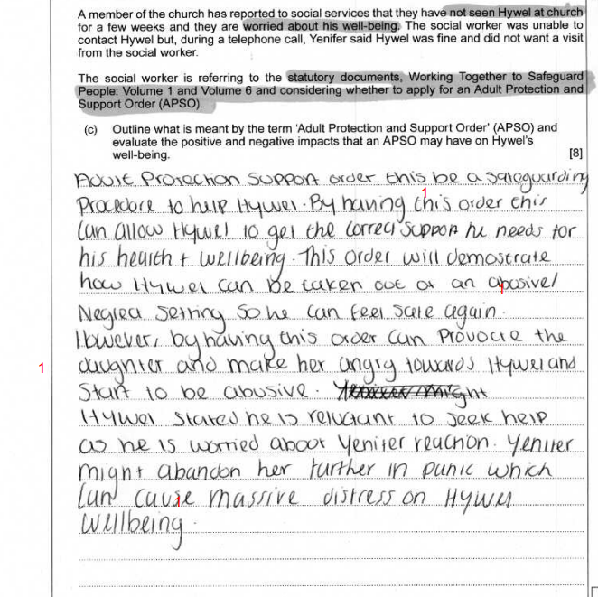
Question 5 (c) Candidate 3 answer with examiner’s comments
This response did not show any creditworthy information on what was meant by the term ‘Adult Protection and Support Order’ (APSO). The candidate needed to make clear the key features of an APSO, such as: legal order, can have a private conversation with adult at risk, APSOs cannot be used at a prison or other secure estate building.
However, the candidate did give a good evaluation which showed positive and negative impacts that an Adult Protection and Support Order may have on Hywel’s well-being.
4 marks awarded
0 marks for AO1
4 marks for AO3

Slide 26
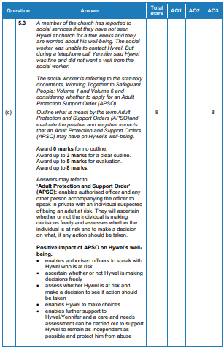
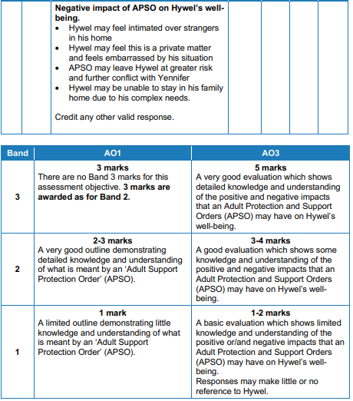
Question 5 (c) Mark scheme

