Slide 1


Exam Walk-Through
GCSE Health and Social Care, and Childcare
Unit 1 – Human growth, development and well-being (3570UB)
Notes:
Talk through the slide and introduce yourself.

Slide 2
What you should have in front of you:
A copy of the exam paper
An answer booklet/lined paper
Any additional resource material
A pen, pencil and ruler
A highlighter
A watch
Post-it notes
Notes:
Read through slide.

Slide 3
What this exam paper is all about:
This examination paper includes of a range of question types to assess the specification content related to human growth, development and well-being.
You have to answer all questions on this paper, using the space provided.
There are a total of 80 marks available, all of the individual questions and sub-questions have marks allocated to them (take note of these!).
You have 1 hour and 30 minutes to answer all of the questions on the paper.
Some of the questions have riders, these are short sentences at the start of the question and they are designed to help you.
Notes:
Read through slide.,

Slide 4
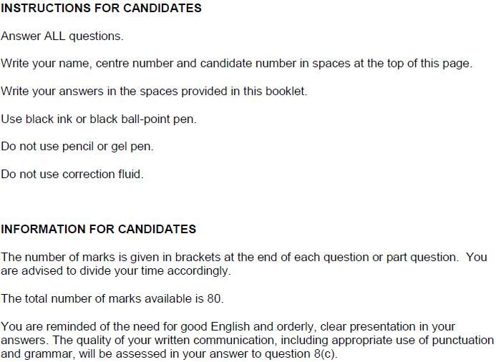
What should I do first?
1. Read the front cover of the exam paper.
2. Make sure your name and candidate number are on your answer booklet.
Notes:
Read the front cover! Don’t assume that this is the same as other examination papers. This paper clearly states that you have to answer all questions, and you should answer the questions in the space provided – if you need more time there are additional pages at the back of the paper.
You will find that there are suggested times to complete each question as we go through this paper, please note that this is only designed for the purposes of this activity.

Slide 5
General points on exam technique
Read through the whole question before starting to answer. This will help you understand what is required of you.
Use a highlighter to pick out key words.
Look at the command words and the number of marks available for each question, they will help you decide how much detail is needed.
If a word is bold, it is important.
Keep your exam paper open at the double page spread, do not fold it in half.
Read your answers to check they make sense.
Notes:
Read through slide.

Slide 6
How do I tackle the questions?
The same approach should be taken to each question:
Step 1 Read question and highlight command verb(s)
Step 2 Highlight key words in the question
Step 3 Identify marks allocated for the question (you should be able to answer in the space provided)
Step 4 Plan your response (list mnemonics etc.)
Top tip! Allocate enough time for each question – base this on the marks available for each question.
Notes:
Read through slide.

Slide 7
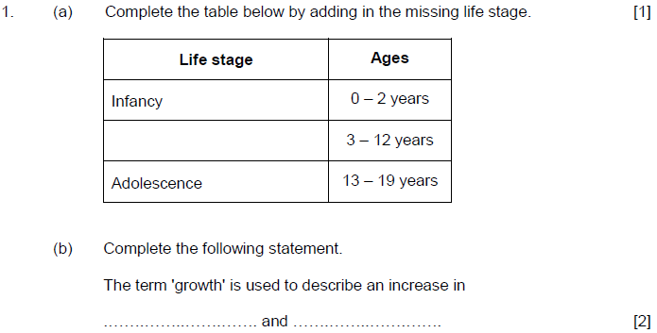



Question 1, AO1
3:00
Start the clock!
Try and answer both of these questions in 3 minutes – you many not need all of this time.
Notes:
a) 1 mark only – insert the life stage that is missing – a one work answer: Childhood
b) 2 marks for 2 one word answers – this mass or weight and height.
These questions should not take long – don’t rush them, but don’t spend too much time on them either as they are not worth many marks!

Slide 8
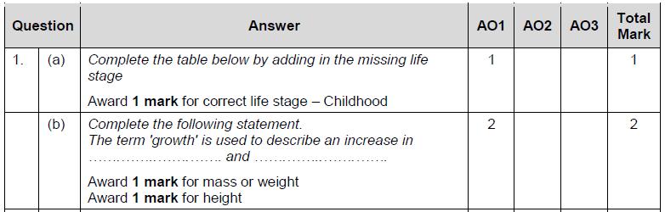
Question 1 AO1 mark scheme
Notes:
Read through the mark scheme.

Slide 9
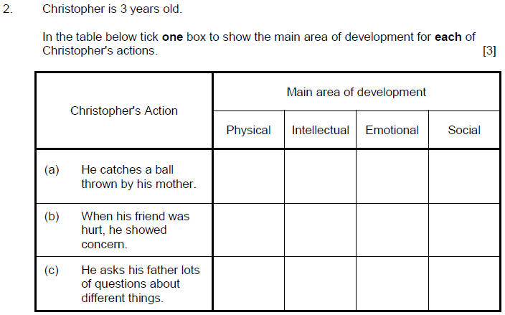


Question 2, AO2
3:00
Start the clock!
Try and answer this question in 3 minutes, you may not need all of this time!
Notes:
There are a total of 3 marks available for this question – three ticks are required.
Make sure you read each of the actions carefully and put your ticks in the right boxes – double check when you have done it just to make sure the main areas of development are listed in the way that you expect them to be – it is your responsibility to check this!
Again, do not spend too long on this – 3 marks should be approximately 3 minutes to complete.

Slide 10
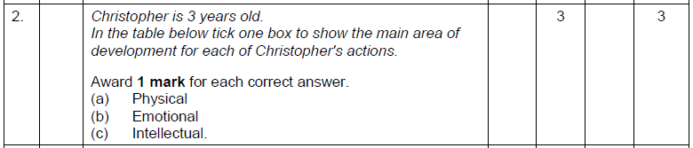
Question 2 AO2 mark scheme
Notes:
Read through the mark scheme – noting that these are right/ wrong answers, point marking only.

Slide 11
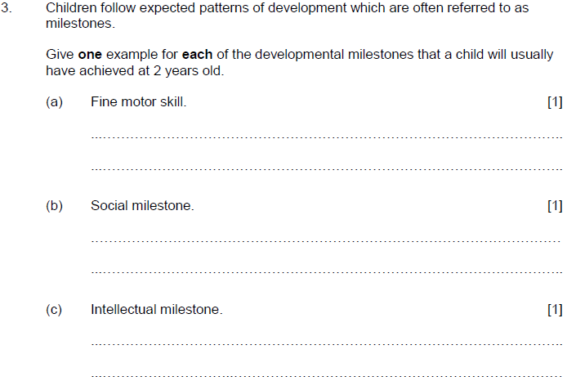



Question 3, AO1
The rider at the start of the question is there to help you!
3:00
Start the clock!
Try and answer all of these questions in 3 minutes.
Notes:
There are a number of key issues to consider in this question - the most important one is the age of the child – this question focusses on a 2 year old.
You must give an example in each case, each one worthy of 1 mark. These may be two or three word responses – note how you have a couple of lines for each, this shows you that you are expected to give more than one word answers.
You have to read the whole question first to make sure you understand what you are being asked to do.
There is a huge list of possible answers for each of these questions - you just need one.

Slide 12
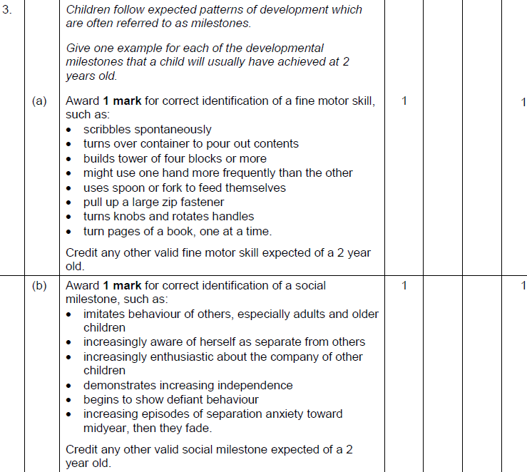
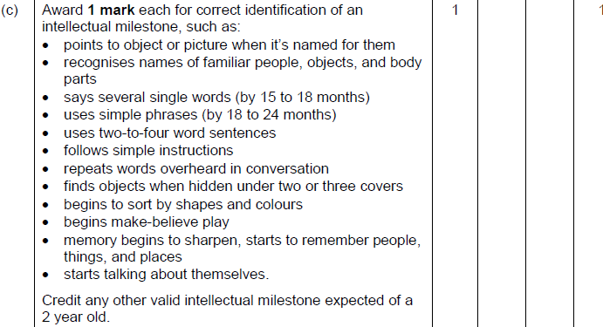
Question 3 AO1 mark scheme
Notes:
You only have to give one of these responses for each of the questions – you may express yourself differently to the way it is listed in the mark scheme. Try and use health and social care and childcare terminology where you can to show your knowledge and understanding.

Slide 13
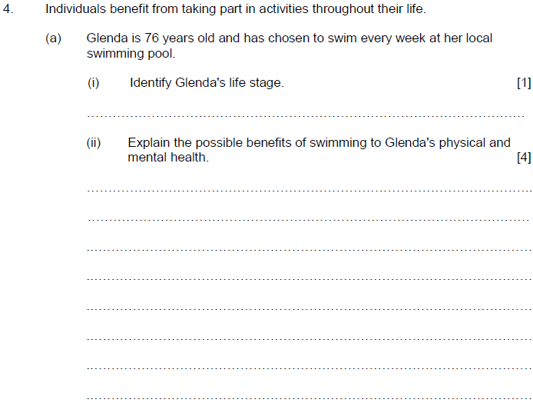


Question 4 (a), AO1/AO2
6:00
Start the clock!
Try and answer both of these questions in 6 minutes.
Use the space provided to respond to the questions.
Notes:
i) Glenda’s life stage is easily identifiable from her age which is given to you in the question – one word answer expected here: Later adulthood
ii) This is the first time you have been asked to give an extended response on this paper, with a total of 4 marks available.
An explanation usually includes examples to show your understanding of the question so try and offer some justification in your answer, for example do not just write a list or bullet points for this question e.g. By swimming, Glenda is less likely to gain weight and become obese.
The question also asks you to consider her physical AND mental health.

Slide 14
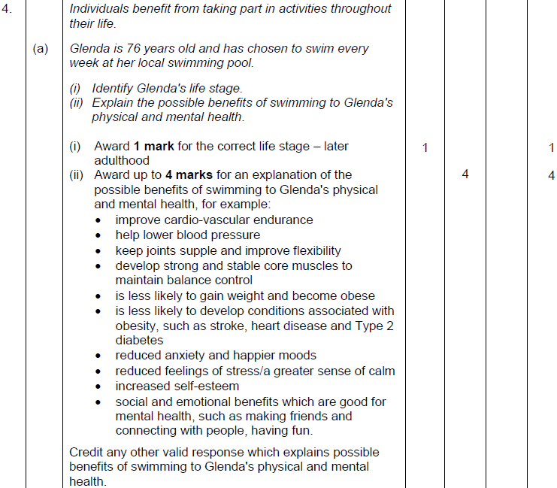
Question 4 (a) AO1/AO2 mark scheme
Notes:
Note that there are a variety of answers that are correct for this question – not all of them are necessary for the full 4 marks. It is more important that you give a detailed explanation – rather than just writing a list. You may have come up with an answer that is not included in this list, that is OK and you may still be given credit for this when it is marked by an examiner. Check with your teacher if you are unsure.

Slide 15
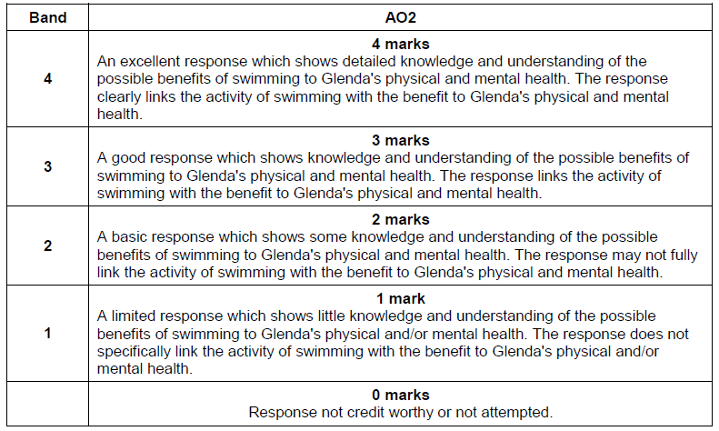
Question 4 (a) AO2 mark scheme bands
Notes:
Note that even if you give a detailed explanation of the possible benefits of swimming to Glenda’s physical health – you cannot achieve over 1 mark as mark bands 2, 3, and 4 all need you to have considered physical and mental health.

Slide 16
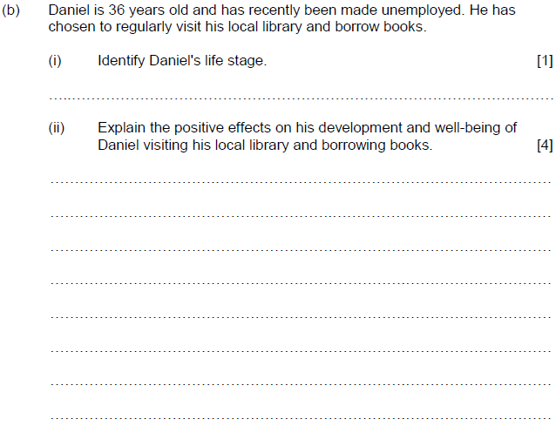


Question 4 (b), AO1/AO2
6:00
Start the clock!
Try and answer both of these questions in 6 minutes.
Notes:
b) i) One mark for the correct identification of Daniel’s life stage – as detailed in the question, a one word answer: Adulthood
ii) The second explain question in the paper so far – 4 marks available for POSITIVE effects on his (Daniel’s) development AND well-being only – we do not need any negatives here, even if you know them you will not get credit for them! Again, as with the previous question – try and justify your answer e.g. reading improves knowledge, this could lead to Daniel being able to get more qualifications or a new job.

Slide 17
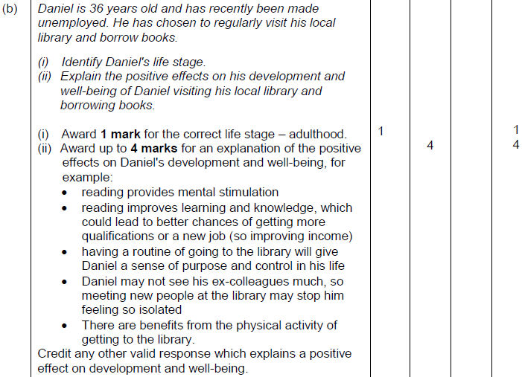
Question 4 (b) AO1/AO2 mark scheme
Notes:
The question has to be linked to Daniel and appropriate for his situation and life-stage.

Slide 18
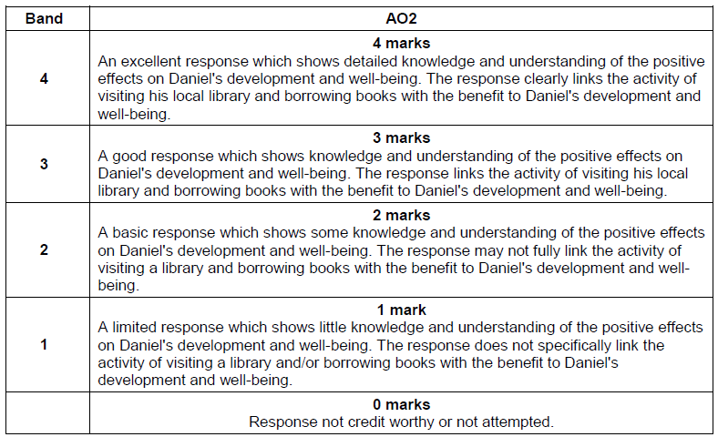
Question 4 (b) AO2 mark scheme bands
Notes:
Summarise mark bands.
Again, to achieve into the top band – you will need to make sure that there is a detailed explanation rather than just a list.

Slide 19
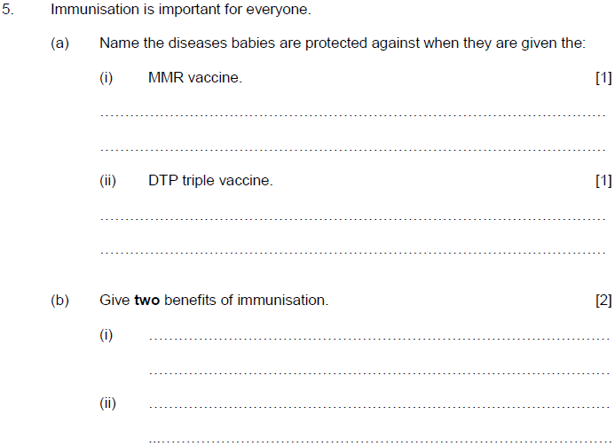



Question 5 (a) (b), AO1
5:00
Start the clock!
Try and answer all of these questions in 5 minutes.
Notes:
5 a) There are only two right answers here – you either know them or you don’t!
Is Measles, Mumps and Rubella
Is Diphtheria, Tetanus and Polio
b) Here you just need to list two benefits of immunisation - these can be bulleted if you wanted, there is no need for a description or explanation for either of these responses.

Slide 20
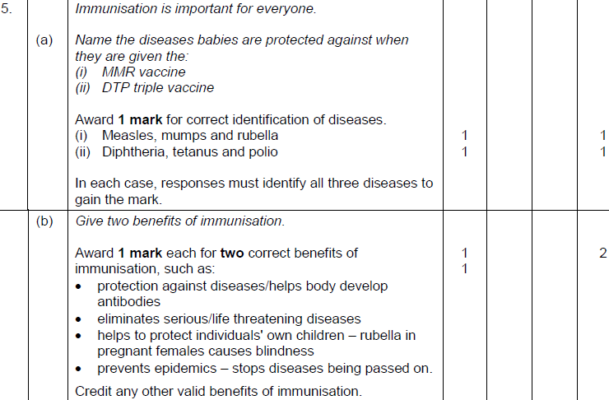
Question 5 (a) (b) AO1 mark scheme
Notes:
Note that the two marks are awarded for the CORRECT identification of all of the diseases for i) and ii) for example no marks would be awarded for Measles on it’s own.
The benefits of immunisation do not need any explanation – can just be a list.

Slide 21
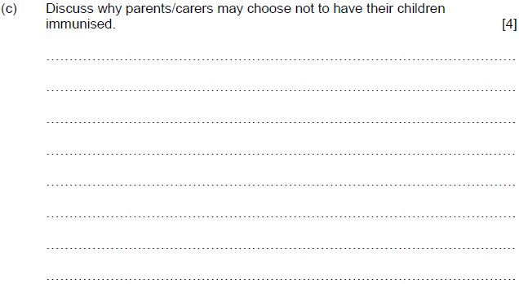

Question 5 (c), AO3
5:00
Start the clock!
Try and answer this question in 5 minutes – how did you get on?
Remember to be guided by the marks available – don’t write too much the maximum you can get is 4 marks.
Notes:
This is the first AO3 question in this paper – this is the command verb discuss.
A discussion expects you to examine an issue in detail in a structured way, taking into account different ideas – you must do this to achieve into the top mark band. You must provide more than a list and include some detail – plan your response to make sure you include all of your ideas, the examiner would expect a good answer to include a range of ideas – not just one.

Slide 22
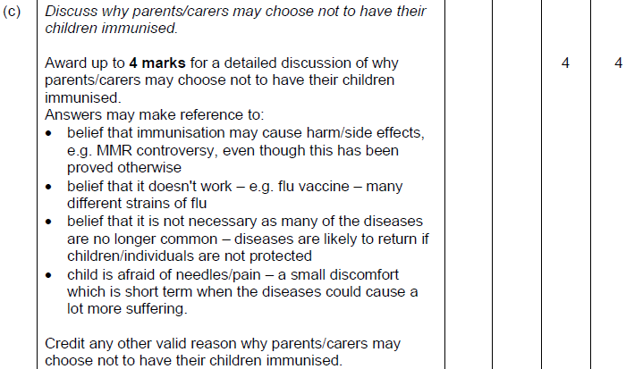
Question 5 (c) AO3 mark scheme
Notes:
There are many possible responses for this question – not all are listed here. You may have come up with an alternative idea which could also be credited – make sure you use appropriate health and social care and childcare terminology too. You may like to

Slide 23
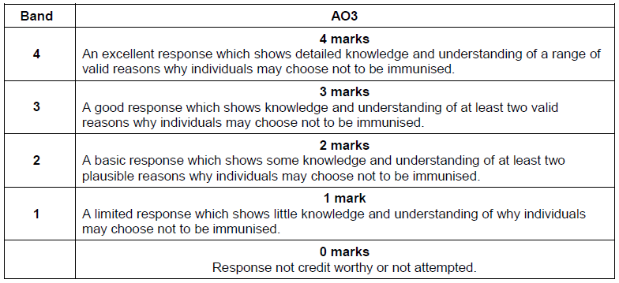
Question 5 (c) AO3 mark scheme bands
Notes:
To be in the top mark band there has to be evidence of a rang of valid reasons – remember not to just discuss one!

Slide 24
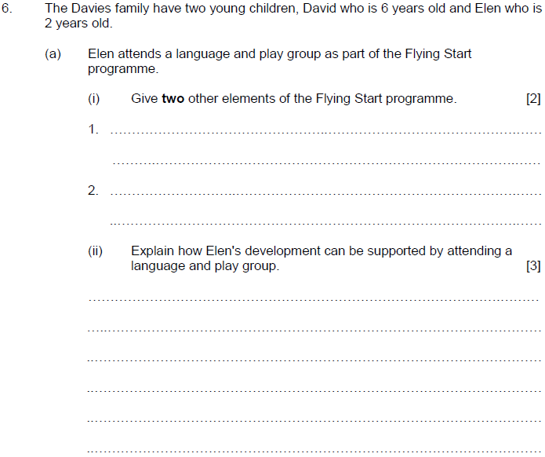


Question 6 (a) (i) AO1, (ii) AO2
6:00
Start the clock!
Try and answer both of these questions in 6 minutes.
Notes:
i) Make sure you do not include LANGUAGE or PLAY as part of your response as you are asked for two other elements. These can just be listed – give is an AO1 command verb testing knowledge and understanding.
ii) Make sure that this makes specific reference to Elen and that your response is appropriate for a 2 year old girl, you will not be credited for anything that is not age appropriate.
To explain you should: provide details and reasons for how and why something is the way it is…and link this to the situation provided in the question.

Slide 25
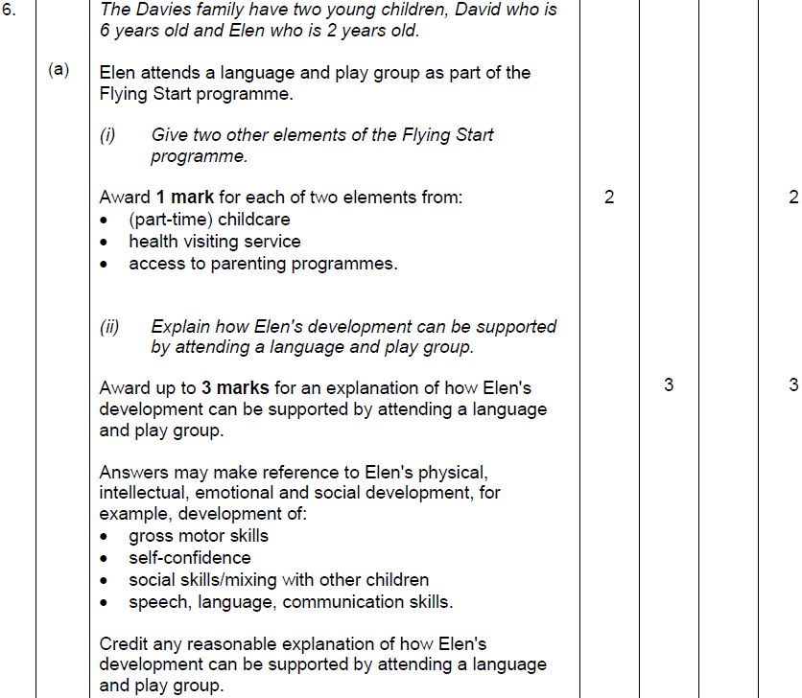
Question 6 (a) (i) AO1, (ii) AO2 mark scheme
Notes:
How did you get on?
Read through the mark scheme and expected responses.

Slide 26
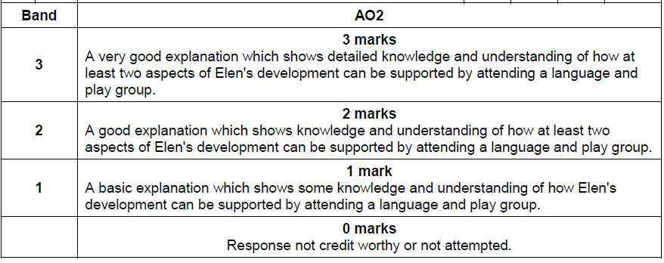
Question 6 (a) AO2 mark scheme bands

Slide 27
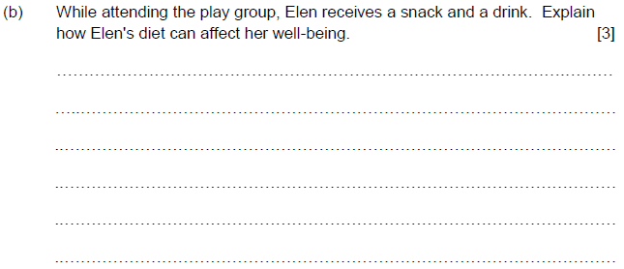

Question 6 (b), AO2
4:00
Start the clock!
Try and answer this question in 4 minutes – how did you get on?
Notes:
b) As an explain question, here you need to provide details and reasons for how and why Elen’s diet can affect her well-being.
You may decide to include an example to show your knowledge and understanding and these may be positive and/or negative affects on Elen’s well-being.

Slide 28
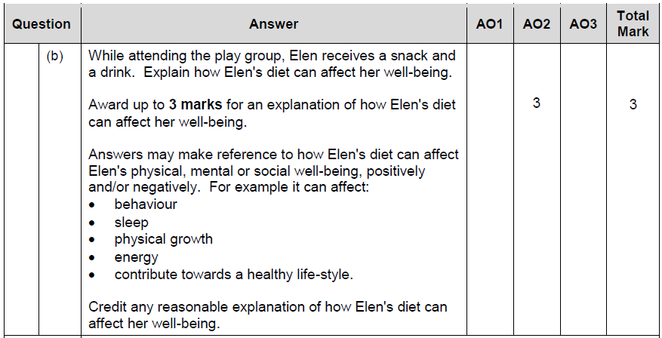
Question 6 (b) AO2 mark scheme
Notes:
How did you get on? Did you give both positive and negative effects?
The question doesn’t specifically state this, so you can still achieve the full 3 marks for a response that is solely positive or negative.

Slide 29
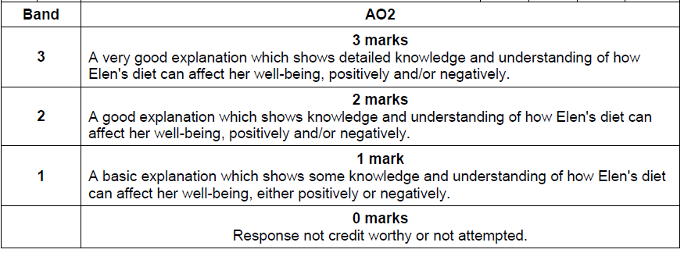
Question 6 (b) AO2 mark scheme bands

Slide 30
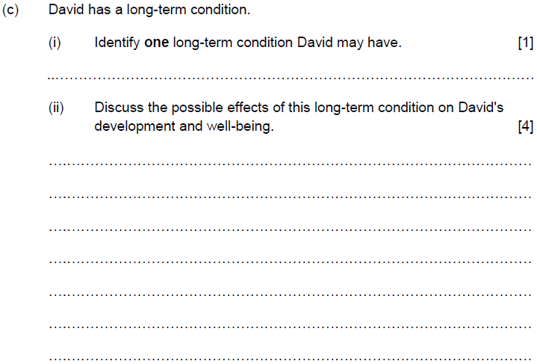
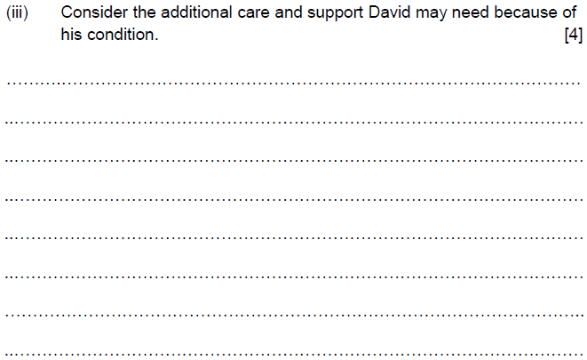



Question 6 (c) (i) AO1, (ii) (iii) AO3
10:00
Start the clock!
Try and answer these questions in 10 minutes – how did you get on?
Notes:
Take 10 minutes to answer these questions – this is approximately how long you would take in the exam.
For c, i) the responses may be varied for this question – an example may be e.g. cancer
For c, ii) the important thing to note here is that this question needs to be linked to the one above – therefore if you have said cancer for I, this second question must now be relevant or linked to cancer and DAVID – discuss as a command verb means that you ‘examine an issue in detail in a structured way, taking into account different ideas’
For c, iii) again this has to be linked to DAVID – the command CONSIDER means that you need to ‘review and respond to given information’

Slide 31
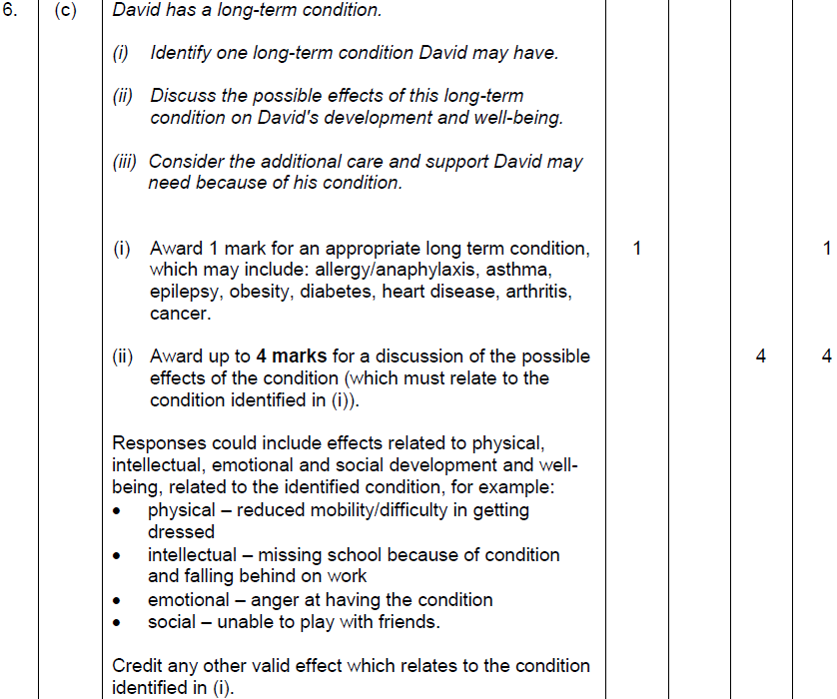
Question 6 (c) (i) AO1, (ii) AO3 mark scheme
Notes:
How did you get on?
Any of the examples listed for i) are correct
ii) Linked back to David

Slide 32
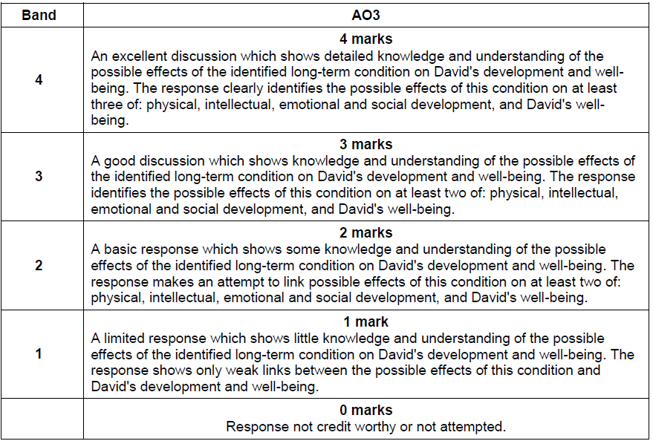
Question 6 (c) (ii) AO3 mark scheme bands
Notes:
Mark bands – discuss means that you must examine an issue in detail in a structured way, taking into account different ideas – this is necessary to achieve into the top mark band.

Slide 33
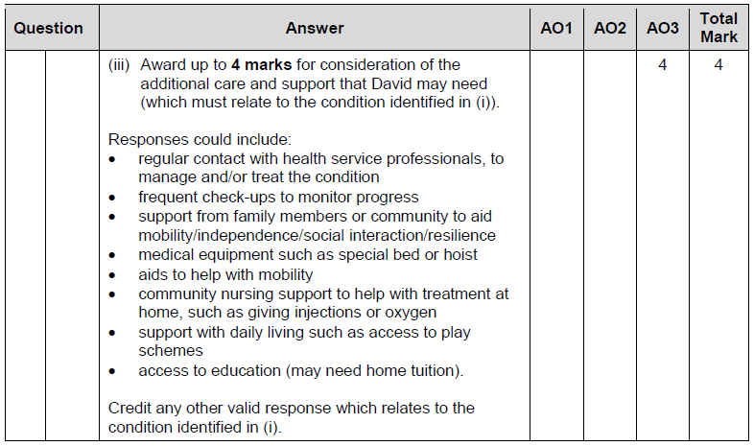
Question 6 (c) (iii) AO3 mark scheme
Notes:
This response must be linked to DAVID and linked to the condition as identified in i.
You will not be able to achieve into the top mark band if you don’t do this!

Slide 34
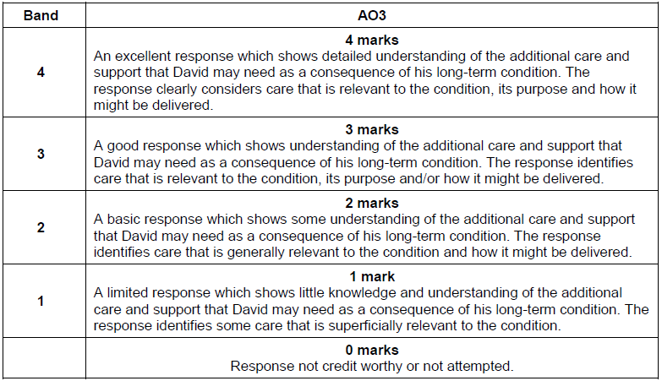
Question 6 (c) (iii) AO3 mark scheme bands

Slide 35
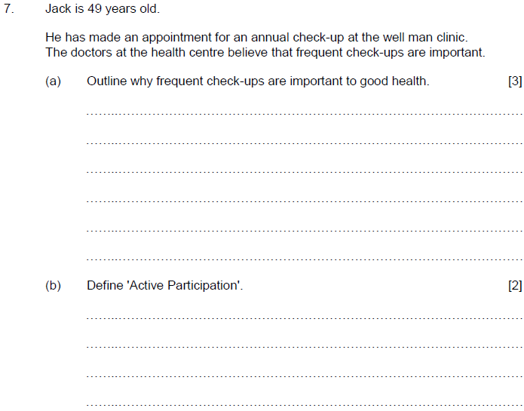


Question 7 (a) (b), AO1
6:00
Start the clock!
Try and answer these questions in 6 minutes – how did you get on?
Notes:
For this question – underline the important information in the rider - i.e. he is male and 49 years old, he is attending a well-man clinic and check ups are important.
For a) the command here is outline and there are three marks available in total – it does not ask for a list, so you do need to give a bit more detail than just a list.
For b) the command here is define, and there are a total of two marks available – again, just a short answer is required here – a definition.

Slide 36
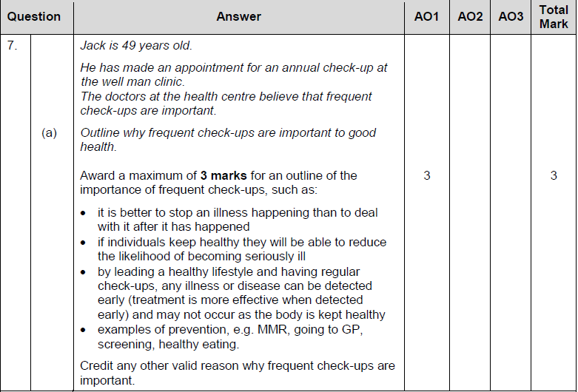
Question 7 (a) AO1 mark scheme
Notes:
Read through the mark scheme - these are possible responses.

Slide 37
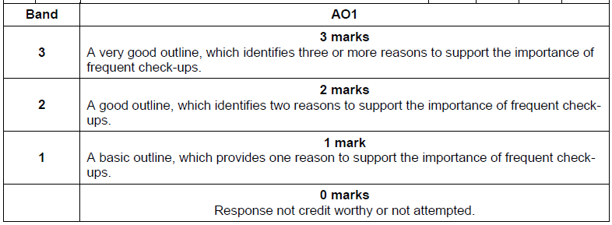
Question 7 (a) AO1 mark scheme bands
Notes:
You can see that to get into the top band you need to identify three of more, this decreases as you move down to the lower mark bands.

Slide 38
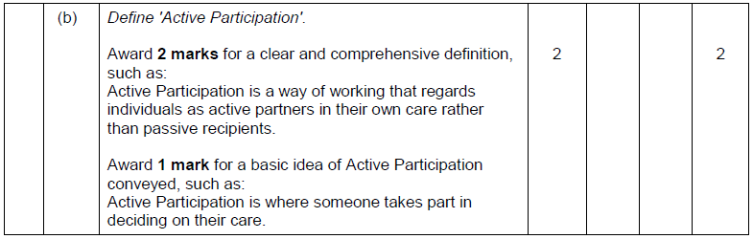
Question 7 (b) AO1 mark scheme
Notes:
The mark scheme gives an example of what a 1 mark and 2 mark answer may look like.

Slide 39
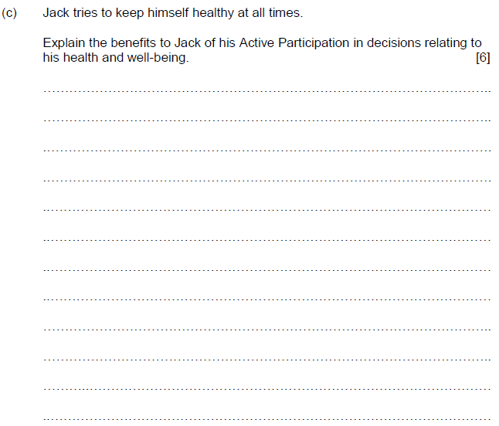

Question 7 (c), AO2
7:00
Start the clock!
Try and answer this question in 7 minutes – how did you get on?
Notes:
Underline the important parts of the question – i.e. JACK – the question still relates to JACK, so you must refer to Jack or ensure that the response is relevant to Jack.
To explain, you need to provide details and reasons for how and why something is the way it is – so linking in active participation with his decisions relating to his health and well-being.

Slide 40
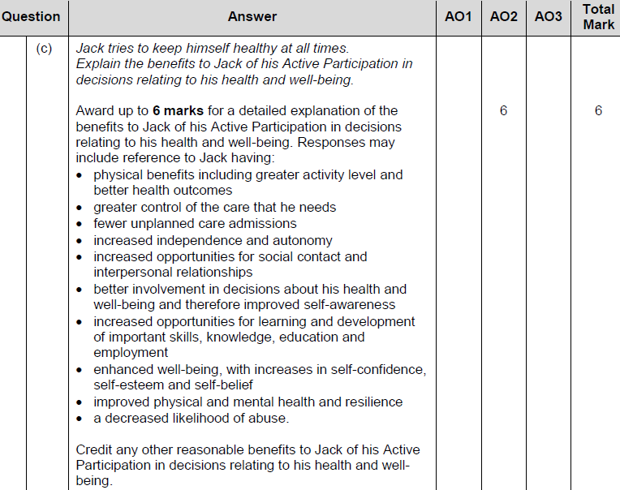
Question 7 (c) AO2 mark scheme
Notes:
The mark scheme details a lot of possible answers – your answers may not match these exactly but you will still be awarded marks, they don’t have to match the mark scheme word for word!

Slide 41
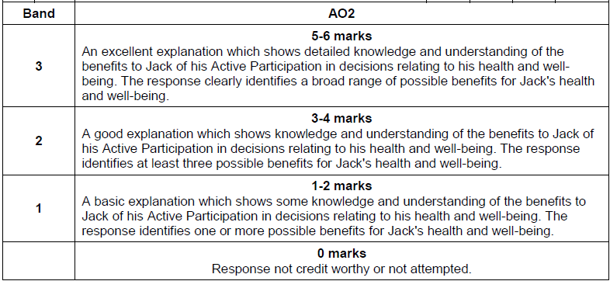
Question 7 (c) AO2 mark scheme bands
Notes:
To be in the top band for this question, you will need to make sure that there is evidence of a broad range of possible benefits for Jack’s health and well-being.
For 3-4 marks, the mark scheme states that there will be at least three benefits listed – and this then just one or more for the bottom band.

Slide 42
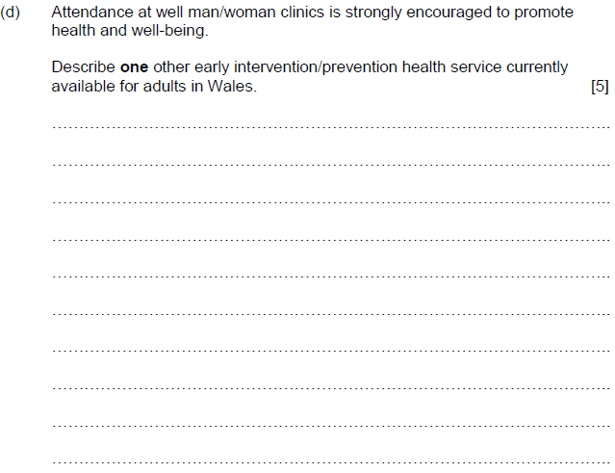

Question 7 (d), AO1
6:00
Start the clock!
Try and answer this question in 6 minutes – how did you get on?
Notes:
Underline the important parts of the question – i.e. the command verb – describe, and the ONE that is in bold – early intervention/prevention health service.
Therefore, you cannot use well man/woman clinics in your response – you will not gain any marks if you do this.
The command verb means that you do not need to go into lots of detail or try to explain or assess - describe means that you need to provide characteristics/main features or a brief account.

Slide 43
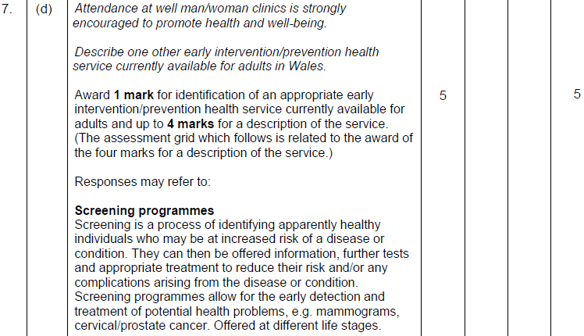
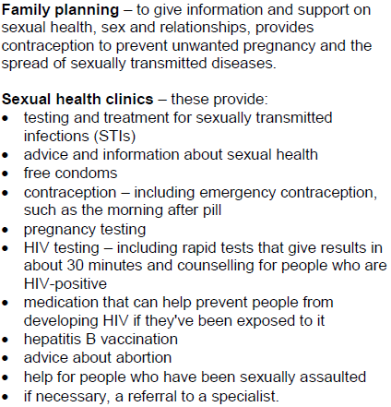
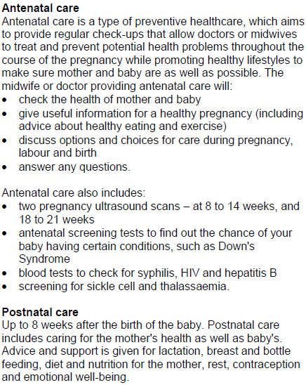
Question 7 (d) AO1 mark scheme
Notes:
There are lots of appropriate responses to this question – the question stipulates that you only need to give one.
You can see from the mark scheme that one mark is available simply for the identification of an appropriate or correct early intervention/prevention health service – there are then a further 4 marks available for the description.
(Summarise the mark scheme)

Slide 44
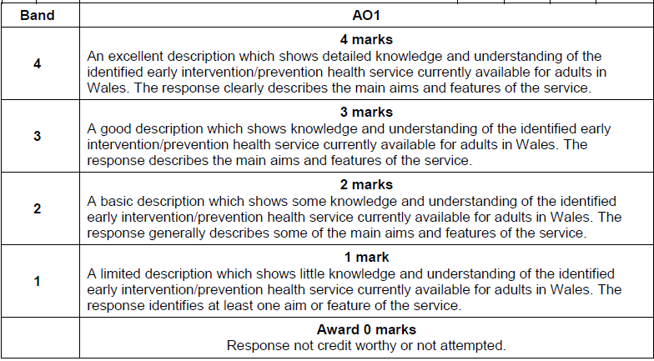
Question 7 (d) AO1 mark scheme bands
Notes:
To achieve into the top band the description provided needs to be detailed and include the main aims and features of the service - as detailed on the previous slide……

Slide 45
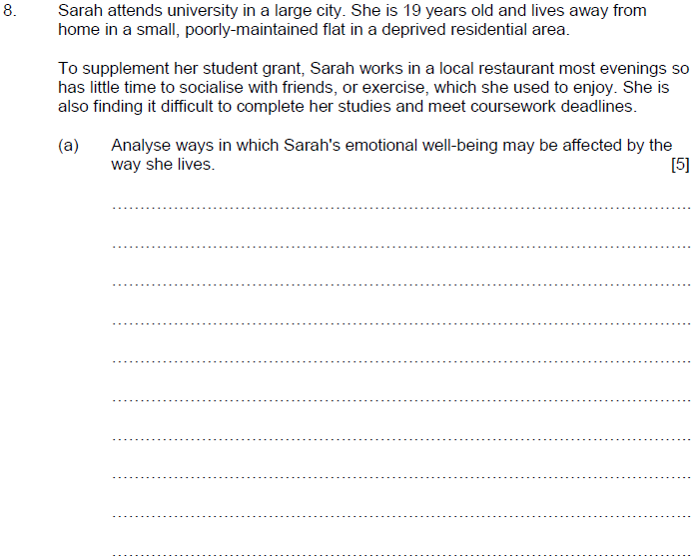

Question 8 (a), AO1/AO3
6:00
Start the clock!
Try and answer this question in 6 minutes – how did you get on?
Notes:
This question has quite a detailed rider at the start. Do not be tempted to skip through this and go straight to the question – the rider is there to help you and assist you in contextualising the question. The question also relates directly back to the rider (i.e. Sarah) so you need to make sure it is read and underlined as you go.
The question asks you to analyse – to do this you need to: examine an issue in detail/how parts relate to the whole, to explain and interpret – which is quite a lot for a 5 mark question. Make sure you learn your command verbs so that you know what the question is asking you to do!
How did you get on with the time and space allowed? Did you go over the time allocated? If so – more practice of timed questions is needed!

Slide 46
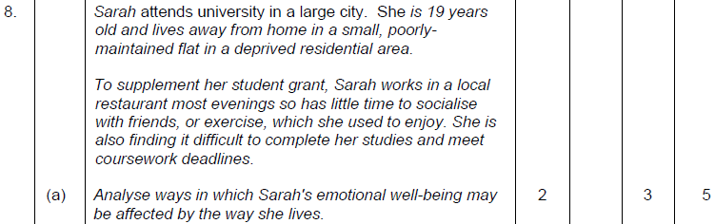
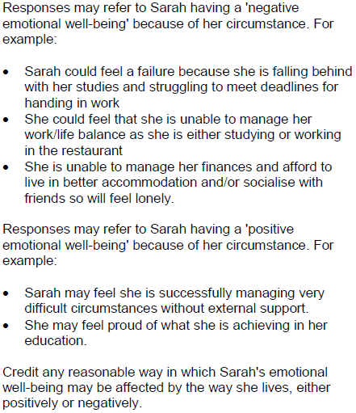
Question 8 (a) AO1/AO3 mark scheme
Notes:
You will notice here that the marks are split between AO1 and AO3 – there are 2 marks for AO1 and 3 marks for AO3 – there is more detail on this in the next slide.
The possible responses may include – (read the M/S)
Note that ALL of these are linked and are relevant to SARAH – and are split between positive and negative emotional well-being.

Slide 47
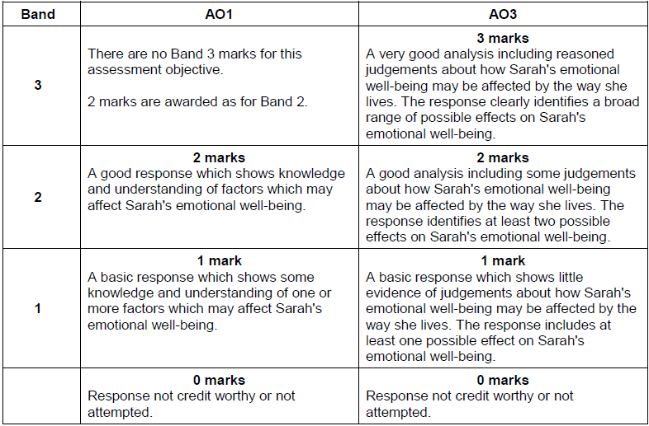
Question 8 (a) AO1/AO3 mark scheme bands
Notes:
You can see here that there are 2 marks available for AO1 – to achieve these marks you need to show good knowledge and understanding of the factors which may affect Sarah’s emotional well-being.
To achieve into the top band for AO3 – you have to make reasoned judgements with a broad range of possible effects (it doesn’t say they have to be positive AND negative) so it is possible to achieve the full 3 marks here if you just go in to detail on one.

Slide 48
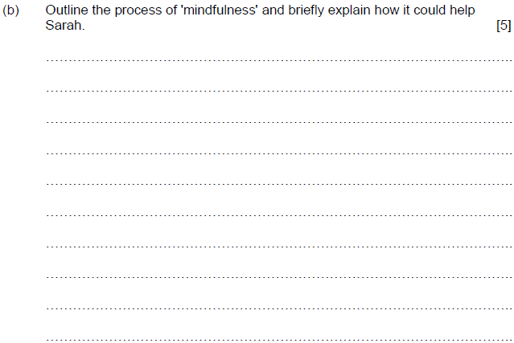
Question 8 (b), AO1/AO2
6:00
Start the clock!
Try and answer this question in 6 minutes – how did you get on?
Notes:
This question directly relates to Sarah, so you must ensure that your response is relevant to Sarah’s situation.
Underline the command verbs (note that there are TWO in this question – outline and BRIEFLY explain.
So, here you need to do more than list all that you know about mindfulness – this will not get you the full 5 marks – instead we need to give an outline first and then go on to explain how it could help Sarah.
Again, this question is 5 marks – you should be used to writing in the space provided to you by now – and take about 6 minutes to answer this question.

Slide 49
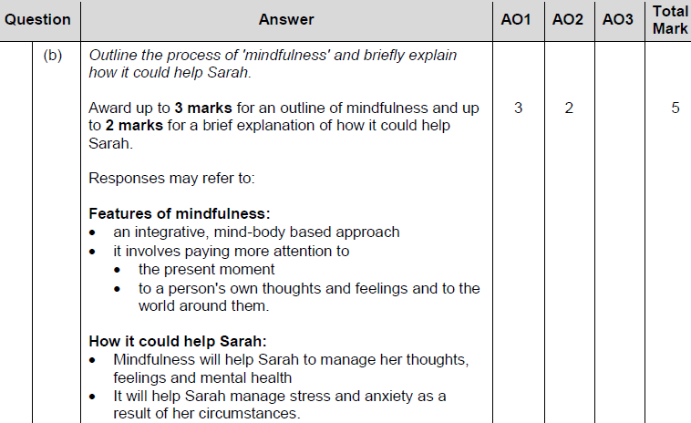
Question 8 (b) AO1/AO2 mark scheme
Notes:
The mark scheme shows how the marks are split between AO1 and AO2 – the most marks (3) are available for the outline of what mindfulness is. Be careful not to run out of time and just write about what it is – the maximum you could achieve in that situation would be 3 marks.
The extra 2 marks come from the brief explanation of how it could help Sarah – think about Sarah’s situation and make sure it is appropriate to her.

Slide 50
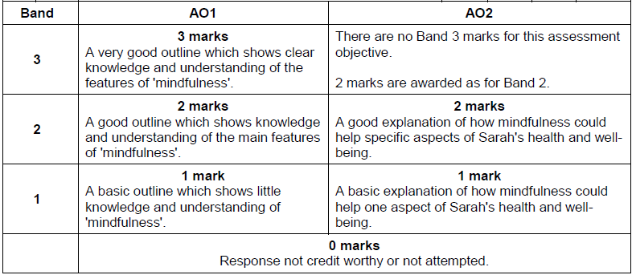
Question 8 (b) AO1/AO2 mark scheme bands
Notes:
The mark bands show that to achieve into the top band for AO1 you will need to be giving a very good outline – showing clear knowledge and understanding of mindfulness – the top band for AO2 shows how the explanation must be linked to Sarah.

Slide 51

Question 8 (c), AO2/AO3
The question relates to Sarah - make sure your response relates to Sarah’s health and well-being.
12:00
Start the clock!
Try and answer this question in 12 minutes – how did you get on?
Notes:
The last question! How did you do?
Did you have enough time to answer it?
This is the longest question on the paper – it always comes at the end of the paper, you should be warmed up by now!
Underline the command verb – ASSESS – this means that you need to make an informed judgement about the ways in which poor housing AND low income (you must address both as the question asks that!) could affect Sarah’s health and well-being.

Slide 52


Question 8 (c) AO2/AO3 mark scheme
Notes:
As you can see from the mark scheme – the marks are spilt 5/5 for AO2 and AO3/
There are a total of 5 marks available for evidence of understanding of how poor quality housing AND low income could affect Sarah’s health and well-being and an additional 5 marks available for assessing and drawing reasoned conclusions about this.
You can see in the mark scheme that there are lots of appropriate answers for both poor quality housing and low income. All of these need to be linked back to Sarah’s situation.

Slide 53

Question 8 (c) AO2/AO3 mark scheme bands
Notes:
The two mark bands show that the responses have to be excellent to achieve into the top mark bands.
For this question you are also assessed on the quality of your written communication – your grammar, punctuation and spelling are all assessed in this response.

Slide 54

How did you do?
Raw mark grade boundaries for this unit are not yet available.
The Uniform Mark Scale (UMS) is used as a device for reporting, recording and aggregating your unit assessment outcomes. The UMS is used so that you and others who achieve the same standard will have the same uniform mark, irrespective of when you take the unit.
Uniform marks for this unit correspond to unit grades as follows:
Notes:
As this unit has not yet been sat, it is not possible for us to provide you with any information in relation to raw mark grade boundaries.
The UMS as listed below may be useful as a guide for how you have done in this assessment.

Slide 55


Any questions?
Do you have any further questions about this exam?
If so, write them on a post-it note and stick it to the front of your paper to give to your teacher.
Notes:
Read slide.

