Slide 1


WJEC Level 2 Health and Social Care: Principles and Contexts
Feedback on summer 2023 assessments
Pre-recorded Professional Learning
Autumn 2023
Notes:
Welcome to this pre-recorded presentation for the WJEC Level 2 Health and Social Care Principles and Contexts qualification. This recorded session will give feedback on the Summer 2023 assessments.
1

Slide 2
Running Order
Welcome and introduction
Overview of the Level 2 qualification, including results and data from Summer 2023.
Unit 1: Key points from the Principal Examiner.
Unit 1: candidate responses to Unit 1 examination questions.
Unit 2: Principal Moderator feedback in NEA performance.
Unit 2: Tips on elements of the NEA.
Useful contacts.
Notes:
The running order for this pre-recorded session includes an introduction to the qualification, the key points from the Examiners’ reports for Unit 1, a look at specific questions from the examination, feedback from the Principal Moderator for Unit 2 and helpful tips for the NEA.

Slide 3
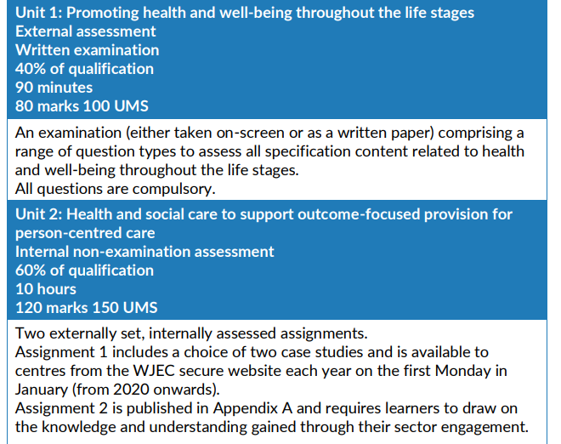
Summary of assessment
Notes:
The Level 2 Health and Social Care: Principles and Contexts is made up of 2 units – Unit 1, an external examination worth 40% of the qualification, and Unit 2 an internally assessed NEA consisting of 2 tasks set externally by WJEC. Candidates can choose between 2 case studies which are available on WJEC’s secure website from the first Monday in January each year. Assignment 2 can be found in the Appendix of the specification which is on the Health and Care Learning Wales website.

Slide 4
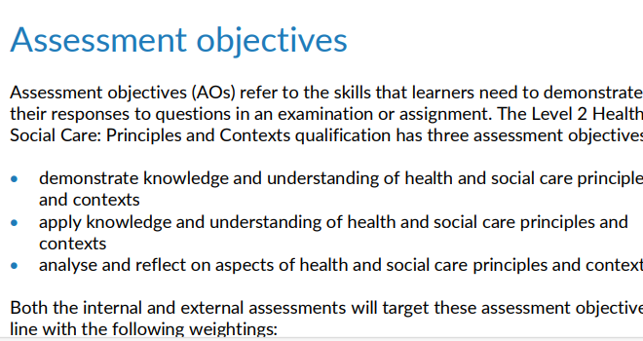
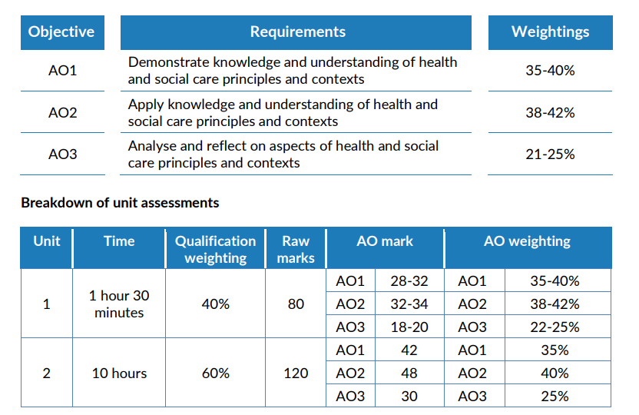
Assessment Objectives.
Notes:
Candidates will be assessed on assessment objectives A01, A02 and A03 and will be required to demonstrate knowledge and understanding but also to apply their knowledge to scenarios and to be analytical and reflect on aspects of health and social care principles and contexts. Further amplification on requirements and weightings of assessment objectives can be found in the specification on the Health and Care Learning Wales website.

Slide 5
2023 Grade Boundaries and Outcomes
Level 2 HSC P and C
These raw mark boundaries can be used as a rough guide to advise learners on their predicted grades – mock results but remember these can change annually
Unit | D | M | P
Unit 1 | 55 | 43 | 32
Unit 2 | 78 | 54 | 30
wjecservices.co.uk/MarkToUMS/default.aspx
Centres | Cands | D | M | P
11 | 212 | 14.6 | 63.2 | 88.7
 |  | Cumulative % of candidates at each grade.
Use this data to compare how your cohort did
Results Statistics Archive (wjec.co.uk)
Notes:
This slide shows the grade boundaries for this year. These can be helpful to give candidates an indication of what their predicted grade is, although grade boundaries change every year. As you can see, the grade required to achieve a Distinction in the NEA is significantly higher than in the examination. The table below shows the percentage of candidates achieving a Distinction, Merit and Pass and is useful to see how your candidates performed compared to the cohort as a whole. This information can be found on the WJEC website under grade boundaries.

Slide 6
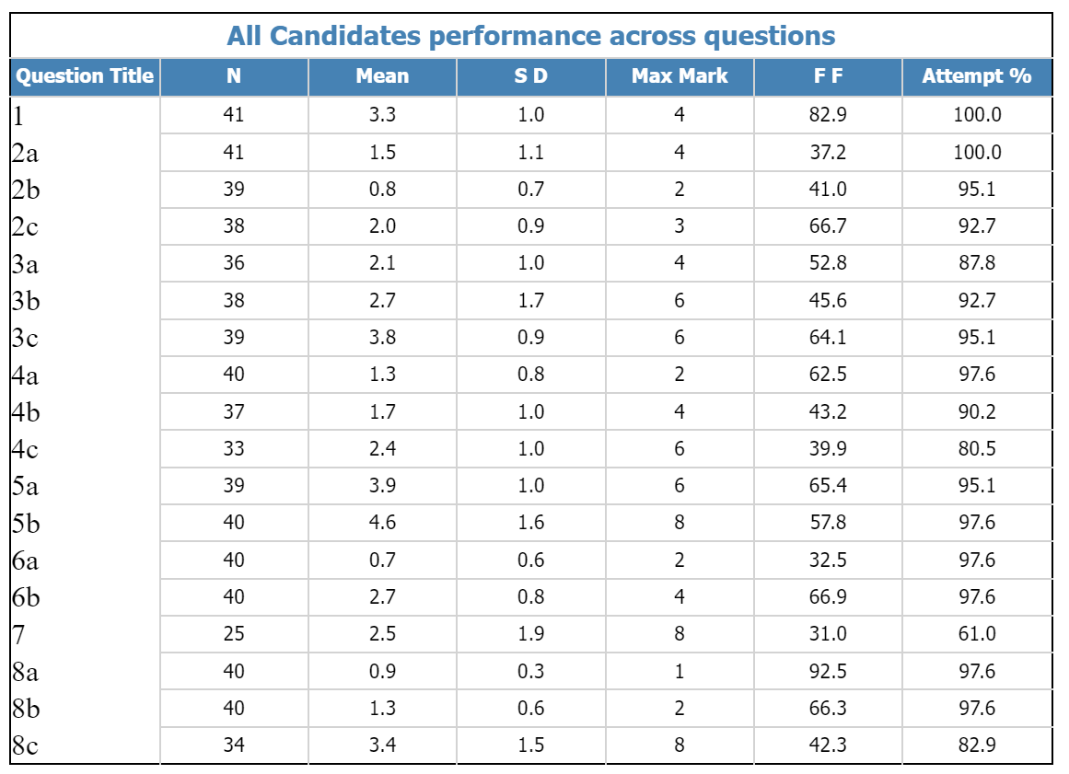
2023 Item Level data – Unit 1 Examination
Use this data to compare how your cohort did
high attempt factor at start but disappointing for some questions
The lower the FF score the less accessible the question
Notes:
This data demonstrates which questions in the Unit 1 exam candidates attempted and which ones they found difficult to access, this can help inform teaching as well as helping when writing exam questions. For example, in Summer 2023 all candidates attempted questions 1 and 2 (a) but found question 7 difficult to access.

Slide 7

Unit 1 Principal Examiner report
Candidates’ knowledge and understanding was generally good.
Application of knowledge varied depending on the scenario – candidates should be encouraged to apply knowledge in a wide variety of contexts.
Candidates generally offered more developed responses that required than just a brief identification – bullet points were not regularly seen.
As some candidates misread the questions, encourage them to spend time checking answers, time permitting.
Practice command words to enable more focus on how answers are constructed.
Notes:
These are main points from the Principal Examiner’s report for Unit 1. Candidates have good subject knowledge and are writing more developed responses but should extend their learning to apply knowledge to the scenarios given in the exam questions.
Candidates would benefit from examination practice to include management of time to enable the checking of answers, highlighting of key words, and knowledge of what each command word means.
Understanding what each command means in relation to answering exam questions will make, particularly the longer questions, more accessible and allow candidates to construct their answers effectively. A list of command words can be found on pages 7 to 9 of the Guidance for Teaching on the Health and Care Learning Wales website.

Slide 8
Principal Examiner comments:
Unit 1 questions.
2b candidates not to confuse/be vague – walking not milestone, first steps is/ walking unaided – rolling over, first tooth
3b challenging – not many links to self concept, referred to culture and beliefs. (topic area 1.2 on spec)
3c Top marks were given to those who assessed the impact of starting a family and gave positive and negative impacts.
4c many candidates confused an inclusion policy with being included and gave basic details about Aled making friends and having a social life. They needed to assess the benefit of the college having a policy on Aled.
5b As this question was an A03 Evaluate question, there should be a balance of positive and negative effects and a conclusion.
7 many candidates did not attempt this question. There was a lack of knowledge of the Wellbeing of Future Generations Act which made this question inaccessible for some candidates. Legislation is an important topic area and can be found in section 1.4 of the specification.
8c Some candidates lost marks lost here due to a lack of detail, candidates needed to address both the purpose and challenge of the flu vaccine.
Notes:
Here we can see comments made by the Principal Examiner that relate to particular questions in Unit 1. We can look at candidates’ responses to these questions after this. A copy of the examination paper and mark scheme can be located on the secure website.

Slide 9
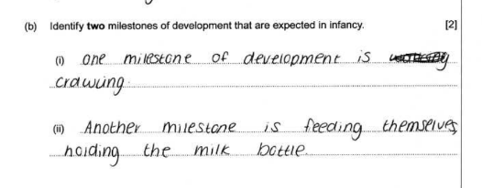
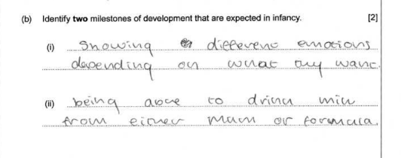
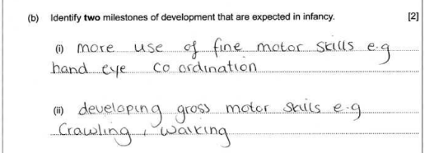
Unit 1: Question 2 (b)
1 mark for crawling, 1 mark for feeding themselves holding the bottle
0 marks, both suggestions are too vague and not milestones.
1 mark for crawling, 0 marks for hand-eye
co-ordination as too vague.
Some candidates gave vague or confused answers and not specific milestones. ‘Walking’ is not a milestone but ‘taking first steps’ is.
Notes:
This question was generally well attempted although some candidates gave answers that were too vague, for example ‘walking’ is not worthy of credit but ‘taking first steps’ is. Other relevant answers are rolling over, crawling, first tooth, sitting up, first words (mum, dad), first smile – these are all milestones of development.

Slide 10
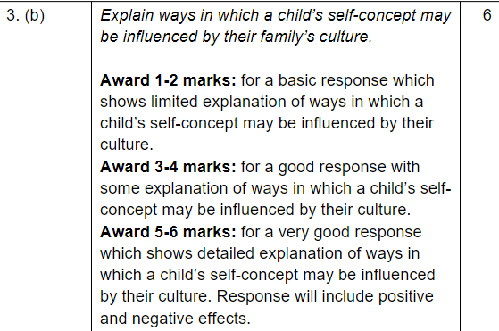
Unit 1: Question 3(b)
This question was challenging for many candidates who found it difficult to link self-concept to culture.
More work needs to be done on developing candidates’ knowledge and understanding of self-concept.
Support can be found on page 14 and 15 of the Level 2 Guidance for Teachers on the healthandcarelearning.wales website
gft-l2-hsc-principles-and-contexts-e-27052021.pdf (healthandcarelearning.wales)
Notes:
This question was challenging for many candidates who found it difficult to link self-concept with culture. More work needs to be done in developing understanding of self-concept, further support can be found in the Guidance for Teaching resources on the health and care learning (Wales) website.

Slide 11
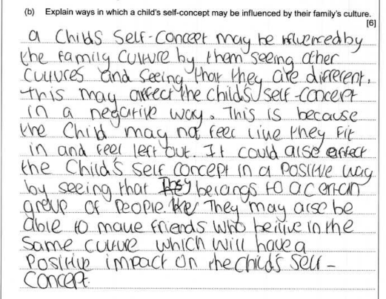
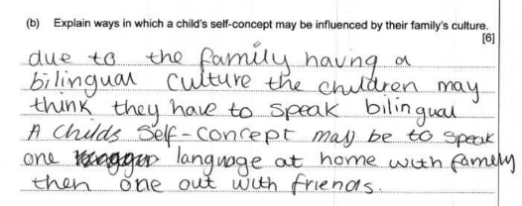
Unit 1: Question 3 (b)
5 marks: a good and balanced response; negative effect – not fitting in, being discriminated against, positive effect – a sense of belonging, making friends. A little lacking details for full marks.
1 mark: a very basic response which alludes to language culture affecting self-concept but not clear enough for more than 1 mark
Notes:
Positive effects on self-concept are; good role models to copy behavior/beliefs, a sense of belonging increases self worth, following traditions and culture makes a child feel included and accepted.
Negative effects on self-concept are; cultural dress may affect self image due to feeling different, a child could have low self esteem if discriminated against, there could be low self esteem if their culture is not understood.
The responses on this slide show 2 answers ranging from 5 (a balanced response) to 1 (a basic response)

Slide 12
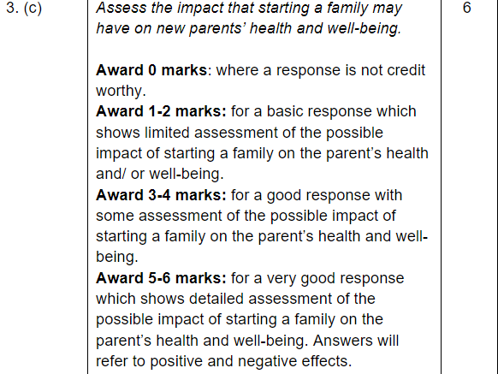
Unit 1: Question 3 (c)
Principal Examiner comment:
Top marks were given to candidates who assessed the impact and gave positive and negative impacts of starting a family on parent’s health and well-being.
Notes:
This question uses an A03 command word – ‘assess’. Candidates should be able to compare ideas and make informed judgements and decisions in this question. They should do that by applying knowledge and understanding to the scenario.

Slide 13
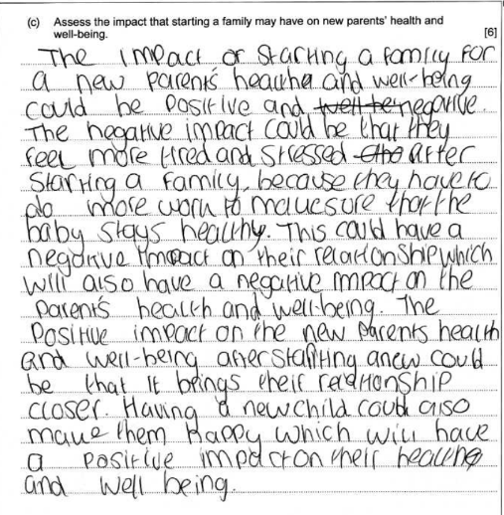
Unit 1: Question 3 (c)
4 marks: this candidate understands the command word and gives positive and ngative impacts on the parents’ health and well-being, but the response lacks the detail required for Band 3.
Notes:
This response fell into the 3 – 4-mark band – a good response with some assessment of the possible impact of starting a family on the parents’ health and well-being. It is clear that the candidate understands the command word ‘assess’ and there is some basic explanation following their points but not enough detail to reach the next band.

Slide 14
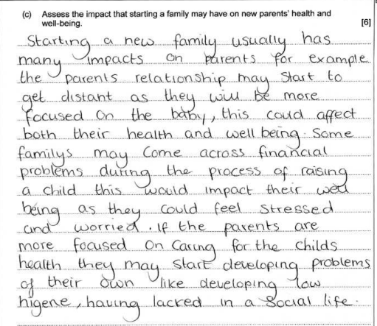
Unit 1: Question 3 (c)
4 marks: this candidate addresses 3 negative impacts on the parents’ health and well-being and makes some judgements (stressed and worried) but there is a lack of balance and detail to attain a Band 3 mark.
Notes:
This response has the same mark of 4, although the candidate only concentrates on the negative impacts, points are generally well explained showing understanding.

Slide 15
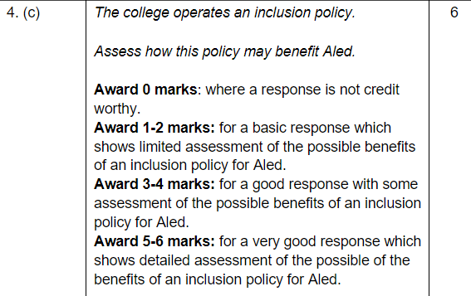
Unit 1: Question 4 (c)
Principal Examiner comment:
4c many candidates confused an inclusion policy with being included and gave basic details about Aled making friends and having a social life. They needed to assess the benefit of the college having a policy on Aled.
Notes:
This question was not fully understood by some candidates who focused on Aled being included at college rather than the benefits of an inclusion policy.

Slide 16
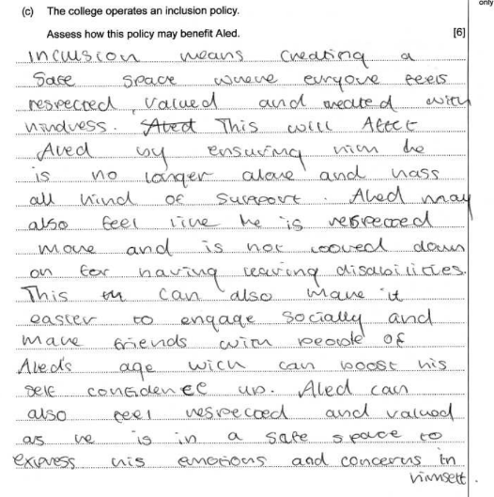
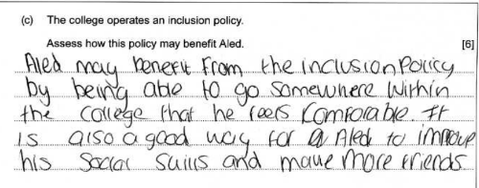
Unit 1: Question 4 (c)
1 mark for basic understanding of the college providing a safe, comfortable space for Aled.
5 marks for a good understanding of the college providing a safe space for students, making them feel respected and valued which in turn makes Aled feel respected and help him socially, boosting his self-confidence. Application of knowledge is evident in this answer
Notes:
Responses here range from a good assessment achieving 5 marks to a basic understanding achieving 1 mark.
Other points that could have been included are removing discrimination at college so that Aled feels equal due to his age, additional needs, lack of qualifications and inability to find a job.
Inclusion policy focuses on well-being and progress of every student’s individual needs.
Aled is more likely to be successful due to this individual support.
He will be encouraged to participate in social activities and make friends, as he will be happy and social supported by the inclusion policy, he will be more likely to attend college.

Slide 17
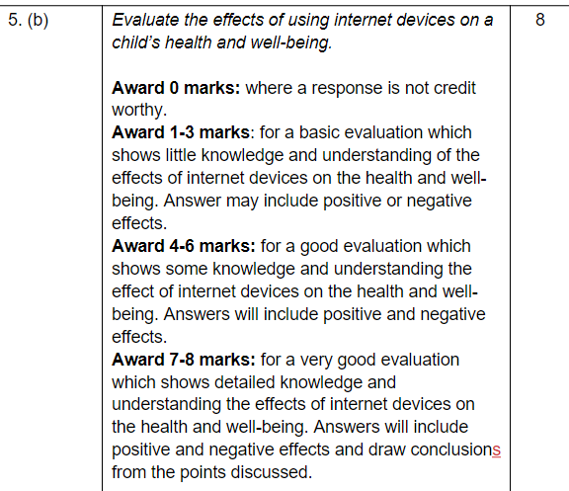
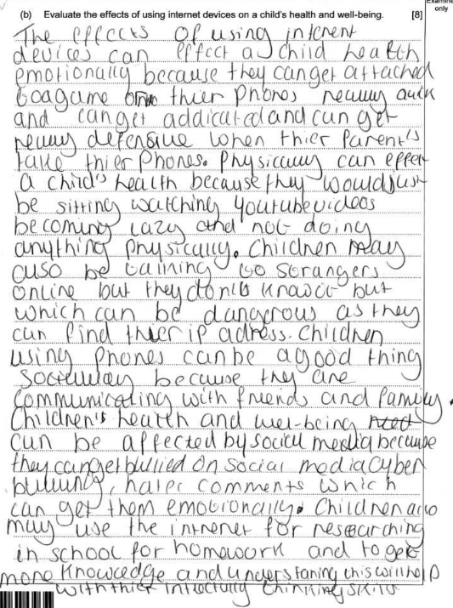
Unit 1: Question 5(b)
Full marks for a very good evaluation of both negative and positive points (explained), related to emotional, physical and social health as well as the dangers that could affect health and well-being.
Notes:
This answer shows that the candidate understands the command word ‘evaluate’ as they have included positive and negative effects of internet devices on a child’s health and well-being and applied their knowledge to emotional, physical and social health. This response was awarded full marks.

Slide 18
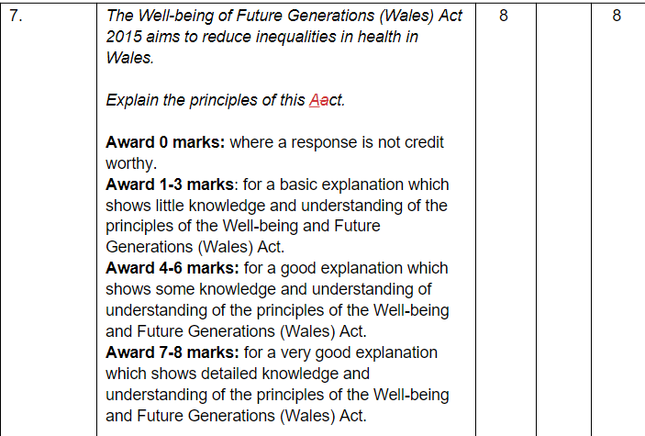
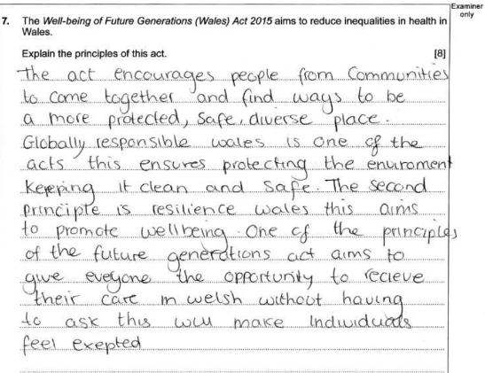
Unit 1: Question 7
5 marks for explaining that communities should work together, diversity, global responsibility to protect the environment, resilience to promote well-being of future generations, reference to Welsh language related to equality. Lots of correct points, explanation lacks detail for top band.
Notes:
Answers could include improving the social, economic, environmental and cultural well-being of Wales, a joined-up approach between organisations, people and communities, creating a Wales that we want to live in now and in the future.
7 well-being goals which are: health and social care has a statutory duty to meet current needs whilst protecting future needs of Wales
Improve the social, economic, cultural well-being of Wales
work towards reducing inequality in health and poverty
work towards a healthier Wales by raising awareness of health and well-being issues
to improve long term health where individual’s choose behaviour and lifestyle choices that benefit future health and resilience, reducing future needs for health and social care
the act aims to address climate change
encourages health and social services to work better with each other and individuals
to make communities in Wales more cohesive increasing informal care and support for health and social care needs

Slide 19
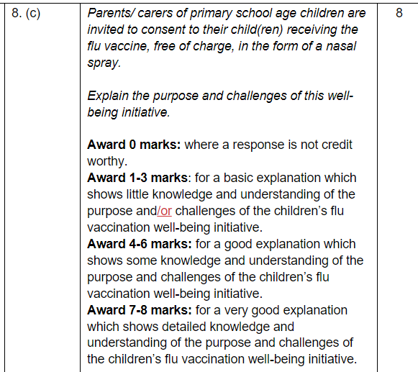
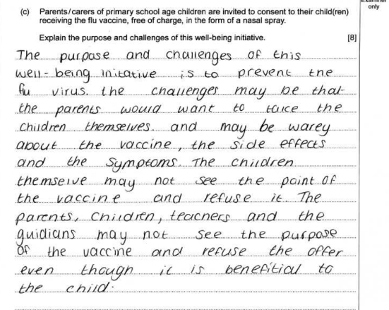
Unit 1: Question 8 (c)
6 marks: addresses the purpose (prevent the virus, it is beneficial to the child) and challenges (wary of the vaccine, side effects and symptoms, may not see the point.) Shows good understanding but lacks detail for top band.
Notes:
This candidate achieves 6 marks for a good explanation of both the purpose and the challenges of the flu vaccine as a well-being initiative. The answer lacks detail to access the higher band. Candidates that discuss only the purpose or the challenges are unable to access marks above 3 out of 8.

Slide 20

Principal Moderator comments Summer 2023:
Unit 2
Notes:
Now we will move on to look at the Principal Moderator feedback from the summer series for Unit 2.

Slide 21
Unit 2 Principal Moderator comments.
Both components of this unit completed for the first time this year.
Please take care to accurately authenticate candidates’ work to include signatures by both candidate and tutor.
Encourage candidates to proofread their work and reflect on the appropriate level of written communication – spelling, punctuation and grammar.
Both tasks are to be completed under controlled conditions and, as such, a word count and notes should be submitted. These pieces of evidence should be included in candidates’ final submissions.
Where candidates quote from the internet, please ensure that quotes are referenced and submit notes prepared prior to the task to indicate that use of the internet is permitted before the task is started.
Notes:
This Unit consists of assignment 1 – a case study, and assignment 2 – a corresponding work placement. This is the first year that candidates have completed both components without mitigation in place. All work should be authenticated before submission by both the candidate and the tutor. Please encourage candidates to proofread their work and use an appropriate level of written communication, checking spelling, punctuation and grammar. Quotes taken from the internet should be referenced in the same way as quotes from books and periodicals, and notes prepared prior to beginning the NEA should be submitted with candidates’ work.
Both tasks in assignment 1 are to be completed under controlled conditions. Guidance on how to complete Non-Exam Assessments can be found on the WJEC webpage.

Slide 22
Unit 2: Assignment 1 feedback
A choice of 2 case studies and corresponding criteria to be completed within a 6-hour controlled assessment.
Most centres gave candidates a choice of case studies.
Standardise work within your centre – some work was awarded Band 4 for bullet points whilst other work was awarded Band 2 for an excellent, detailed account.
Task B was completed well. Spend time on the role of the Multidisciplinary team applying its role to personal well-being outcomes within the scenario.
Task d(i) candidates should be encouraged to write more detail and apply knowledge of the components; choice and control, co-production, equality and inclusion in order to achieve the higher band marks.
Task E: although many candidates gave lengthy descriptions of the Well-being of Future Generations Act, work lacked analysis of how goals influence and support the case study.
Notes:
If there is more than one teacher of this qualification in a centre, try to standardise work, look at exemplars on the WJEC website and apply the mark scheme carefully.
Apply the role of the Multidisciplinary Team to the personal well-being outcomes and describe how each role can support Jodie or Andrew. Further support for this topic can be found under the Resources tab in the Level 2 Health and Social Care section of the www.healthandlearningwales.co.uk webpage, under Unit 2.2 about partnership working.
Learning to apply knowledge to the case study is key for candidates to achieve the higher mark bands.

Slide 23
Unit 2: Assignment 2 feedback.
Assignment 2 – 60 hours of sector engagement in a relevant Health or Social Care work placement.
Evidence of sector engagement is essential.
Primary school placements can be disadvantageous to candidates.
For tasks (c) and (d) a placement diary allows for more in-depth explanation and clearer reflection. Centres should encourage candidates to submit a clear, detailed record of their sector engagement to enhance their learning experience and achieve the higher band marks.
Notes:
Assignment 2 is sector engagement in a health or social care placement. Evidence for the placement is essential and candidates should be encouraged to keep a log or diary of their hours, training, tasks completed and reflection to consider good practice. Many centres chose a primary school as a placement, this is a disadvantage when answering the questions relating to Health or Social Care and is not a health or social care setting. Time spent showing candidates the range of settings within health and social care at the start of this assignment would help in choosing an appropriate placement.

Slide 24
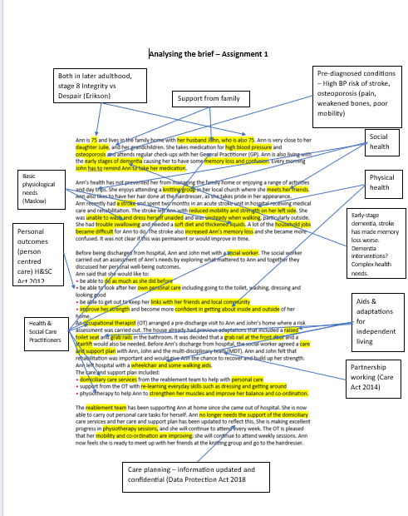
Helpful tips for the NEA (assignment 1)
Encourage candidates to thoroughly analyse the brief by highlighting and labelling all relevant sections.
Familiarise candidates with key terms – co-production, partnership working, choice and control, equality and inclusion.
To encourage candidates to extend their explanations and be more analytical, build on the initial analysis of the case study to identify which health and social care professionals may support the individual and how.

Slide 25
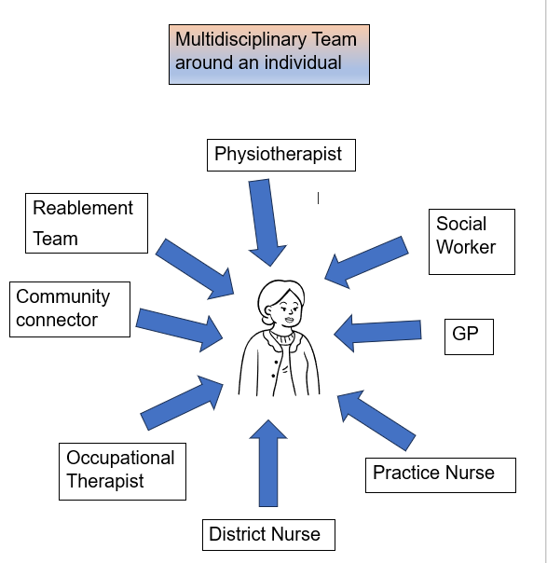
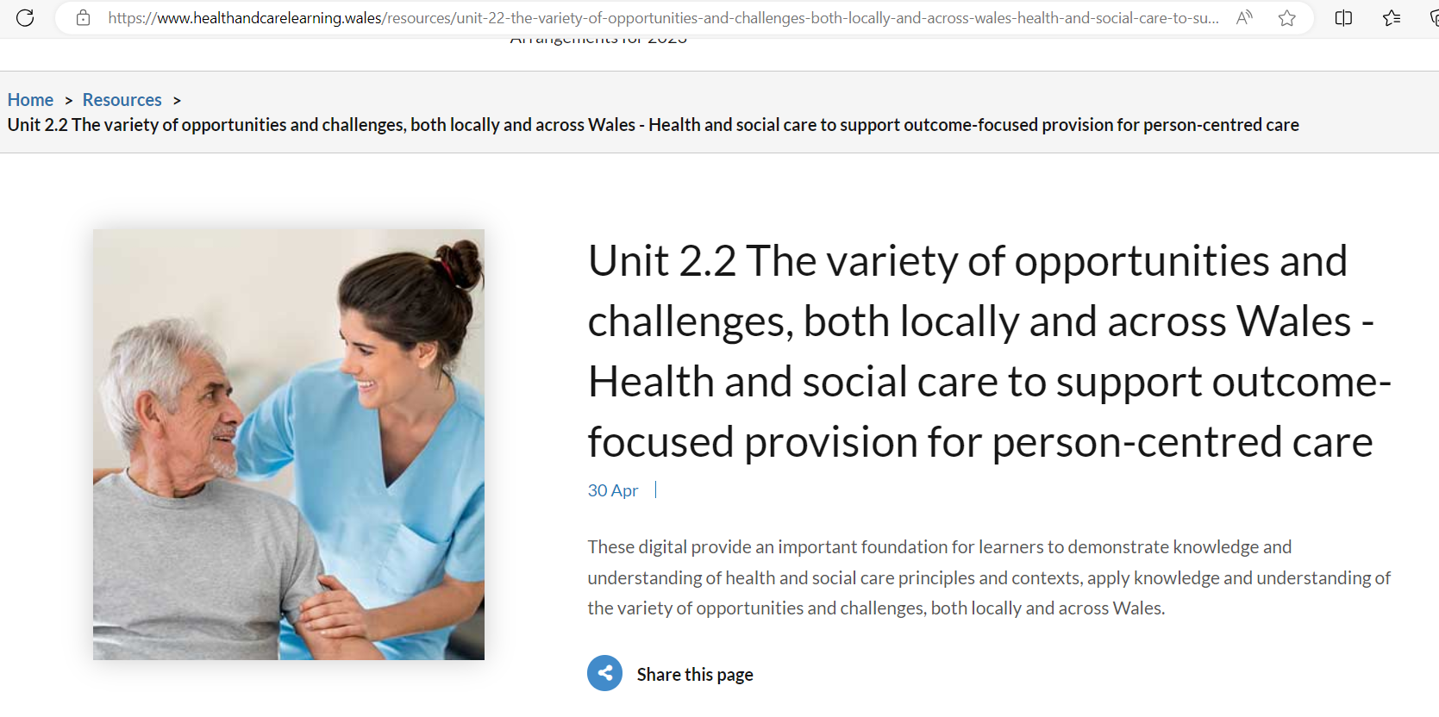
Looking at the multidisciplinary team.
Videos on multidisciplinary team working can be found on Social Care Wales website.
Andy’s story – an excellent example of effective collaborative working - YouTube
Further support on Level 2 Health and Social Care: Principles and Contexts (healthandcarelearning.wales)
Notes:
This slide shows you where you can find more information on how a multidisciplinary team can support personal outcomes to support this area of teaching. Videos can be found on YouTube (from Social Care Wales). Further resources are on the Health and Care learning (Wales) webpage, under the Level 2 Health and Social Care section.

Slide 26

Coming soon
Level 2 Health and Social Care.

Slide 27
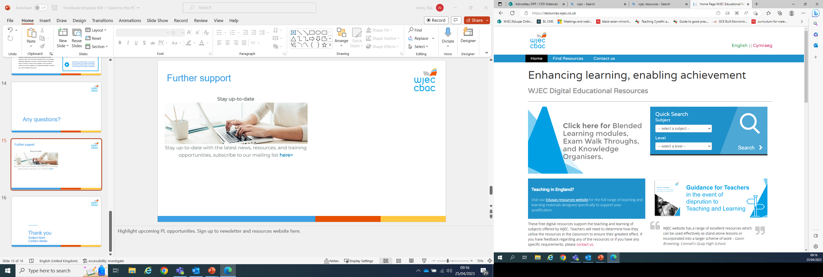
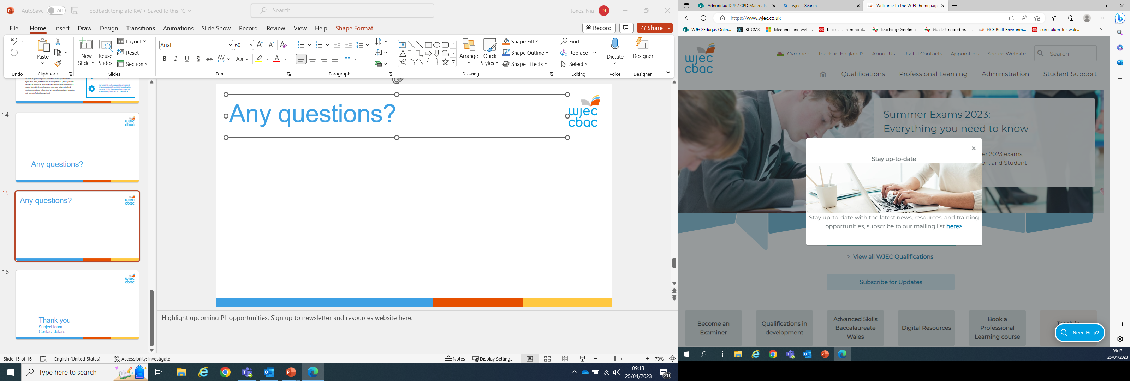
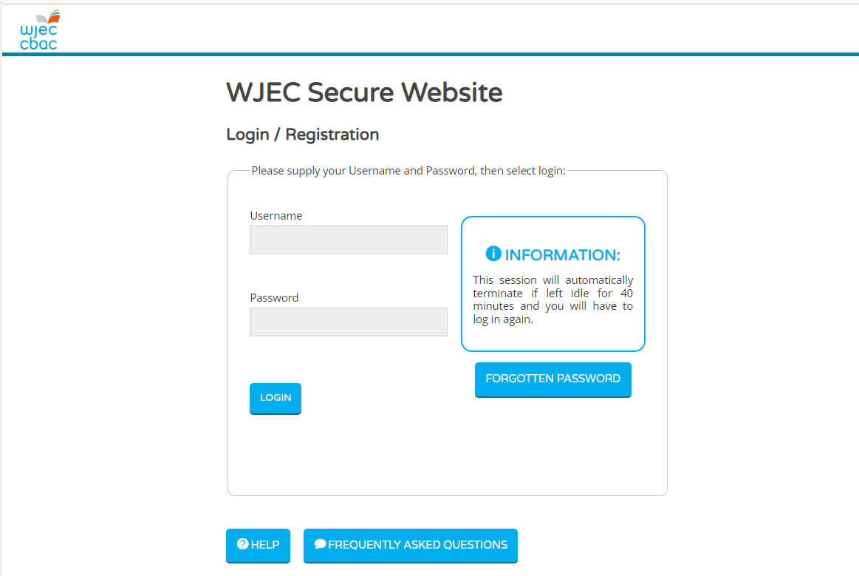
Further support
Stay up to date with new resources, training events and developments by subscribing to our newsletter via the website.
A wide range of free resources are available to support this qualification on www.healthandcarelearning.wales
Further resources and information can be found on the WJEC secure website.
Free resources
Resources (healthandcarelearning.wales)
Newsletter
Secure website
Notes:
Further support for this qualification can be found through subscribing to our newsletter which can be done on the website. A wide range of resources for both units can be found under the Level 2 Health and Social Care section of the Health and Learning Wales (Wales) webpage and additional resources such as exemplars, past papers and mark schemes can be located on the secure website.

Slide 28
Any questions?
CONTACTS:
Contact our specialist Subject Officer and administrative support team with any queries.
Please use the shared mailbox
hscpandc@wjec.co.uk
Thank you

