Slide 1


Exam Walk-Through
GCSE Health and Social Care, and Childcare
Unit 3 – Health and Social care, and childcare in the 21st Century
Notes:
.
This is the Exam Walk Through for the GCSE Health and Social Care, and Childcare
Unit 3 – Health and Social care, and childcare in the 21st Century

Slide 2
What you should have in front of you:
A copy of the exam paper
An answer booklet/lined paper
Any additional resource material
A pen, pencil and ruler
A highlighter
A watch
Post-it notes
Notes:
What you should have in front of you:
A copy of the exam paper
An answer booklet/lined paper
Any additional resource material
A pen, pencil and ruler
A highlighter
A watch
Post-it notes

Slide 3
What this exam paper is all about:
This examination paper includes of a range of question types to assess the specification content related to Health and Social Care, and Childcare in the 21st Century.
You have to answer all questions on this paper, using the space provided.
There are a total of 80 marks available, all of the individual questions and sub-questions have marks allocated to them (take note of these!).
You have 1 hour and 30 minutes to answer all of the questions on the paper.
Some of the questions have riders, these are short sentences at the start of the question and they are designed to help you.
Notes:
This examination paper includes of a range of question types .You have to answer all questions for a total of 80 marks available. The paper lasts1 hour and 30 m

Slide 4
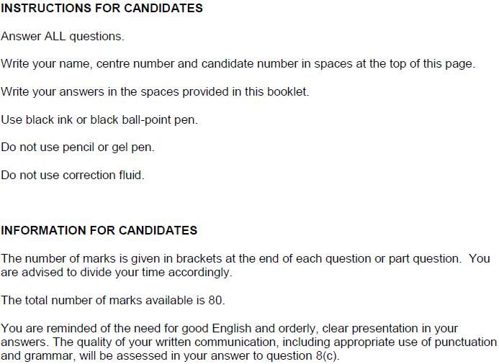
What should I do first?
1. Read the front cover of the exam paper.
2. Make sure your name and candidate number are on your answer booklet.
Notes:
Read the front cover! Don’t assume that this is the same as other examination papers. This paper clearly states that you have to answer all questions, and you should answer the questions in the space provided – if you need more time there are additional pages at the back of the paper.
You will find that there are suggested times to complete each question as we go through this paper, please note that this is only designed for the purposes of this activity.

Slide 5
General points on exam technique
Read through the whole question before starting to answer. This will help you understand what is required of you.
Use a highlighter to pick out key words.
Look at the command words and the number of marks available for each question, they will help you decide how much detail is needed.
If a word is bold, it is important.
Keep your exam paper open at the double page spread, do not fold it in half.
Read your answers to check they make sense.
Notes:
Read through the whole question before starting to answer. This will help you understand what is required of you.
Use a highlighter to pick out key words.
Look at the command words and the number of marks available for each question, they will help you decide how much detail is needed.
If a word is bold, it is important.
Keep your exam paper open at the double page spread, do not fold it in half.
Read your answers to check they make sense.

Slide 6
How do I tackle the questions?
The same approach should be taken to each question:
Step 1 Read question and highlight command verb(s)
Step 2 Highlight key words in the question
Step 3 Identify marks allocated for the question (you should be able to answer in the space provided)
Step 4 Plan your response (list mnemonics etc.)
Top tip! Allocate enough time for each question – base this on the marks available for each question.
Notes:
Step 1 Read question and highlight command words
Step 2 Highlight key words in the question
Step 3 Identify marks allocated for the question in the space provided
Step 4 Plan your response

Slide 7
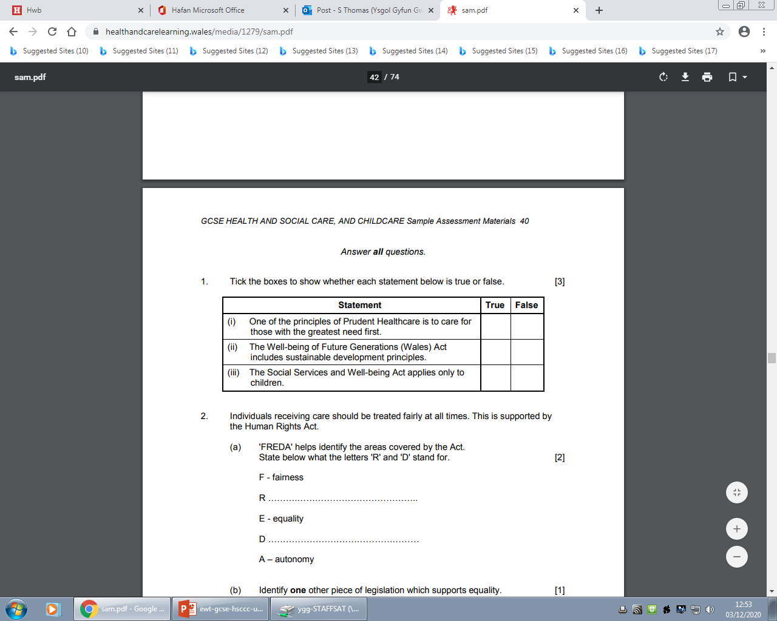
Question 1, AO1
3:00
Start the clock!
Try and answer both of these questions in 3 minutes – you many not need all of this time.
Notes:
a) 1 mark for each statement ticking whether they are true or false for a total of 3 marks.
These questions should not take long – don’t rush them, but don’t spend too much time on them either as they are not worth many marks!
You should allow no more than 3 minutes to complete these. We can see the correct answers in the next slide.
Make sure you read each of the actions carefully and put your ticks in the right boxes

Slide 8
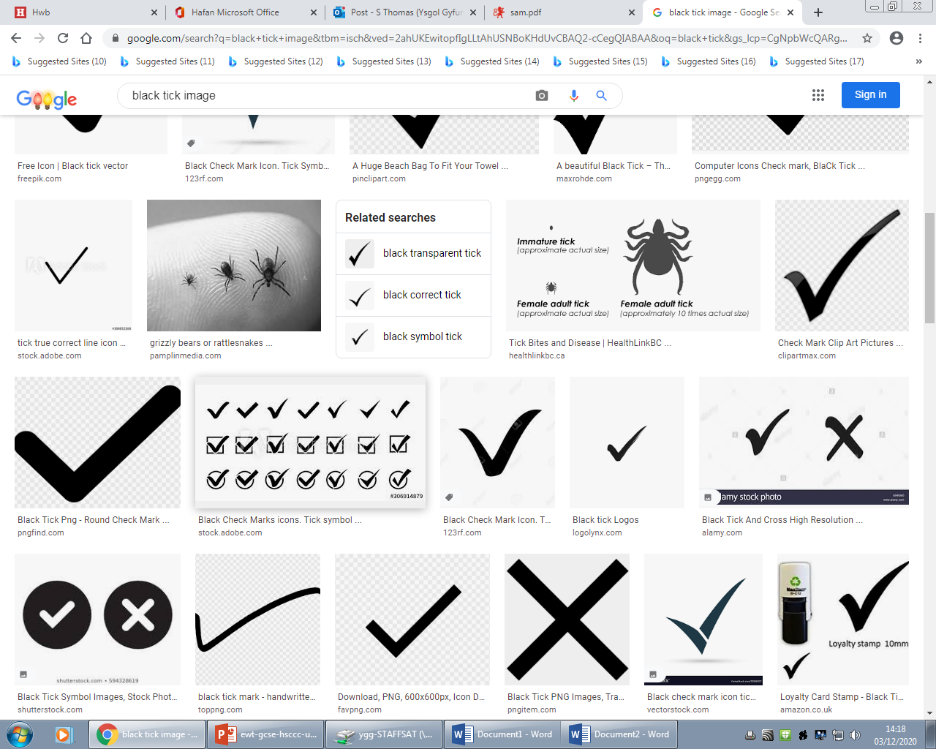
Question 1 AO1 mark scheme
Notes:
These are the correct answers. This candidate would have the full 3 marks.

Slide 9
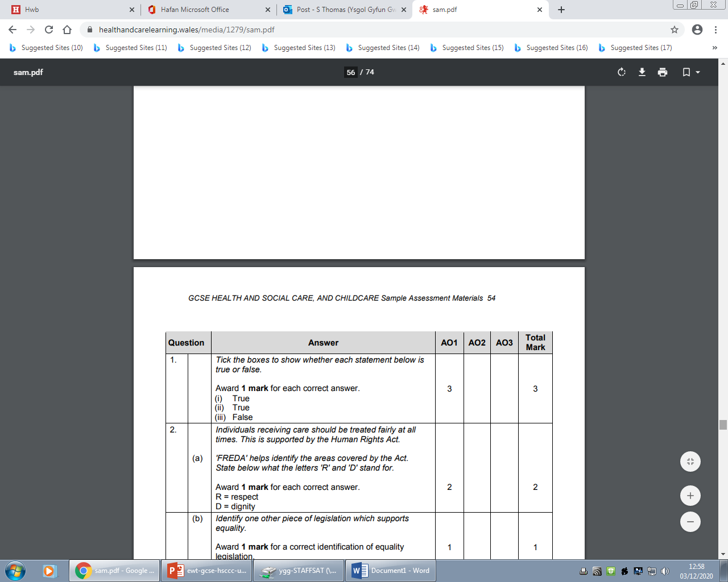
Question 1- marking scheme A01
Notes:
This is what the marking scheme for the first question would look like.

Slide 10
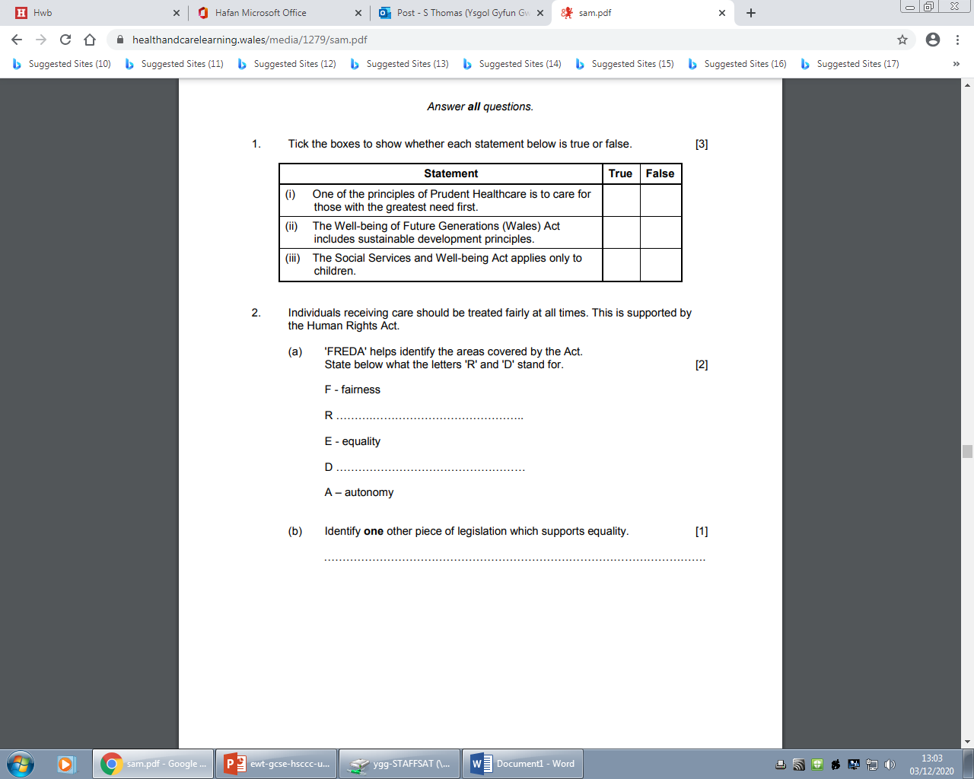
Question 2(a) (b), AO1
3:00
Start the clock!
Try and answer this question in 3 minutes, you may not need all of this time!
Notes:
There are a total of 3 marks available for this question – one mark each for the correct identification of the letter R and D and for part (b) identifying one other piece of legislation which supports equality. Double check when you have done it just to make sure you have identified a different legislation to the one in part (a)– it is your responsibility to check this!
Again, do not spend too long on this – 3 marks should be approximately 3 minutes to complete.

Slide 11
Question 2(a) (b), AO1
Respect
Dignity
The Equality Act 2010
Notes:
This is what your answer could look like.

Slide 12
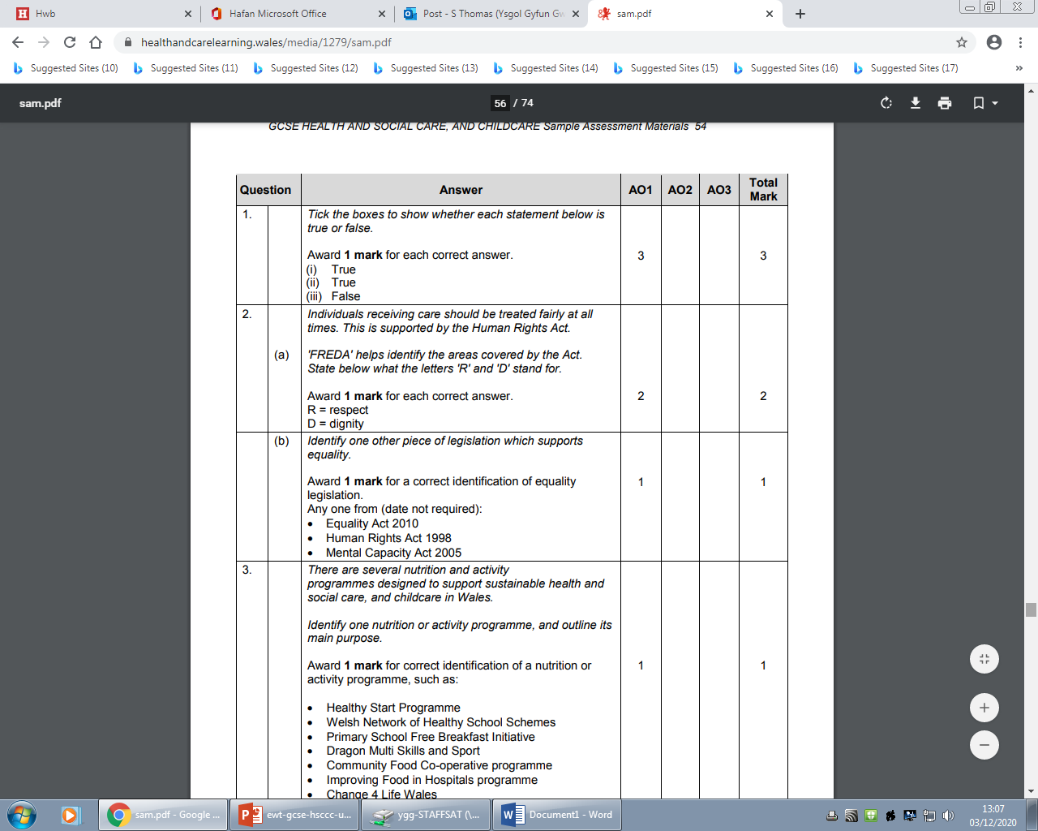
Question 2(a) (b), marking scheme AO1
Notes:
This is what the mark scheme looks like for question 2. There is only one possible answer each for part (a) but three possible answers for part (b).
Only one is needed.

Slide 13
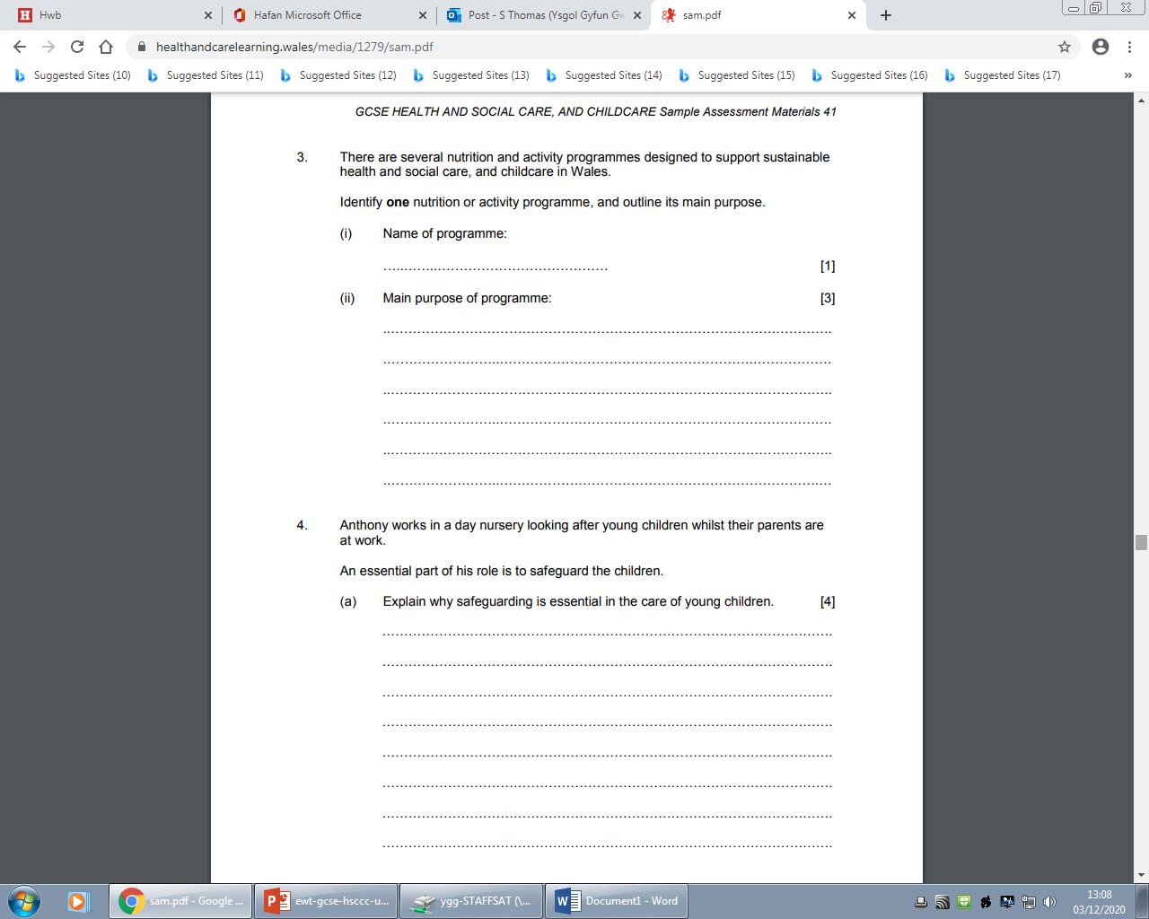
Question 3 (i) (ii), AO1
The rider at the start of the question is there to help you!
4:00
Start the clock!
Try and answer all of these questions in 4 minutes.
Notes:
You have to read the whole question first to make sure you understand what you are being asked to do. This is about a nutrition or activity programme of your choice. You would have studied 9 different ones for the exam. It is your responsibility to choose one of them. It would be sensible for you to select the programme you are most confident with as part (ii) asks you to outline its main purpose for a maximum of 3 marks.

Slide 14
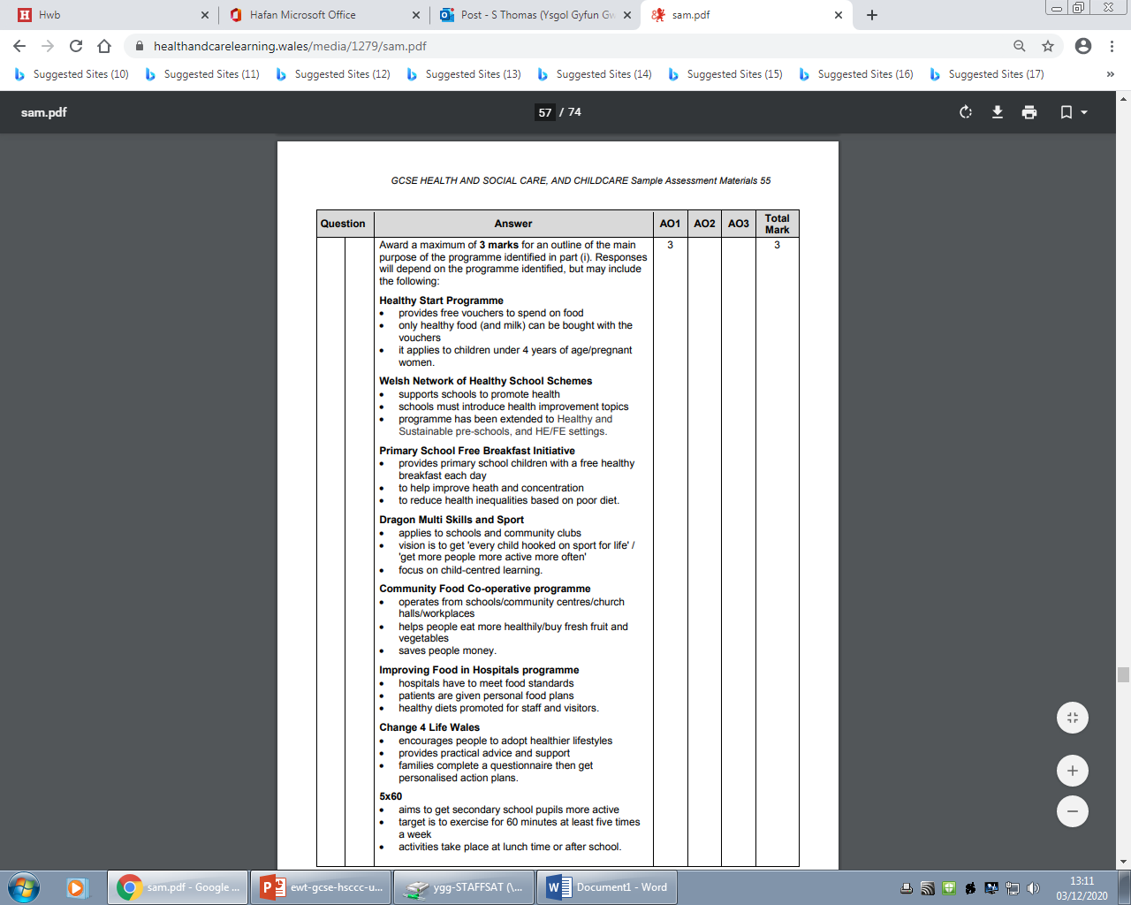
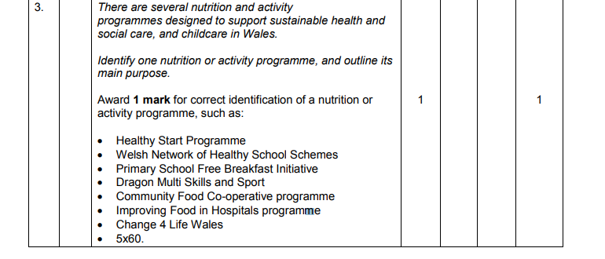
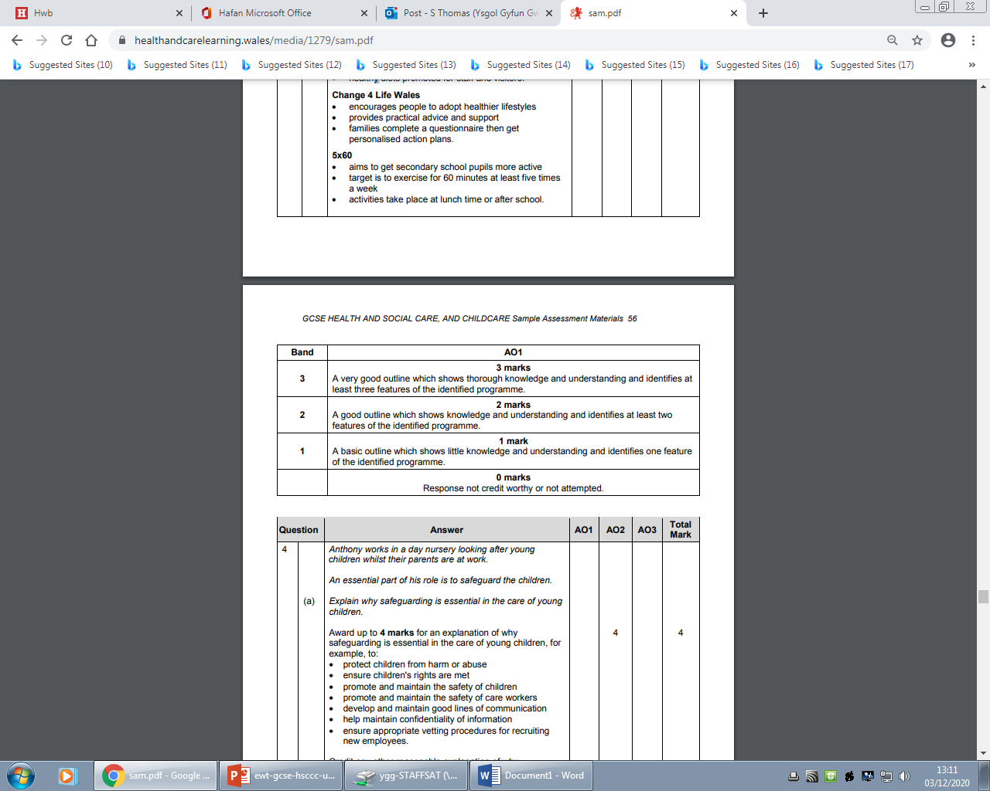
Question 3 AO1 mark scheme
Notes:
Part one asks you to name one programme for one mark.
For the next 3 marks, you only have to give one of these responses to the question – you may express yourself differently to the way it is listed in the mark scheme. Try and use the correct terminology regarding the purposes here you can to show your knowledge and understanding.
.

Slide 15
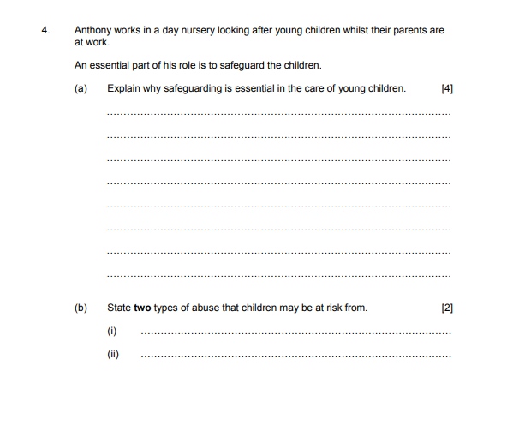
Question 4 (a), AO2 (b) AO1
6:00
Start the clock!
Try and answer both of these questions in 6 minutes.
Use the space provided to respond to the questions.
Notes:
The important factor here is that this question is about safeguarding.
Part (a) asks you to explain. This means giving details and reasons for how safeguarding is essential in the care of young children. If you have the word ‘because’ in your mind here as you are answering the question it will help you answer fully.
For part (b) you are asked to state two types of abuse. You will see from the mark scheme on the next slide that there are 5 different types of abuse but you only need to state two of these.
Try and answer both of these questions in 6 minutes. Using the space provided to respond to the questions

Slide 16
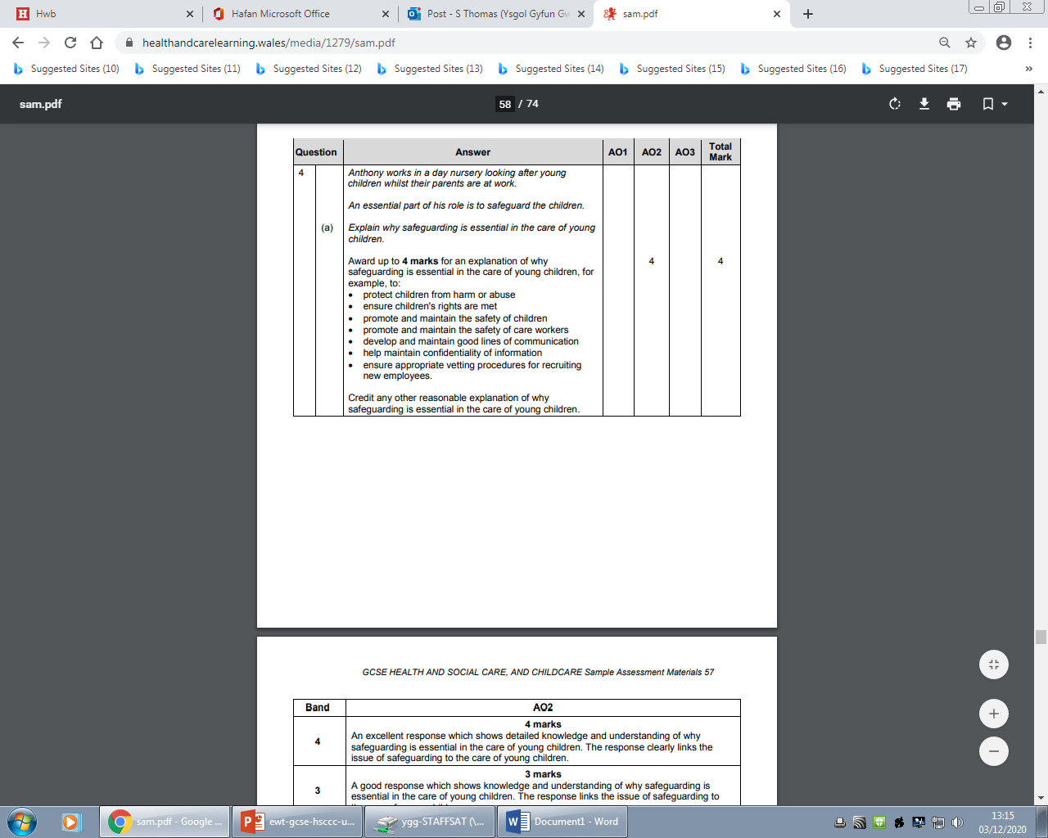
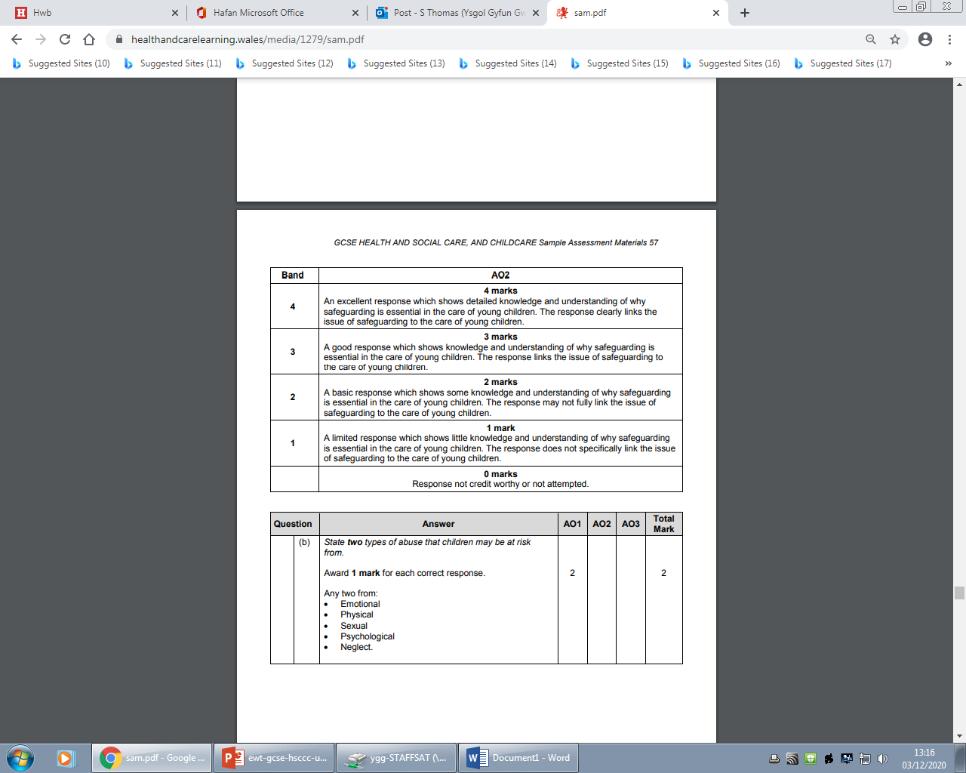
Question 4 (a) (b) AO2/AO1 mark scheme
Notes:
Note that there are a variety of answers that are correct for this question – not all of them are necessary for the full 4 marks. It is more important that you give a detailed explanation – rather than just writing a list. You may have come up with an answer that is not included in this list, that is OK and you may still be given credit for this when it is marked by an examiner. Check with your teacher if you are unsure.
Part (b) shows all the correct responses possible.

Slide 17
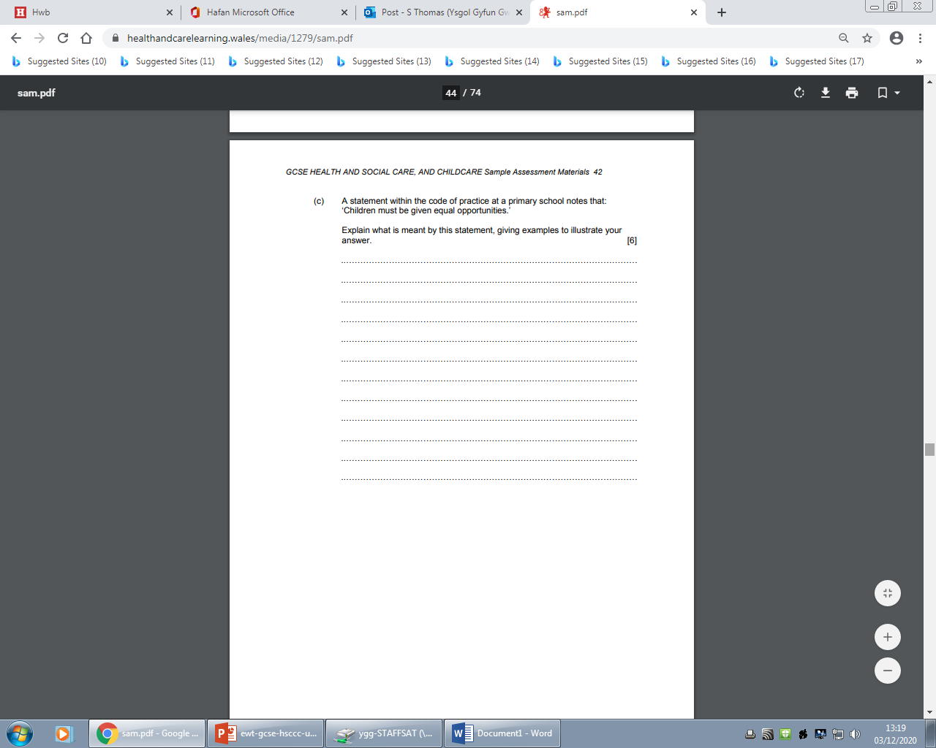
Question 4 (c), AO2
6:00
Start the clock!
Try and answer both of these questions in 6 minutes.
Notes:
Part (c) is another ‘Explain’ question so just like for part (a) remember that you need to provide details and reasons for the meaning of the statement. For the maximum amount of marks you will need to show an excellent explanation, with detailed knowledge and understanding. However, if you are unable to be detailed in your answer, marks will also be awarded for a more basic answer. Try to confine yourself to 6 minutes to complete this question and use the space provided for you as a guideline.

Slide 18
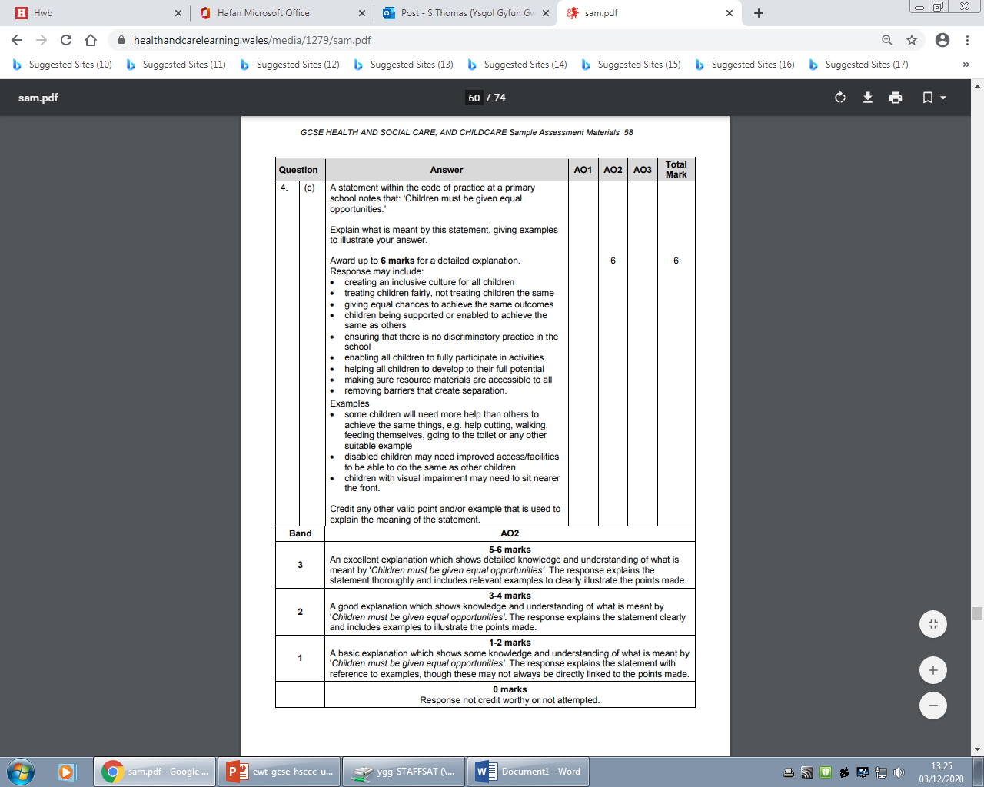
Question 4 (c) AO2 mark scheme
Notes:
Here we see the possible answers and the mark band description. Remember that an excellent explanation without examples would not be awarded full marks as the question asks to explain and give examples. In order to achieve into the top band – you will need to make sure that there is a detailed explanation rather than just a list.

Slide 19
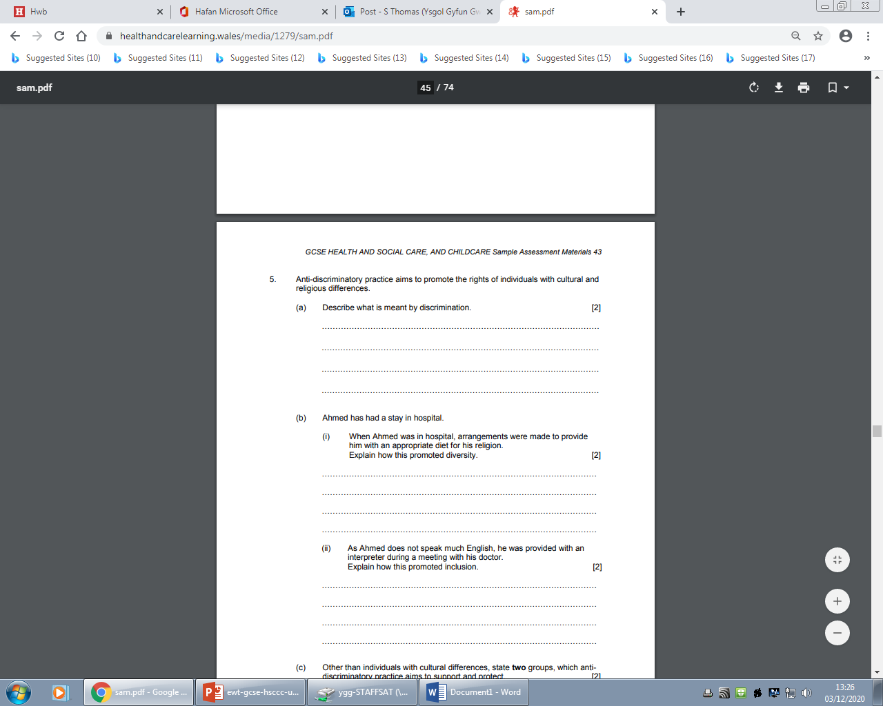
Question 5 (a) AO1/A02
Notes:
Question 5 part (a) is a describe question which asks you to provide the characteristics. There is no need to explain here. There are only 2 marks allocated for part (a) and this should guide you into how much is expected.
Part (b) is about Ahmed and therefore the answers should always make specific reference to Ahmed and your response is appropriate for his situation.
The important terms in question 5 part (b) in (i) and (ii) is Diversity and inclusion. These are part of the specification. You should ask your teacher if you are unsure of their meanings.

Slide 20
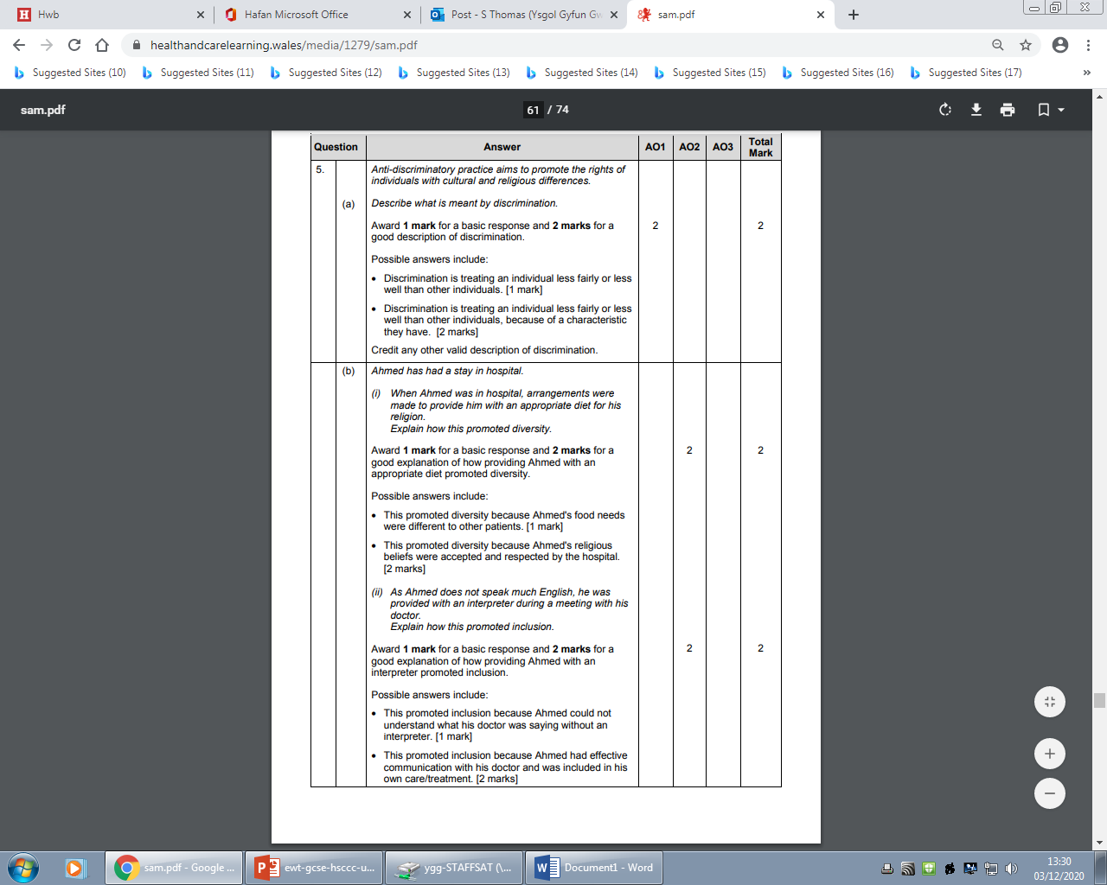
Question 5 (a) (b) (i) (ii) A01/A02 Mark scheme bands
Notes:
In the marking scheme for question 5 part (a), it gives some possible answers. You may have come up with an alternative idea which could also be credited – make sure you use appropriate health and social care and childcare terminology too. For parts (b) (i) and (ii), a correct explanation of the two terms is needed for the total of 2 marks each. However if a good explanation isn’t possible, 1 mark can be awarded for a more basic response and this is true for part (i) and (ii).

Slide 21
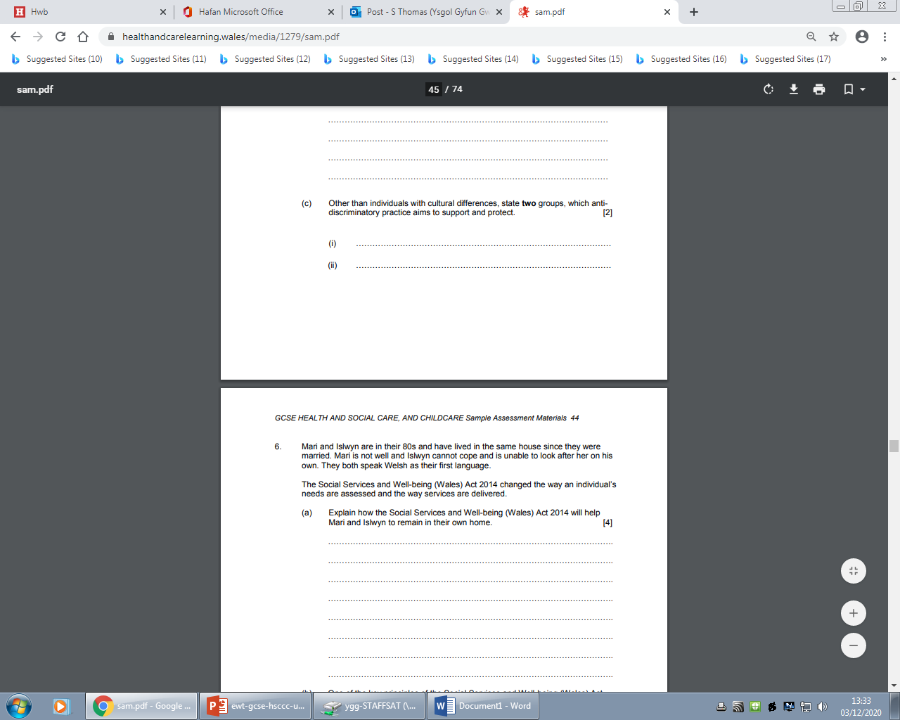
Question 5(c ), A01
2:00
Start the clock!
Try and answer all of these questions in 2 minutes.
Notes:
You should only take 2 minutes for this part ( c) and it asks for two groups, which anti discriminatory practice aims to support and protect. You would have learnt about the different groups in the classroom. Perhaps you will have tried to use different recall methods to learn these groups for the exam.

Slide 22
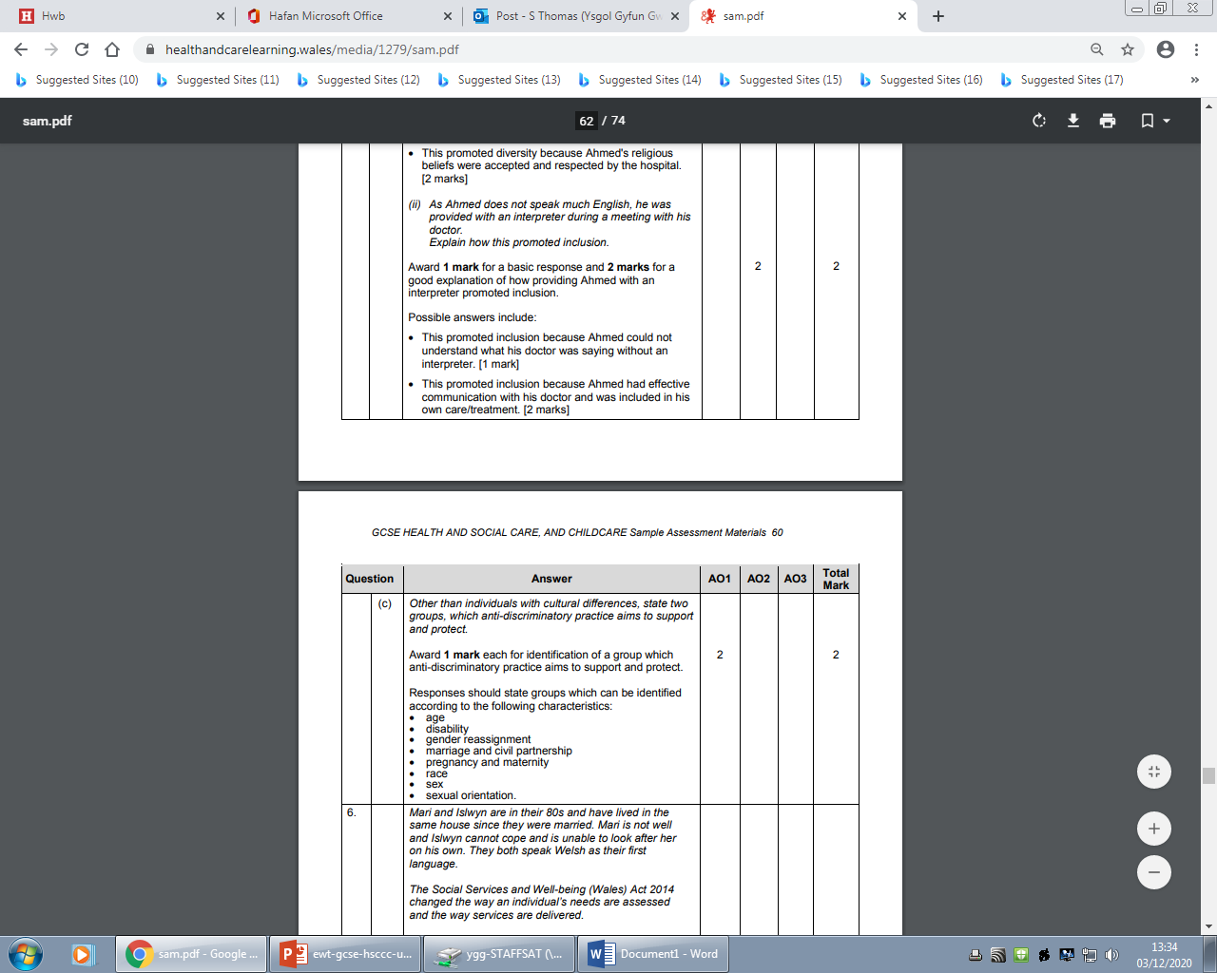
Question 5 (c) (i) (ii) AO1 mark scheme
Notes:
Note that the two marks are awarded for the CORRECT identification of any two of the groups.
Nothing more is needed here.

Slide 23
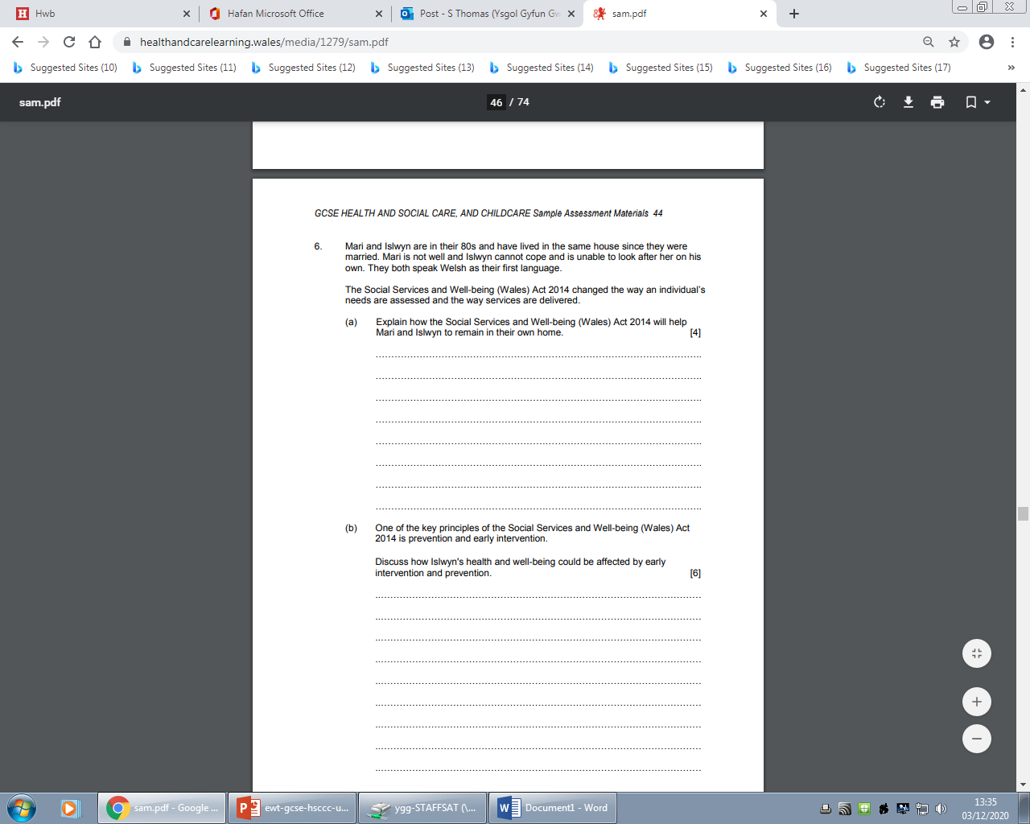
Question 6 (a), AO3
4:00
Start the clock!
Try and answer this question in 4 minutes – how did you get on?
Remember to be guided by the marks available – don’t write too much the maximum you can get is 4 marks.
Notes:
There are a number of key issues to consider in question 6 .The most important one is The Social Services and Well-being (Wales) Act 2014 and then the specific reference to Mari and Islwyn who are both in the older age group. Your answer must make specific reference to the couple. It should take no more than 4 minutes to answer in full. Remember to be guided by the marks available – don’t write too much the maximum you can get is 4 marks but use the space provided.

Slide 24
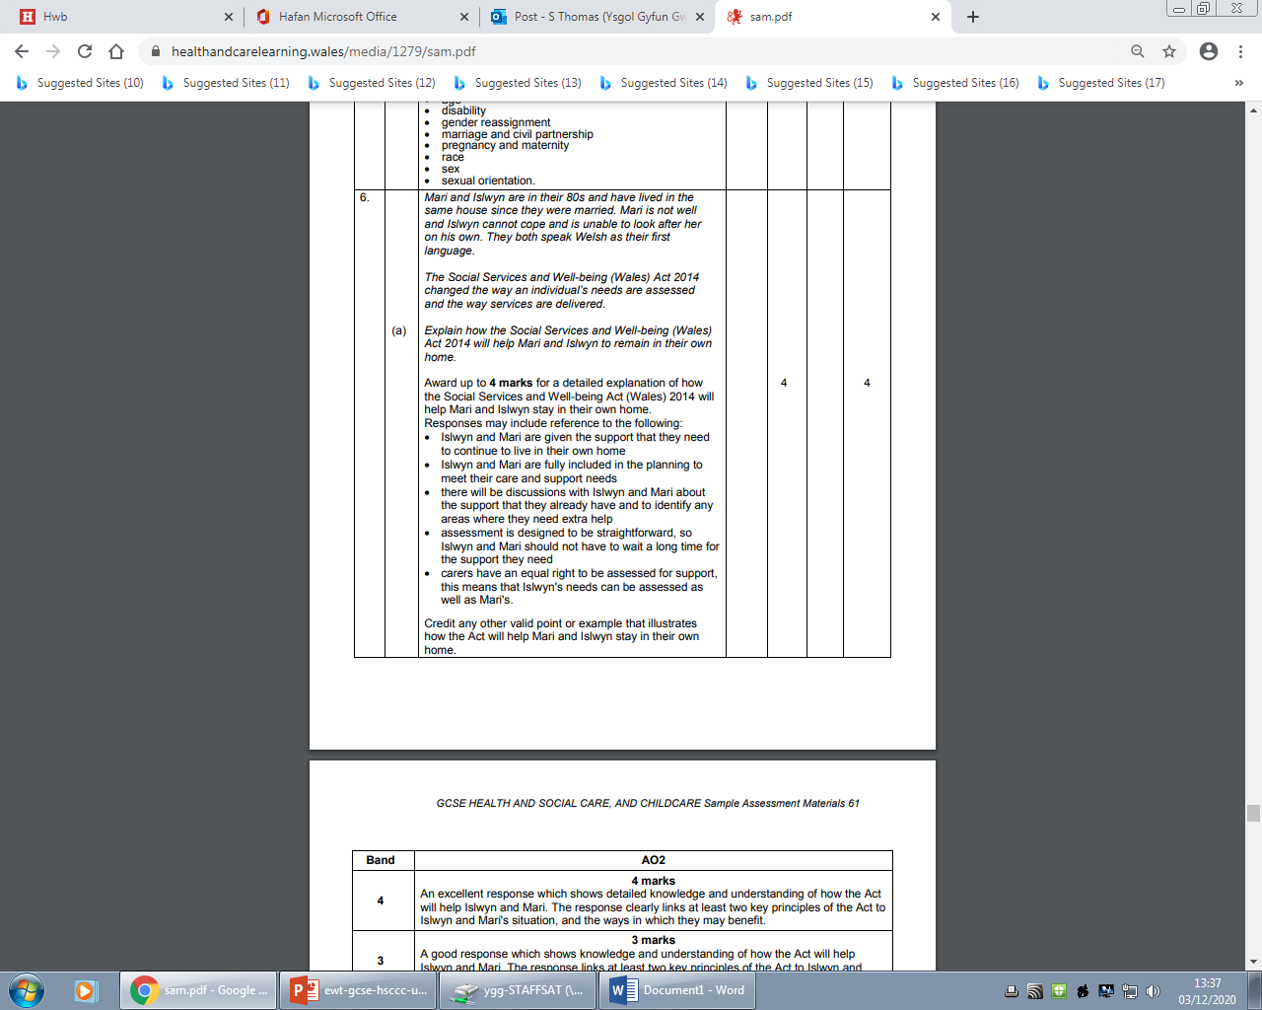
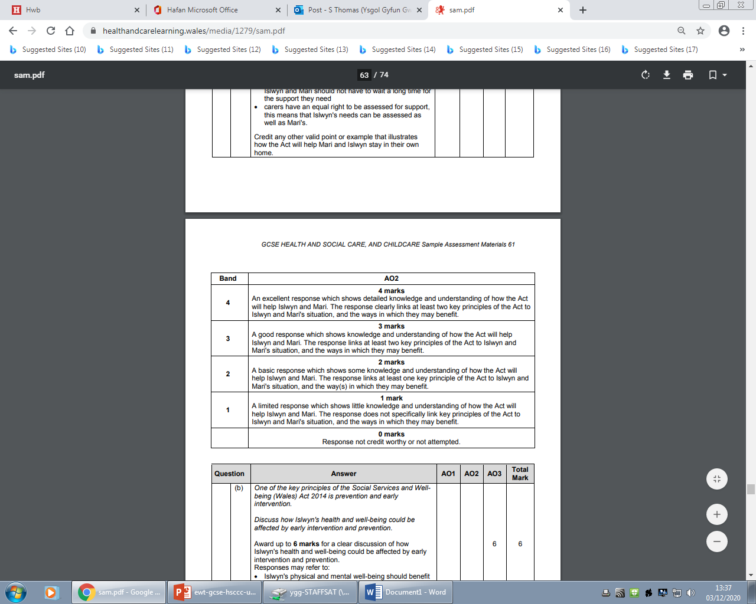
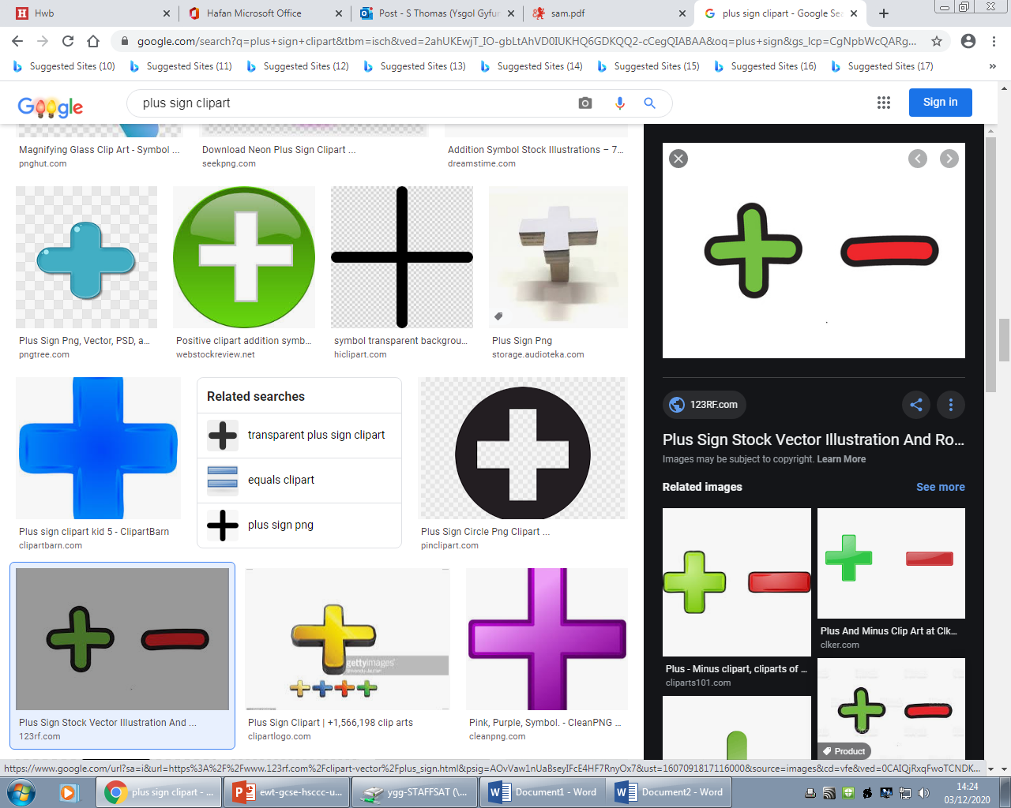
Question 6 (a) AO2 mark scheme
Notes:
There are many possible responses for this question – not all are listed here. You may have come up with an alternative idea which could also be credited – make sure you use appropriate health and social care and childcare terminology too. Notice the mark scheme describes that for the maximum 4 marks an excellent response is needed. This means a detailed knowledge and understanding of how The Social Services and Well-being Act 2014 will help Mari and Islwyn, but also include clear links to at least two key principles of the Act to the couple’s situation, and the ways in which they may benefit.
Remember the question is asking for the benefits only, not the negatives.

Slide 25
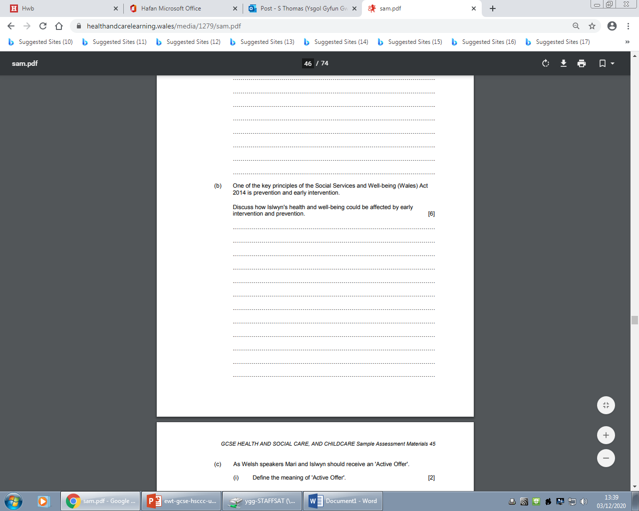
Question 6 (b) AO2
6:00
Start the clock!
Try and answer both of these questions in 6 minutes.
Notes:
This is the first time you have been asked to ‘Discuss’ on this paper, with a total of 6 marks available. Discuss here means examining the issue of how Islwyn’s health and well-being could be affected by early intervention and prevention. For the 6 marks you would be expected to do this in a detailed and structured ways, taking into account different ideas.
Remember to use the space provided as guidance and try not to use more than 6 minutes to answer.

Slide 26
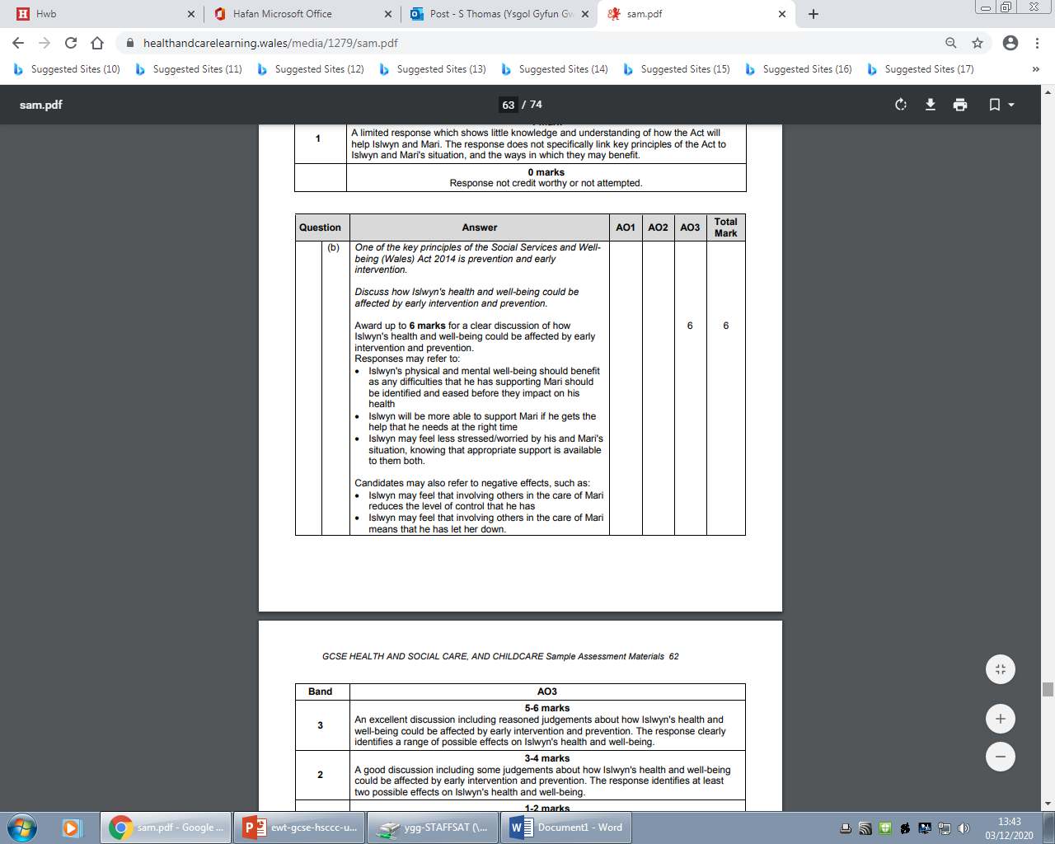
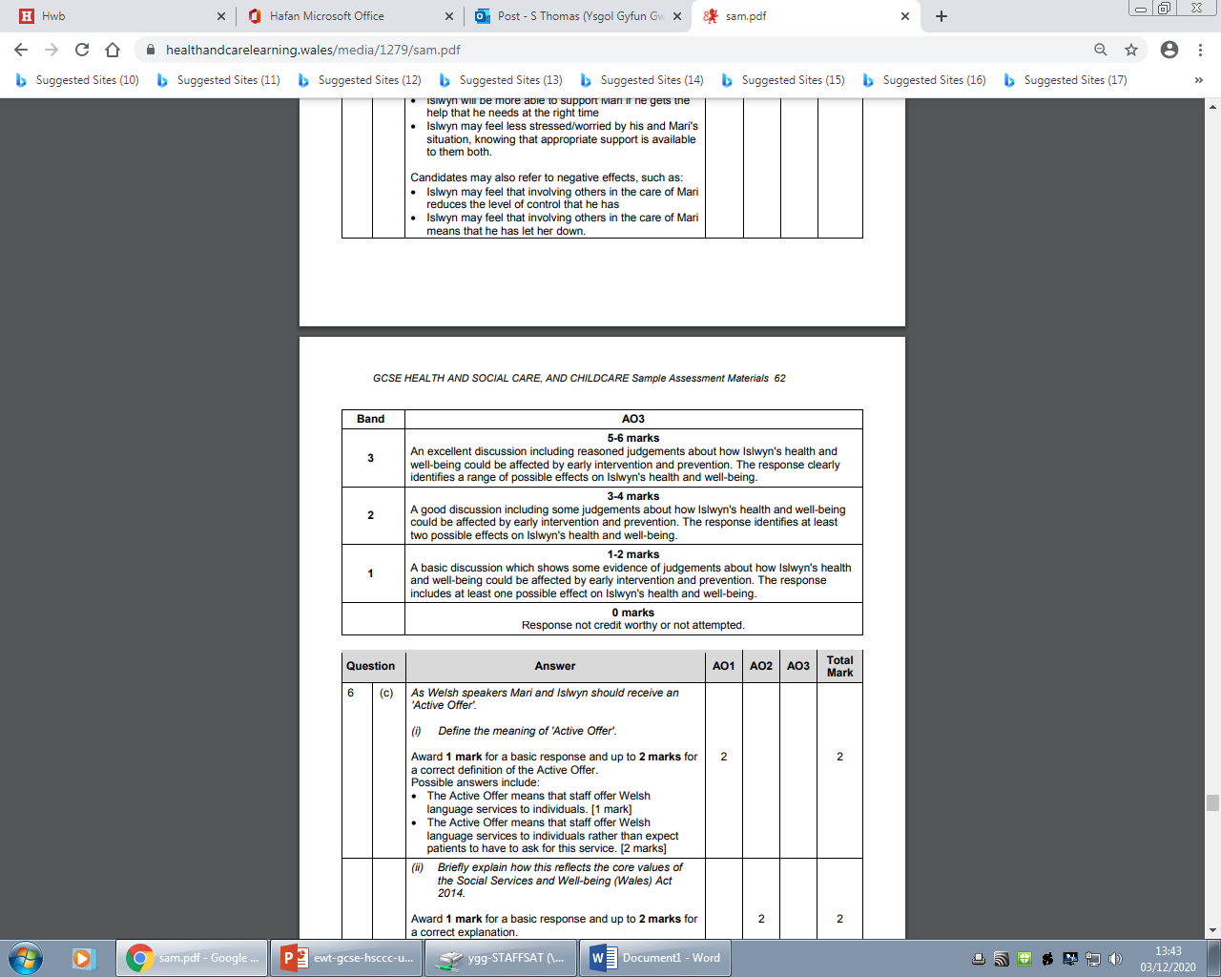
Question 6 (b) AO3 mark scheme bands
Notes:
To be in the top mark band there has to be evidence of a range of valid possible effects on Islwyn’s health and well-being – remember not to just discuss one or two. However, If you can only think of one or two possible effects, marks can still be awarded. Notice that the possible effects can be positive or negative as is shown in the mark scheme. This will give you more opportunities to answer fully.

Slide 27
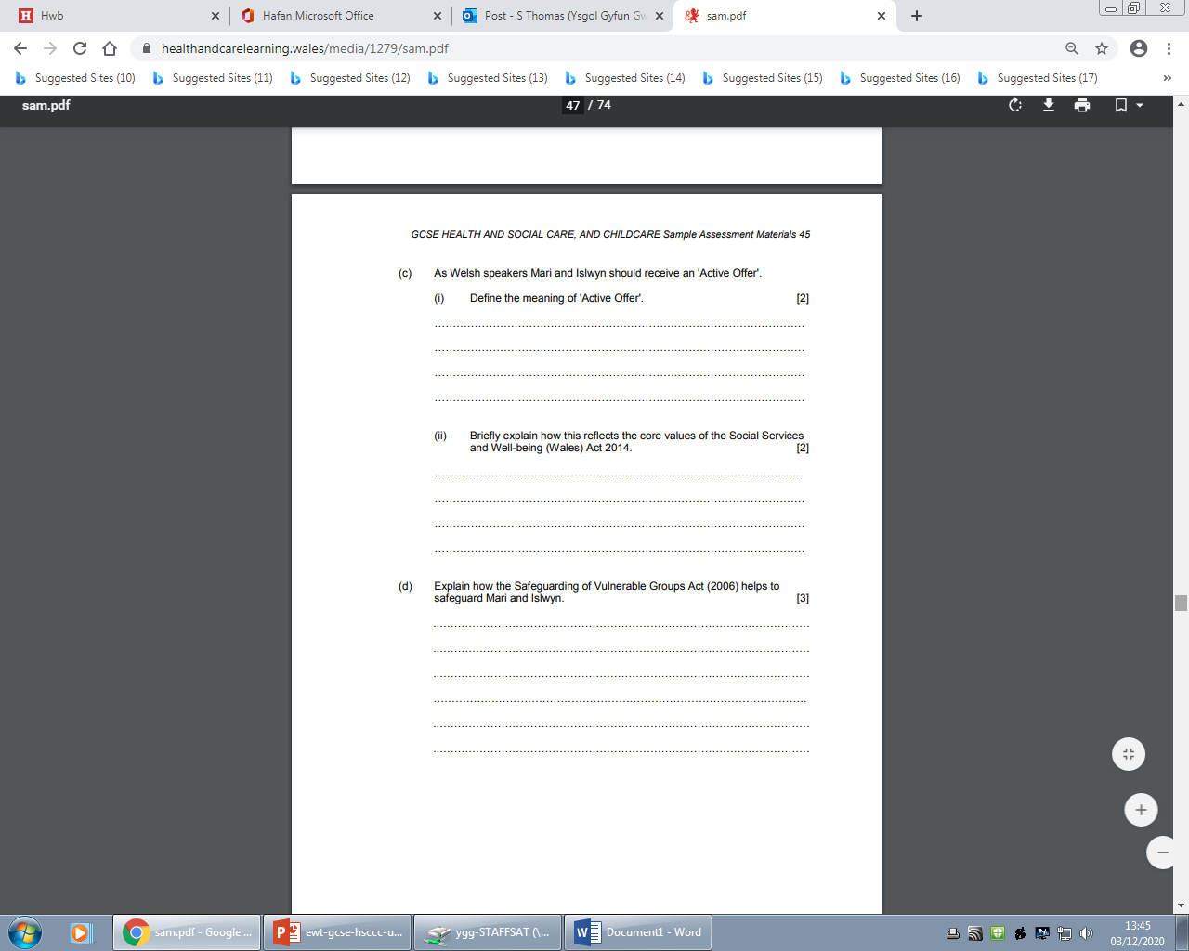
Question 6 (c) (i) AO1, (ii) AO2
4:00
Start the clock!
Try and answer this question in 4 minutes – how did you get on?
Notes:
c) As a define question, here you need to give the exact meaning of ‘Active Offer’ for a total of 2 marks.
For part (ii) it is an explain but only ‘briefly’ as there are only 2 marks allocated.
Allow yourself 4 minutes to answer both parts.

Slide 28
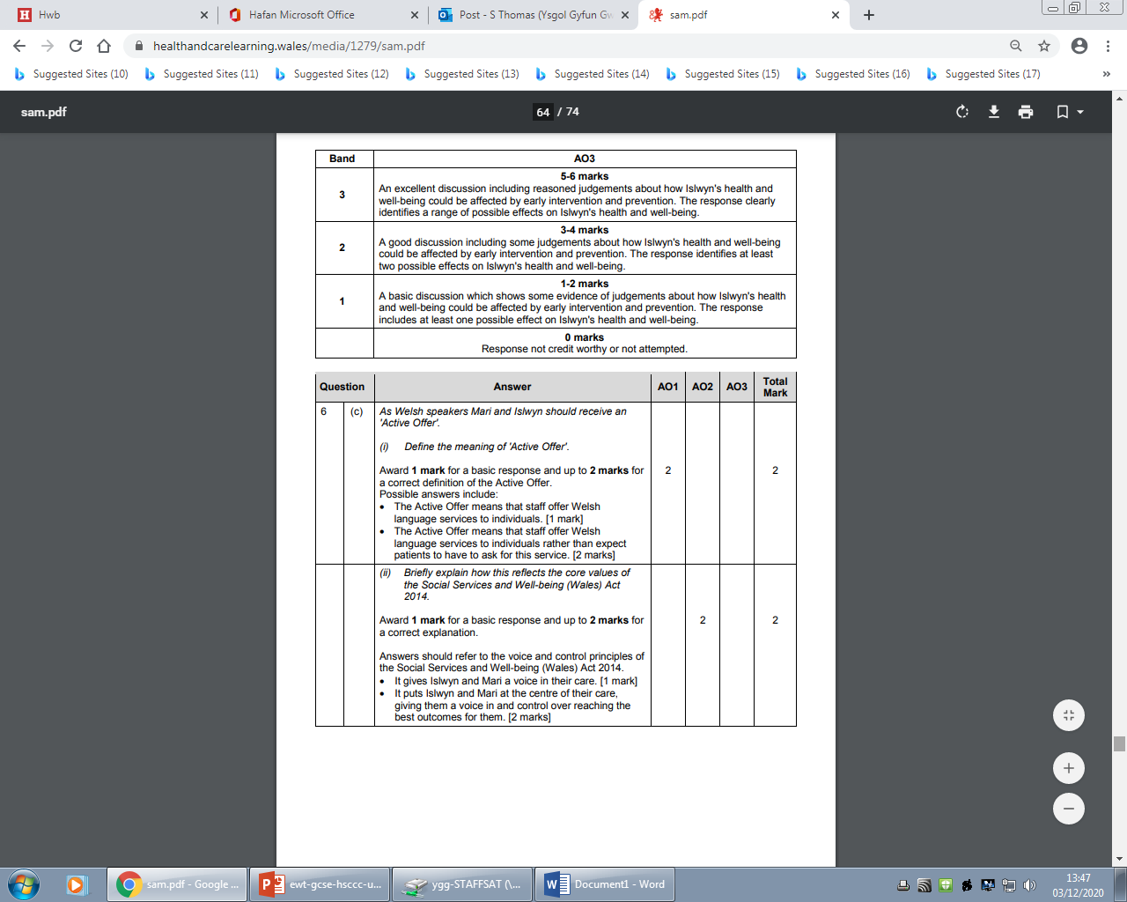
Question 6 (c) AO1/A02 mark scheme bands
Notes:
How did you get on?
Notice that you would be allocated 1 mark for a basic response to part (c ) (i) if you were not able to give a full correct definition of ‘The Active Offer’.
Part (ii) should refer to the voice and control principles of the Social Services and Well-being Act 2010. Again if you are not able to answer fully for the 2 marks, you can still gain 1 mark for a more basic response as the mark scheme states.

Slide 29
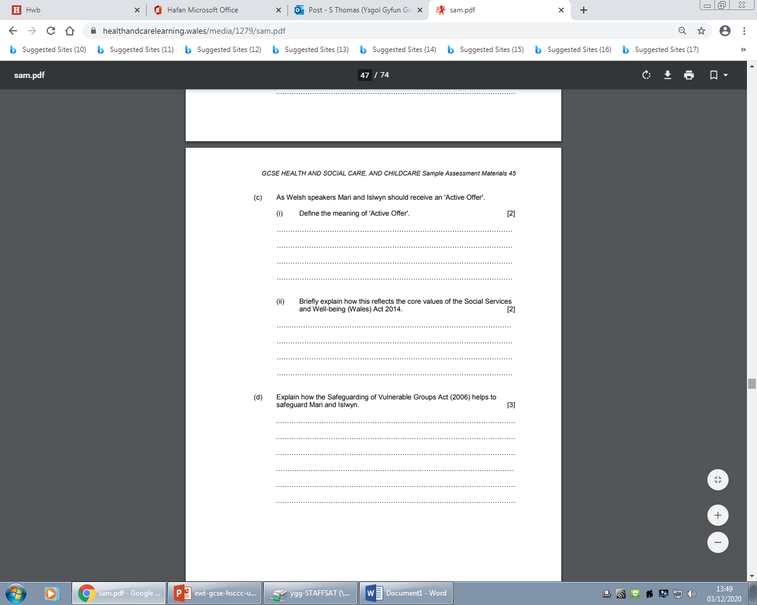
Question 6 (d) AO2
3:00
Start the clock!
Try and answer this question in 3 minutes – how did you get on?
Notes:
Another ‘explain’ question. You will be used to the ‘explain’ command word by now. Remember by using the word because whilst you are structuring your answer, it can help you think of the answer. i.e. the Safeguarding of Vulnerable Groups Act 2006 helps to safeguard Mari and Islwyn because……
Set yourself 3 minutes to answer this question and use the space provide as a guide.

Slide 30
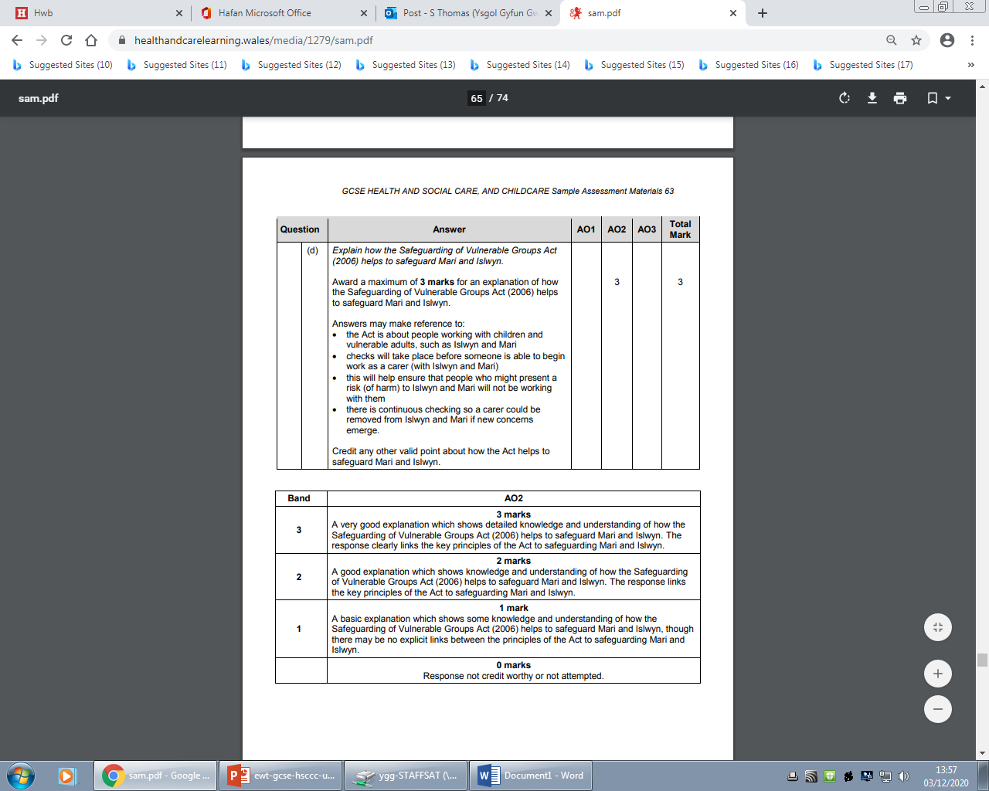
Question 6 (d) AO2 mark scheme
Notes:
How did you get on? Did you make reference to some of the points stated in the mark scheme. Remember, you could be awarded marks for other valid points about how the Act helps to safeguard Mari and Islwyn. The response must show links between the key principles of the Act to safeguarding Mari and Islwyn.

Slide 31
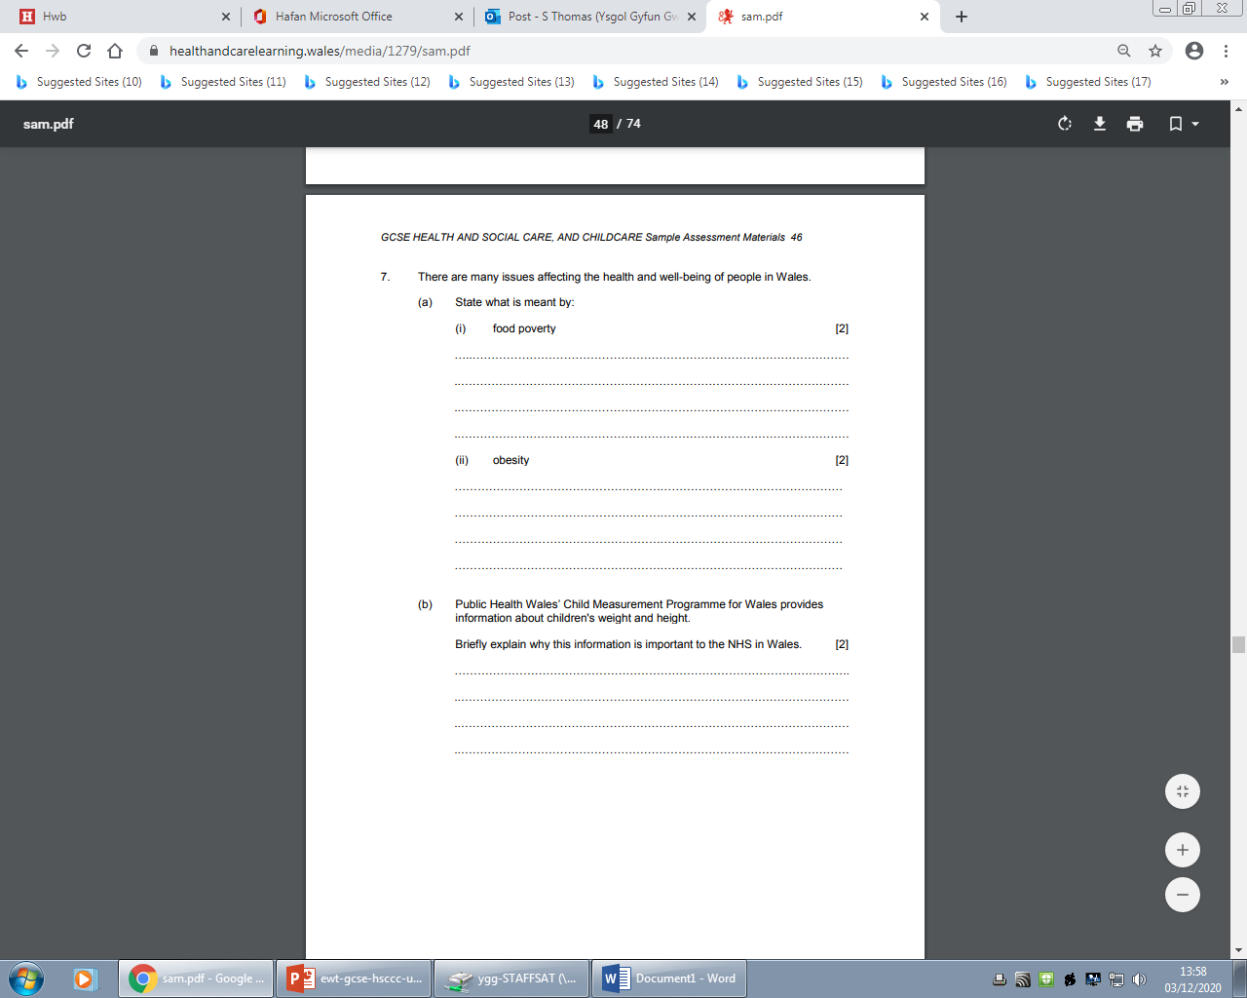
Question 7 (1) AO2
Notes:
There are only 2 questions left on the paper but you must keep up the level of concentration as 33 marks out of the 80 marks are left to answer.
Question 7 is in 4 parts, (a) (b) (c ) and (d).
Part (a) is from the contemporary issues section of the course. It asks specifically for your to state what is meant by two of these contemporary issues.
Part (b) asks you to briefly explain why the information from the Child Measurement Programme for Wales is important to the NHS in Wales.
There are 2 marks for each of these part questions. So you can time them similiarly.

Slide 32
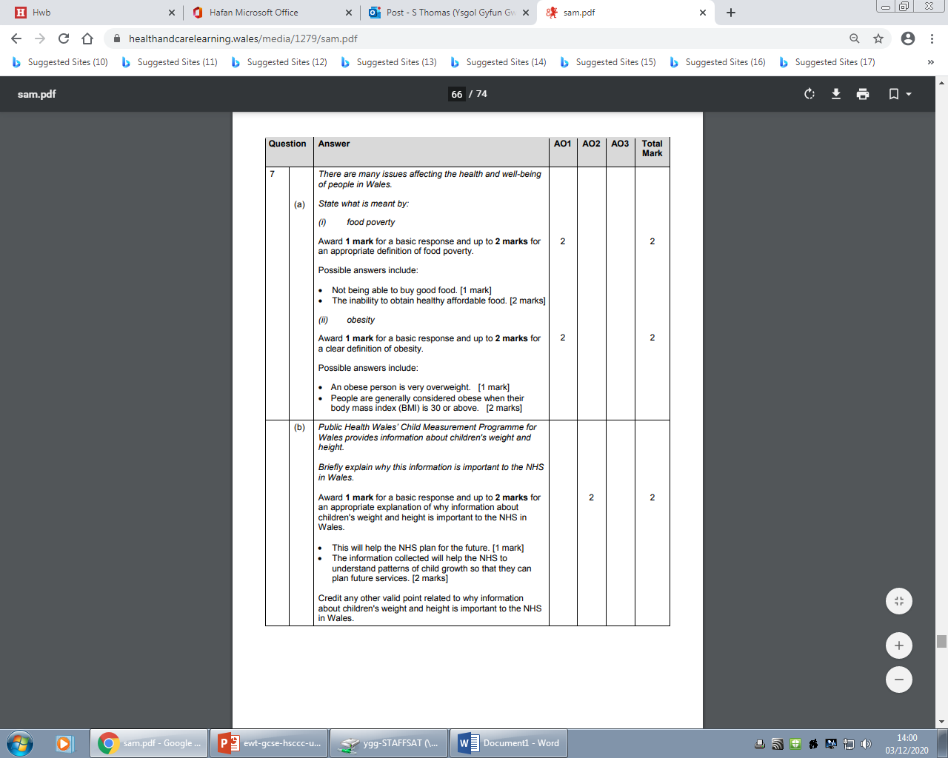
Question 7 (a) (b) A01, A02 mark scheme
Notes:
How did you get on?
The mark scheme shows the possible answers with allowance of 1 mark instead of the 2 marks for a more basic answer.

Slide 33
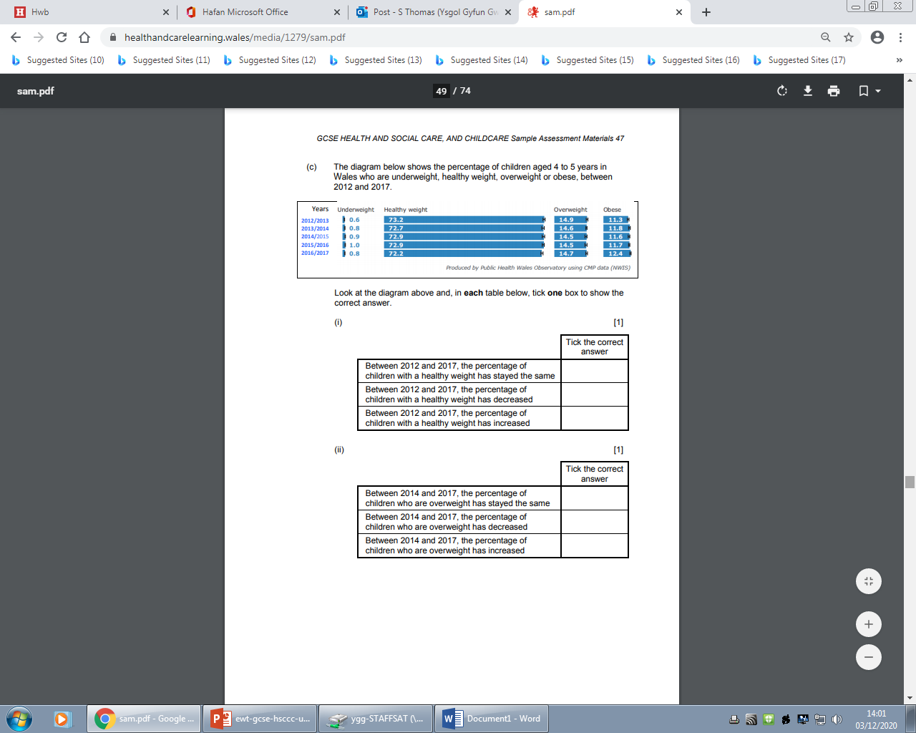
Question 7 (c) (i) A01 (ii) A01
2:00
Start the clock!
Try and answer this question in 2 minutes – how did you get on?
Notes:
For part (c ) you will be expected to read the details on the image before ticking which statement is correct from the choice of three. Work carefully but at the same time you should only allow yourself 2 minutes to answer.

Slide 34
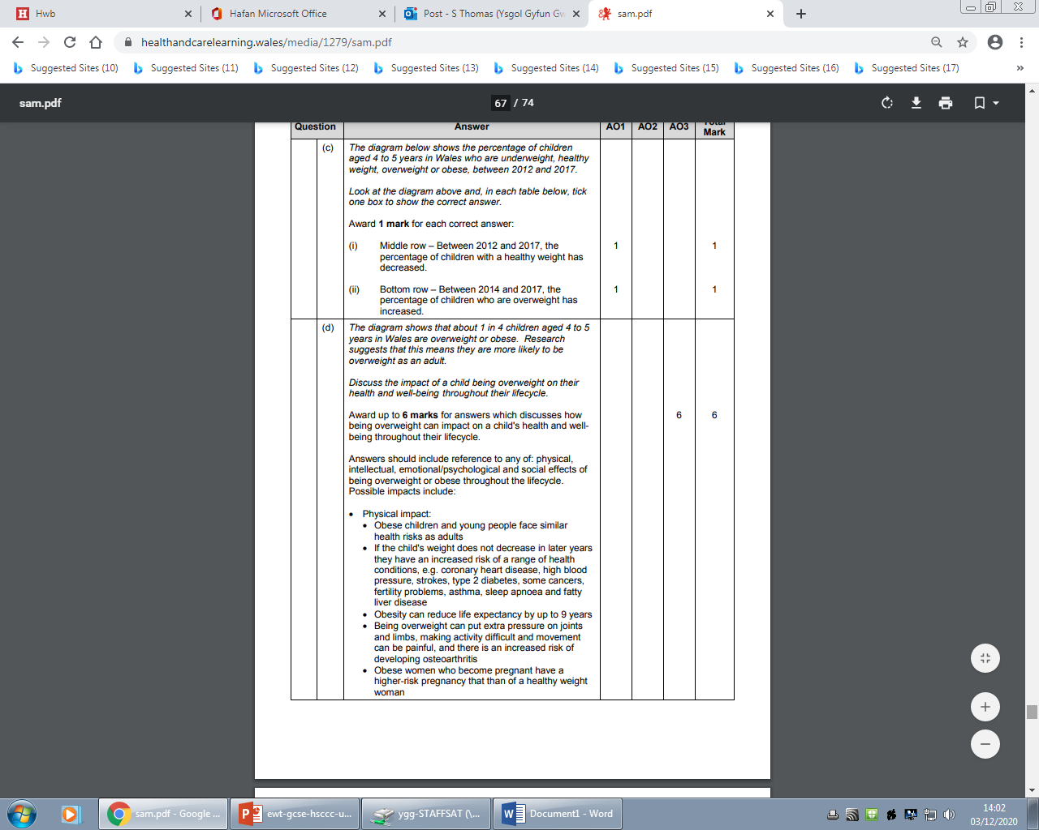
Question 7 (c) AO1 mark scheme
Notes:
There are only two possible correct answers, one to each box here as stated in the mark scheme. These are easy marks as you do not have to recall any information to answer.

Slide 35
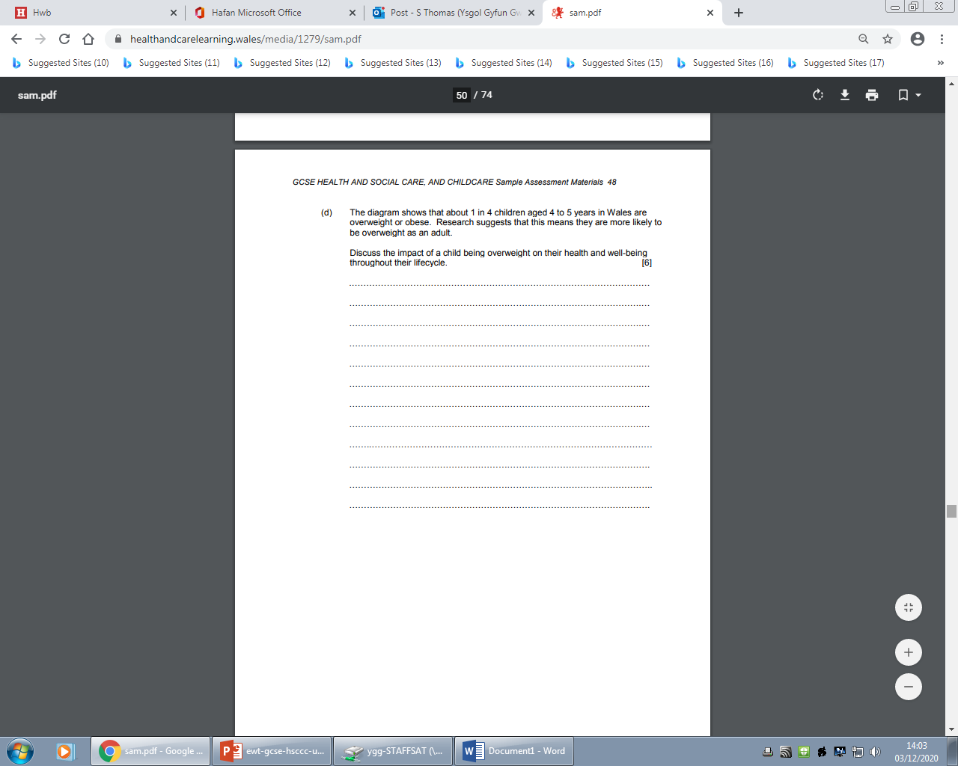
Question 7 (d) AO3 mark scheme bands
6:00
Start the clock!
Try and answer this question in 6 minutes – how did you get on?
Notes:
The last part to question 7 is another Discuss question. Remember that ‘Discuss’ means examining an issue in detail and in a structured was, taking into accounts different ideas. Start the clock and try this question, but allow yourself 6 minutes. You will be quite used by now to aiming for filling the space provided as it is there as a guide for you.

Slide 36
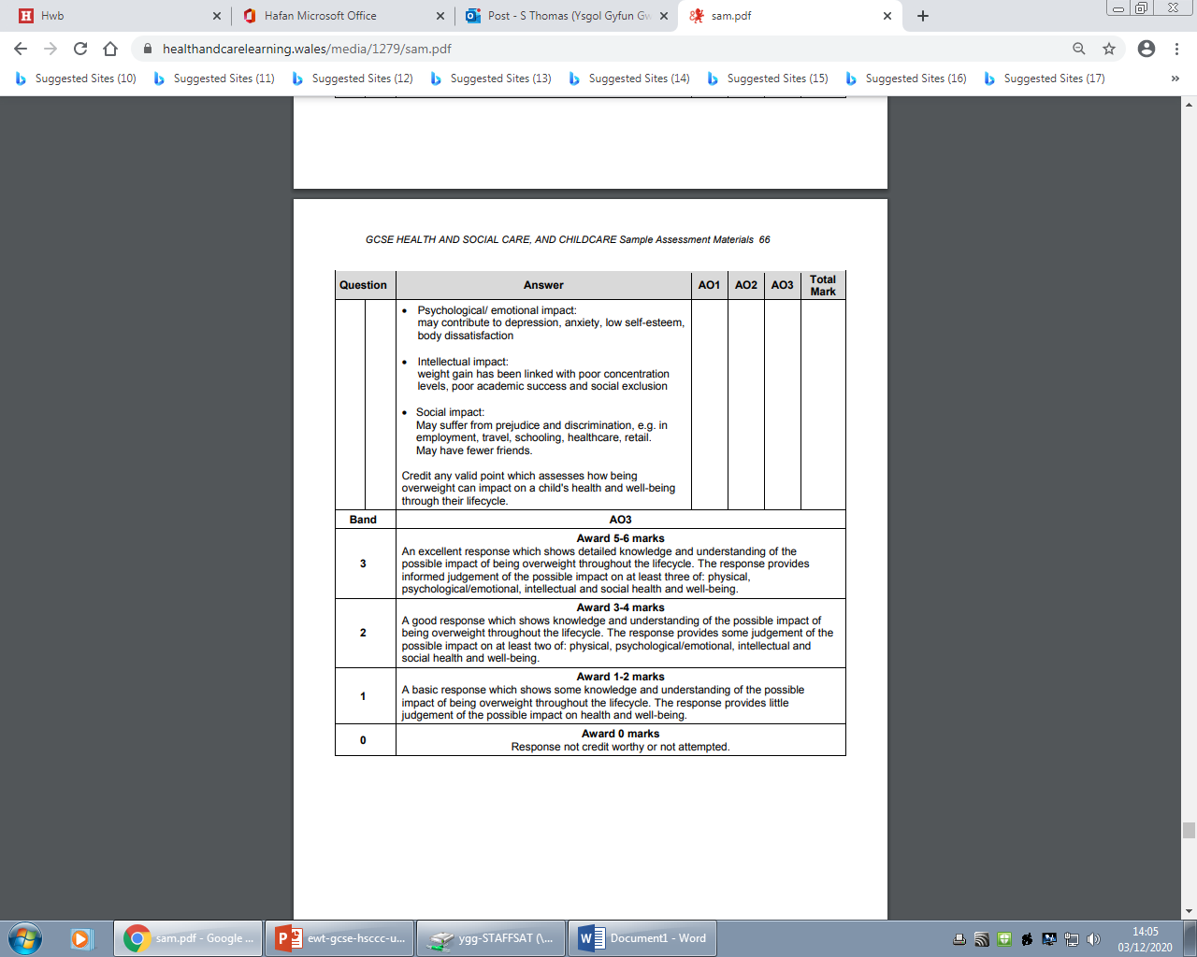
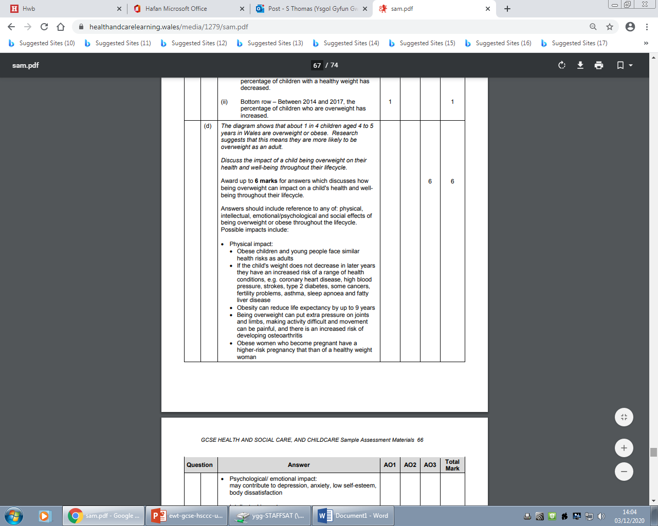
Question 7 (d) AO3 mark scheme
Notes:
As you can see from the mark scheme - these are possible responses. You must provide more than a list and include some detail – plan your response to make sure you include all your ideas, the examiner would expect a good answer to include a range of impacts, including the physical, psychological/emotional, intellectual and social. For a mark band 3 response you would need an excellent response showing detailed knowledge and understanding of the possible impact that being overweight could have throughout the lifecycle, including at least three of: physical, psychological/emotional. Intellectual and social aspects.

Slide 37
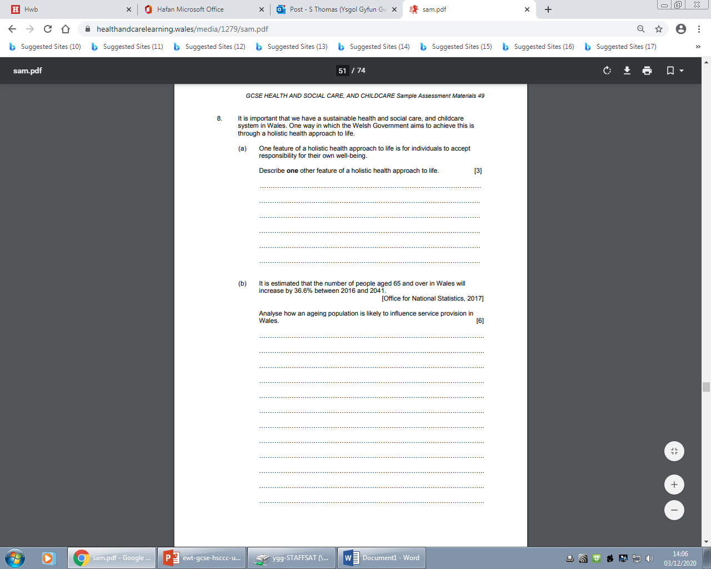
Question 8 (a) AO1
3:00
Start the clock!
Try and answer these questions in 3 minutes – how did you get on?
Notes:
For this last question there are 3 parts with a 10 mark question for the third part so balance your remaining time effectively.
For a) the command here is describe and there are three marks available in total – it does not ask for a list, so you do need to give a bit more detail than just a list.

Slide 38
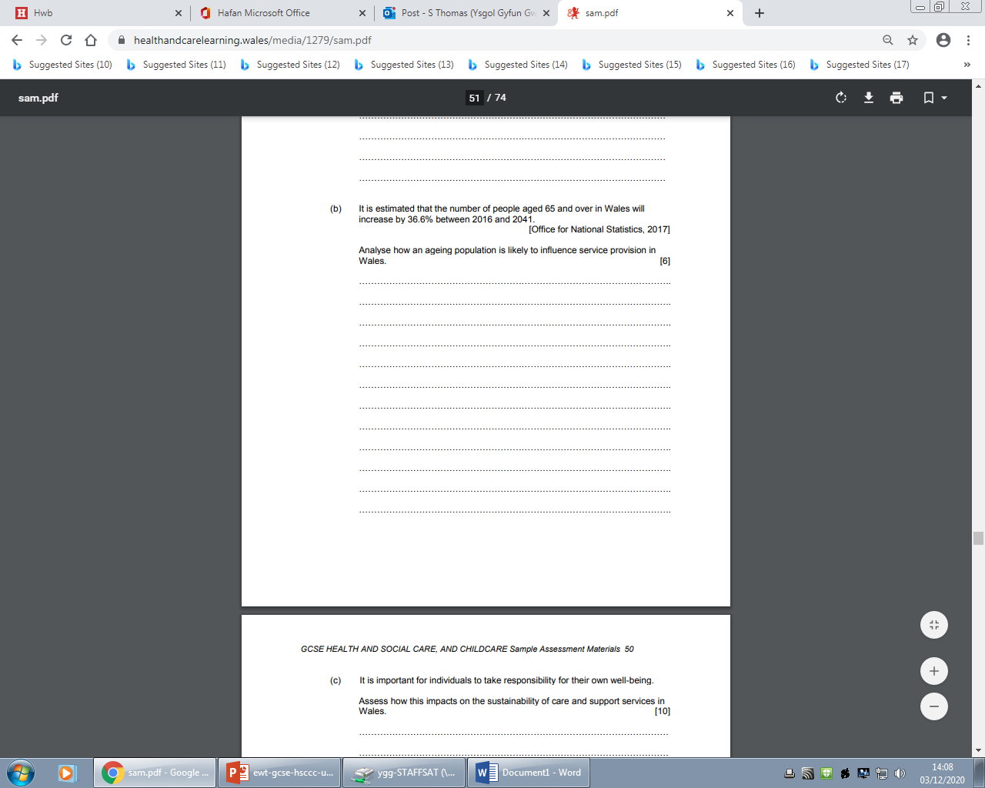
Question 8 (b), AO1
6:00
Start the clock!
Try and answer this question in 6 minutes – how did you get on?
Notes:
Part (b) is the first and only ‘analyse’ question in this paper. Analyse is the command word and asks you to examine the issue of how the ageing population is likely to influence service provision in Wales. This needs to include an explanation and interpretation for the maximum marks. An Analyse questions is a more advanced examination skill and the reason it is towards the latter part of the paper.
Analysing goes beyond explaining. However, as the mark scheme suggests in the next slide up to 3 marks can be awarded for a good response without analyses if you feel you are unable to analyse.
Allow yourself 6 minutes and as with the rest of the paper, remind yourself that the lines provided are an exact guidance for the marks awarded and are there to help you.

Slide 39
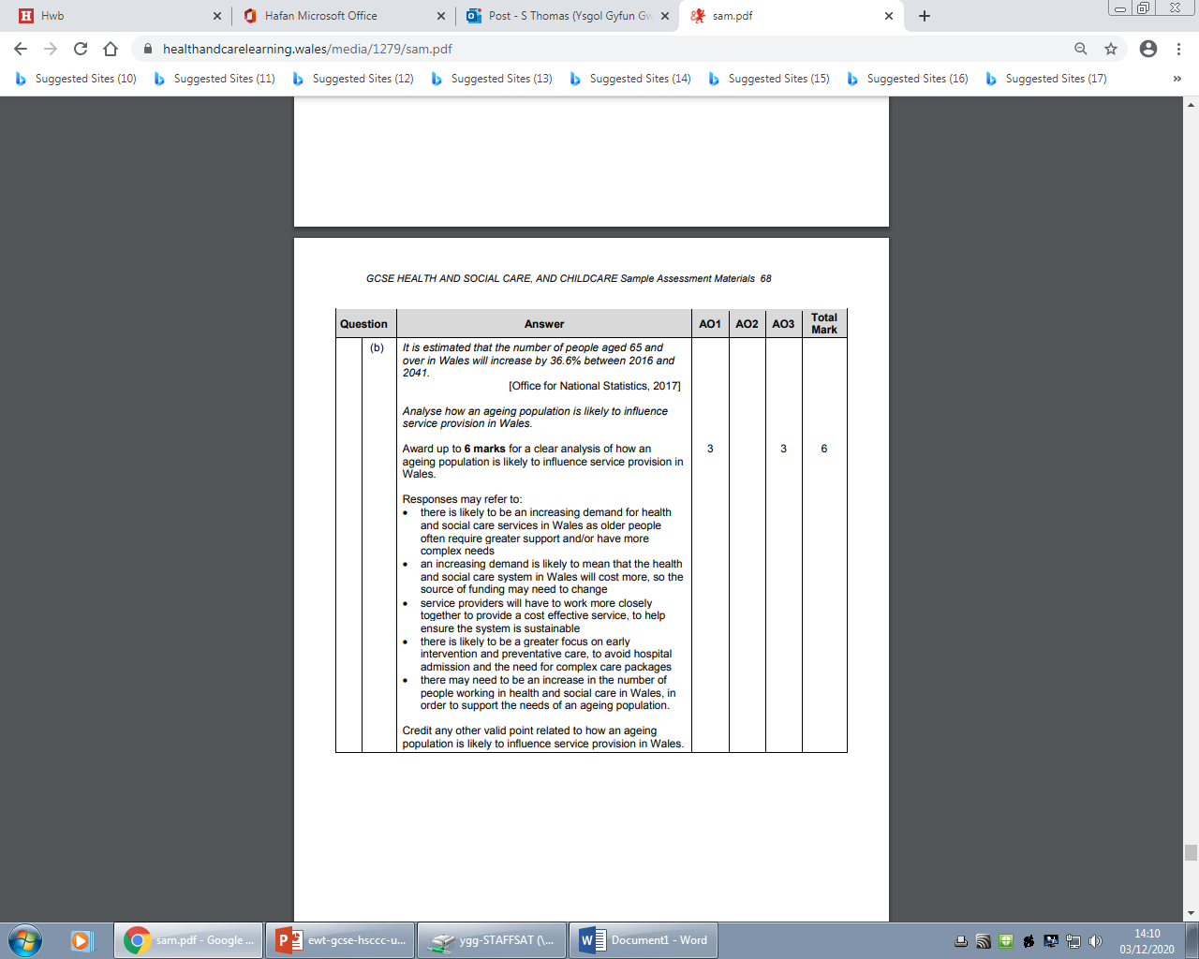
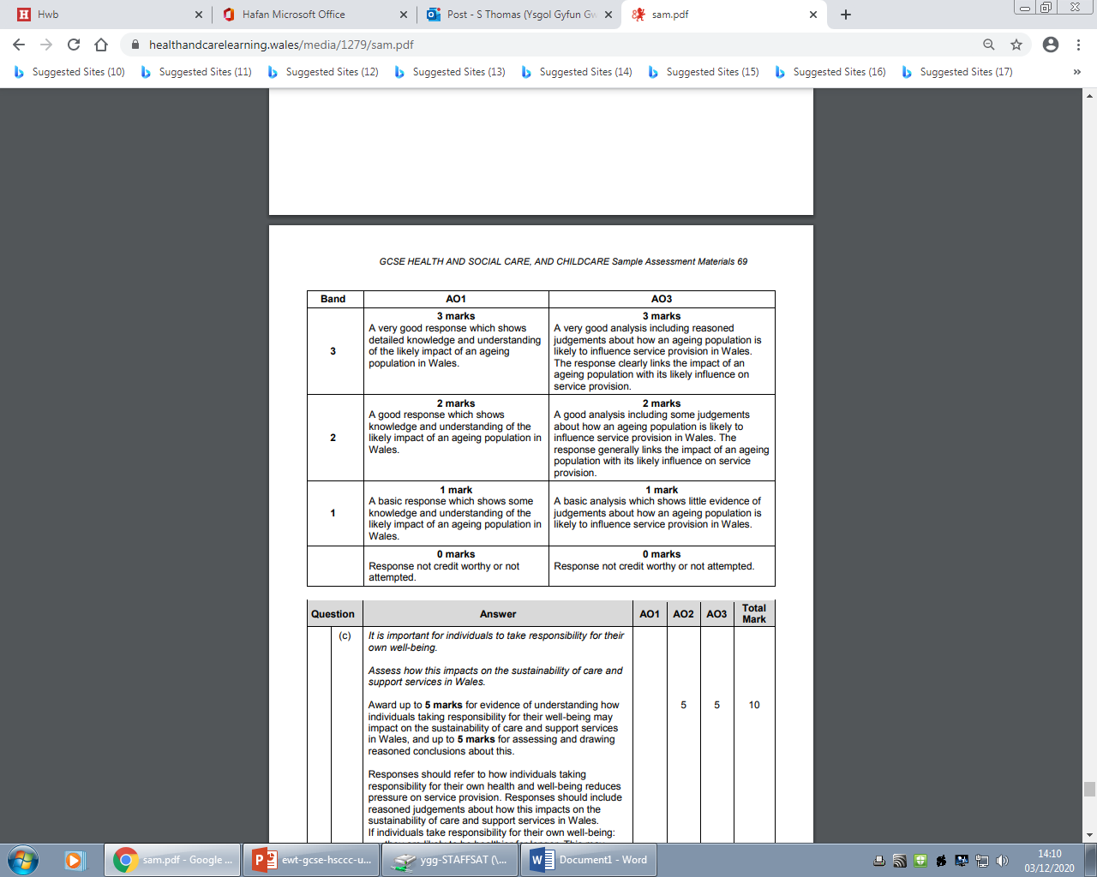
Question 8 (b) AO1 mark scheme bands
Notes:
As you can see from the mark scheme, you can be awarded up to 3 marks for a good response without being able to analyse and make judgements. You culd even answer parts of this question through general knowledge of the contemporary issue of the Ageing population.

Slide 40

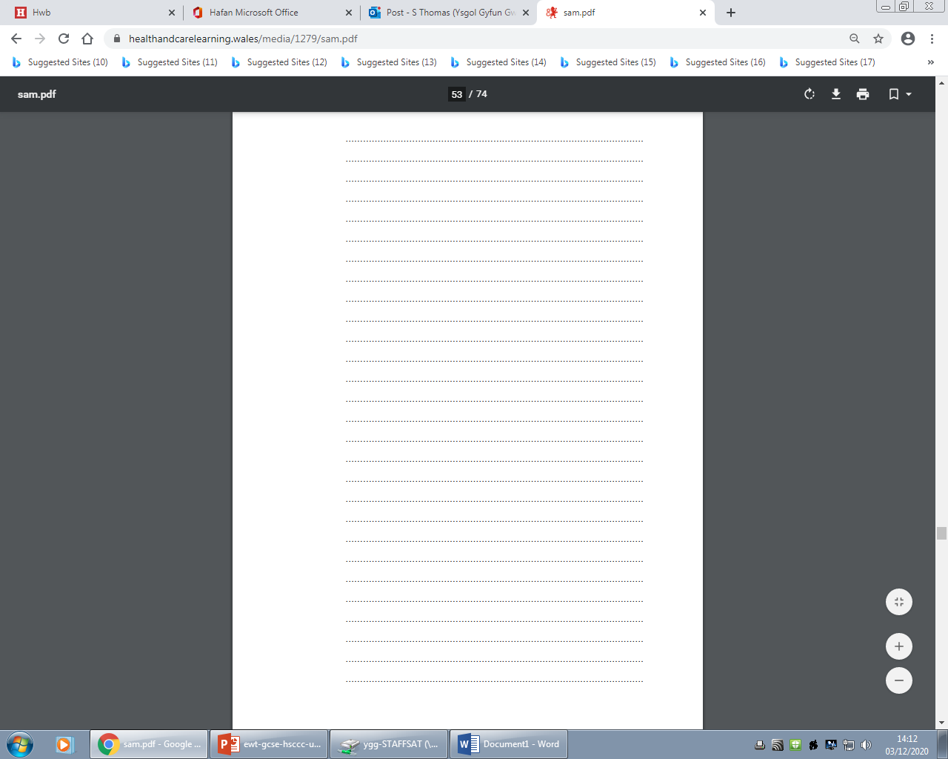
Question 8 (c), AO110
10:00
Notes:
Underline the command verb – assess before starting.
As for question 8 part (b) Assess is a more advanced examination skill and the last question on all the Health and Social Care, and Childcare GCSE papers will be extended responses. Assess asks you to make an informed judgement on how individuals taking more responsibility for their own health and well-being impacts the sustainability and support services in Wales. You will also consider several options or arguments and weigh them up so as to come to a conclusion about the impact.
You are at the end of the paper but will need to go over the paper as a whole quickly if possible before finishing, therefore don’t allow yourself much more than 10 minutes for this question.

Slide 41
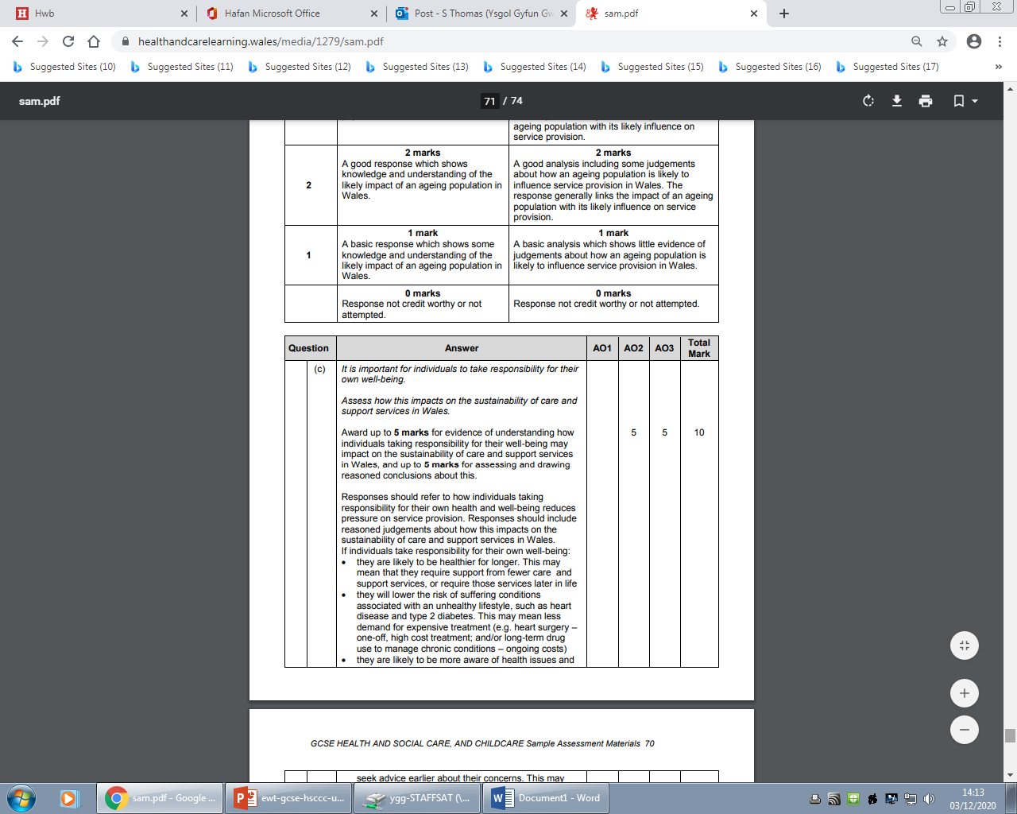
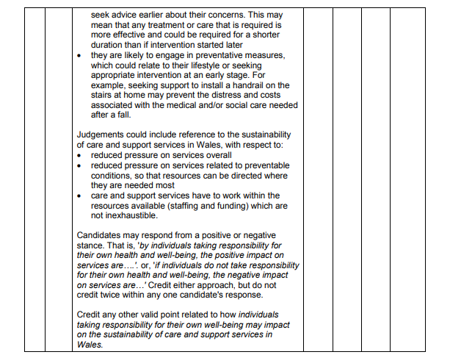
Question 8 (c) AO1 mark scheme
Notes:
The mark scheme will show a wide range of possible responses. As you can see this is split into firstly, the understanding of how individuals taking responsibility for their well-being may impact on the sustainability of care and support services in Wales . Then secondly the assessing and drawing of reasoned conclusions i.e. the judgements.

Slide 42
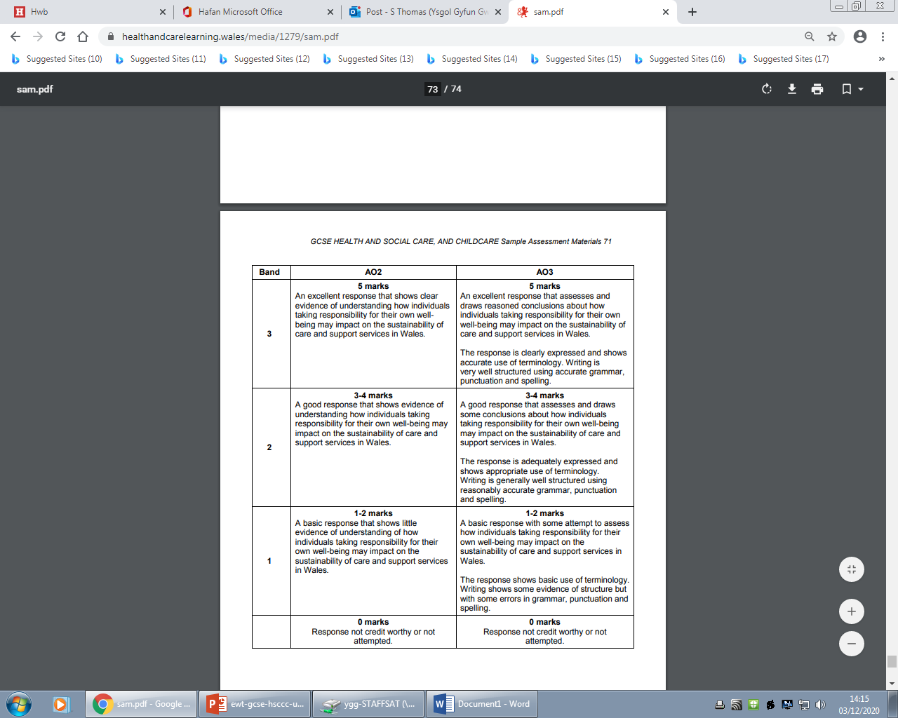
Question 8 (c) AO2/A03 mark scheme bands
Notes:
The mark scheme shows the two parts within this question with up to 5 marks being available for the understanding and another 5 marks for assessing.

Slide 43
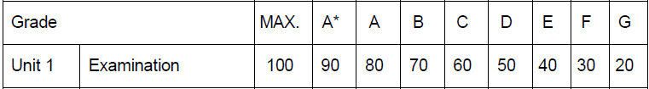
How did you do?
Raw mark grade boundaries for this unit are not yet available.
The Uniform Mark Scale (UMS) is used as a device for reporting, recording and aggregating your unit assessment outcomes. The UMS is used so that you and others who achieve the same standard will have the same uniform mark, irrespective of when you take the unit.
Uniform marks for this unit correspond to unit grades as follows:
Grade
Unit 3
Exam
Notes:
As this unit has not yet been sat, it is not possible for us to provide you with any information in relation to raw mark grade boundaries.
The UMS as listed above may be useful as a guide for how you have done in this assessment.

Slide 44


Any questions?
Do you have any further questions about this exam?
If so, write them on a post-it note and stick it to the front of your paper to give to your teacher.
Notes:
If you have any questions about this exam, you might perhaps like to write them down and give them to your teacher.

