Slide 1

Online Exam Review
Level 3 Health and Social Care: Principles and Contexts
Unit 2: Factors affecting individuals’ growth and development across the lifespan, and how this impacts on outcomes, care and support needs (May 2022)

Slide 2
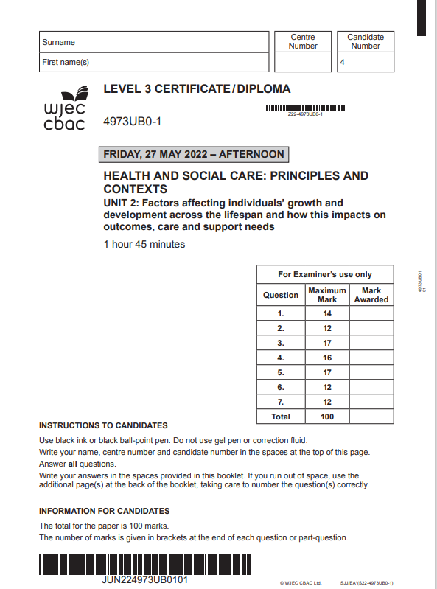

Unit 2: Factors affecting individuals’ growth and development across the lifespan, and how this impacts on outcomes, care and support needs
Online examination review (OER)
Questions selected in this OER form part of the new specification content from September 2022.

Slide 3
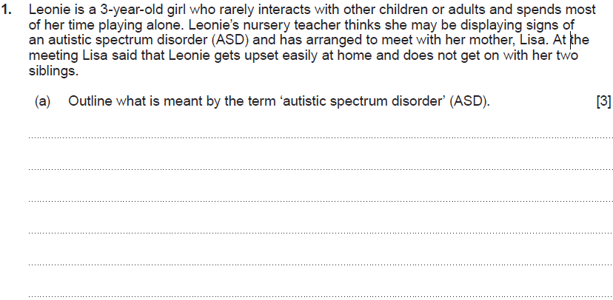
Question 1 (a)

Slide 4
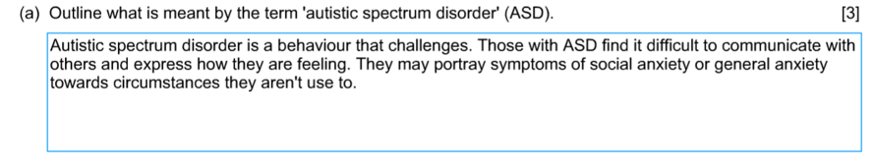
Question 1 (a) Candidate answer

Slide 5
Question 1 (a) Candidate answer with examiner’s comments
3 marks awarded
Answers the question fully, referring to a behaviour that challenges. It identifies difficulty with communication and expressing feelings, along with symptoms of social anxiety.

Slide 6
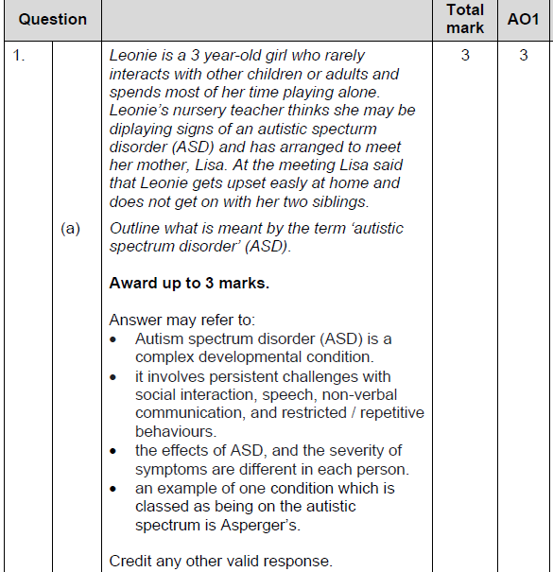
Question 1 (a) mark scheme

Slide 7
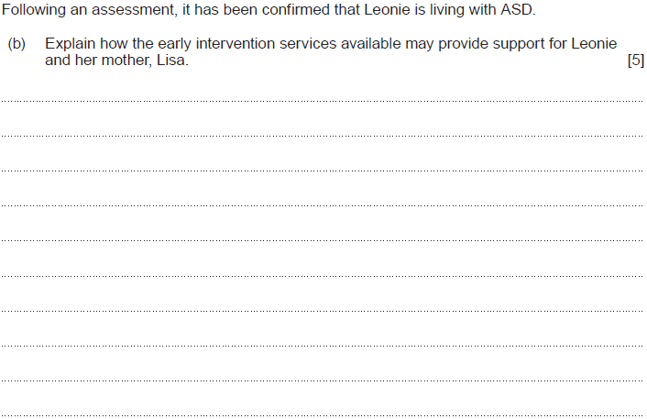
Question 1 (b)

Slide 8
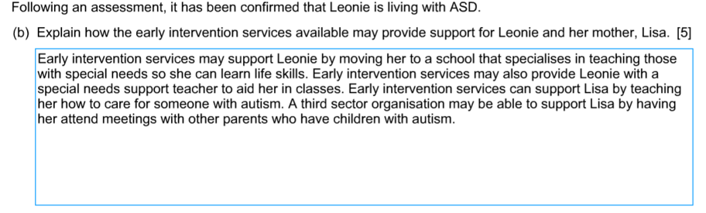
Question 1 (b) Candidate 1 answer

Slide 9
Question 1 (b) Candidate 1 answer with examiner’s comments
3 marks awarded – Band 2
A good explanation which shows detailed knowledge and understanding of how the early intervention services may provide support for Leoni and her mother Lisa.
The question is correctly understood, and the candidate has identified with an explanation a range of intervention services that would support both Leoni and her mother. They have explained the role of special school, support for Lisa and the role of third sector organisations in providing support such as meeting other parents with autism. Answers could further refer to Health Visiting Service, GP NHS Service, allied healthcare professionals and Flying Start programme.

Slide 10
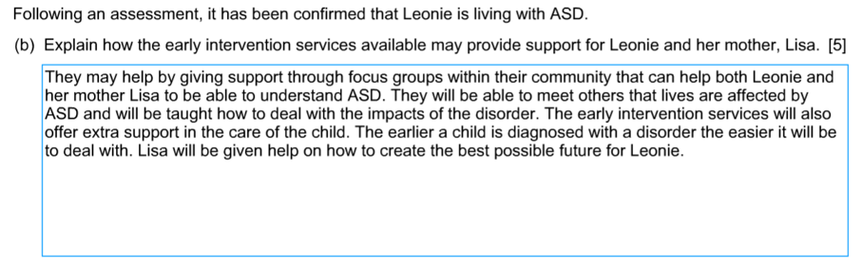
Question 1 (b) Candidate 2 answer

Slide 11
Question 1 (b) Candidate 2 answer with examiner’s comments
2 marks awarded – Band 1
A basic explanation which shows some knowledge and understanding of how the early intervention services may provide support for Leoni and her mother Lisa.
The question is correctly understood, and the candidate has identified briefly support for both Leoni and her mother but failed to identify individual services and explain these fully. Answer could further refer to Health Visiting Service, third sector organisations, GP NHS Service, allied healthcare professionals and Flying Start programme.

Slide 12
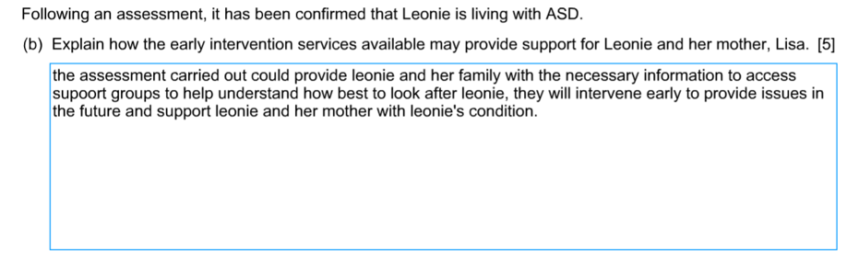
Question 1 (b) Candidate 3 answer

Slide 13
Question 1 (b) Candidate 3 answer with examiner’s comments
1 mark awarded – Band 1
A basic explanation which shows some knowledge and understanding of how the early intervention services may provide support for Leoni and her mother Lisa. Response may not refer to Leoni and her mother Lisa.
The question is correctly understood, and the candidate has identified briefly support for both Leoni and her mother by one intervention service. Answer could further refer to Health Visiting Service, third sector organisations, GP NHS Service, allied healthcare professionals and Flying Start programme.

Slide 14
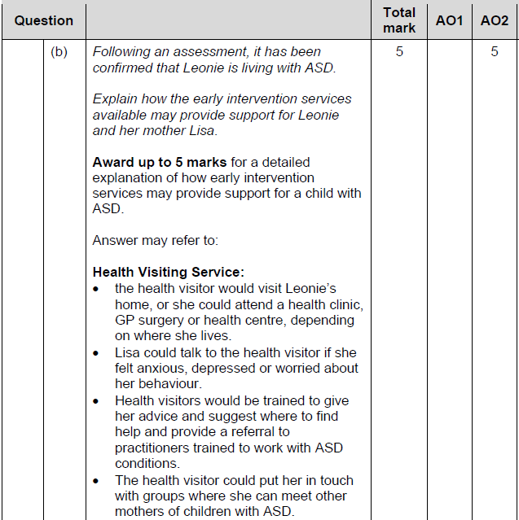
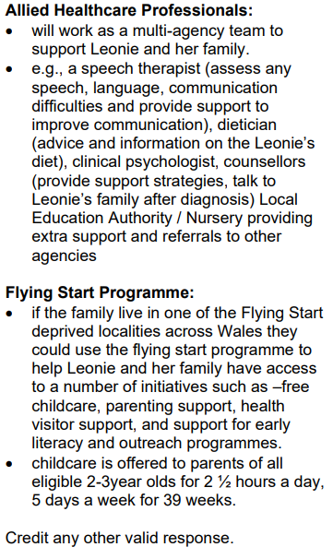
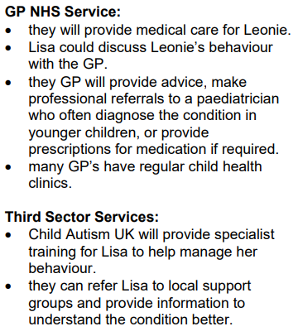
Question 1 (b) mark scheme

Slide 15
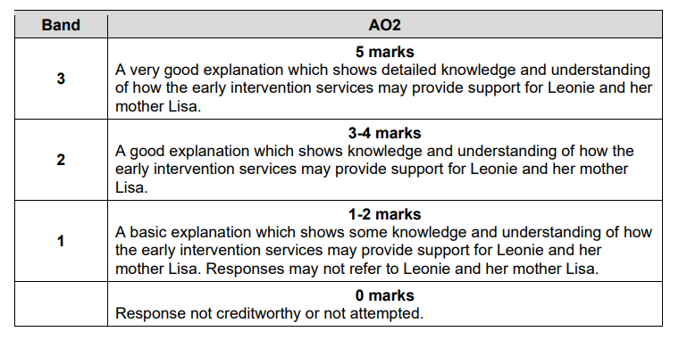
Question 1 (b) mark scheme

Slide 16
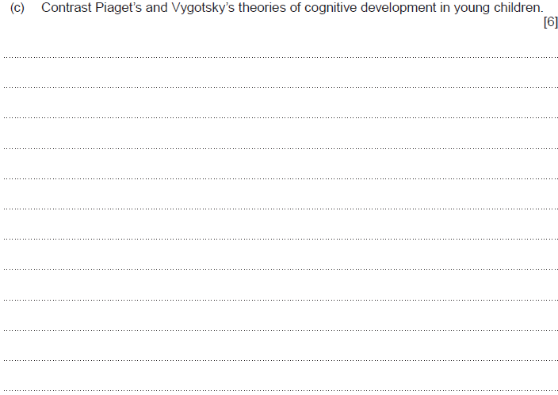
Question 1 (c)

Slide 17
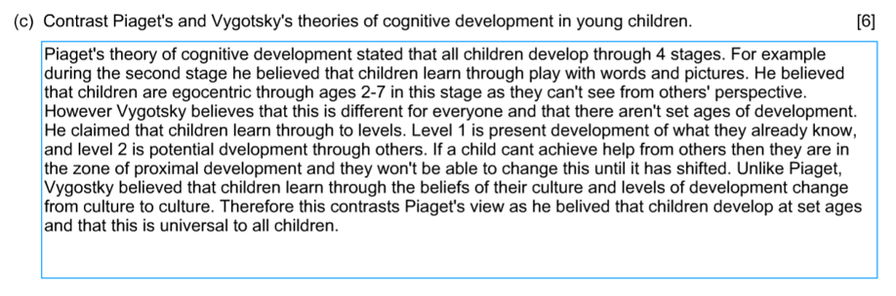
Question 1 (c) Candidate 1 answer

Slide 18
Question 1 (c) Candidate 1 answer with examiner’s comments
5 marks awarded – Band 3
A very good response which contrasts Piaget’s and Vygotsky’s theories of cognitive development in young children, demonstrating detailed knowledge and understanding of both theories.
The candidate has referred correctly to both theories, understood and applied the command verb “contrast” in their answer. It shows a knowledge of both theories and has provided a contrast throughout. Answers could refer to Vygotsky’s scaffolding to support a child, use of a more knowledgeable other, and stress the approach relying on social interaction.

Slide 19
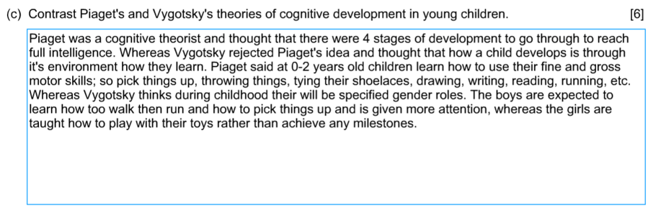
Question 1 (c) Candidate 2 answer

Slide 20
Question 1 (c) Candidate 2 answer with examiner’s comments
3 marks awarded – Band 2
A good response which contrasts Piaget’s and Vygotsky’s theories of cognitive development in young children, demonstrating knowledge and understanding of both theories.
The candidate has referred correctly to both theories, understood and applied the command verb “contrast” in their answer. It shows a knowledge of both theories and has provided a contrast in places. Answers could refer to Vygotsky’s zone of proximal development, scaffolding to support a child, use of a more knowledgeable other, and stress the approach relying on social and cultural interactions.

Slide 21
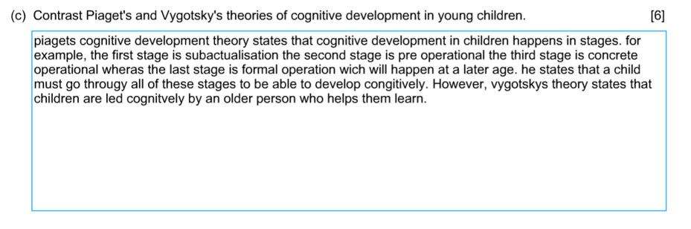
Question 1 (c) Candidate 3 answer

Slide 22
Question 1 (c) Candidate 3 answer with examiner’s comments
2 marks awarded – Band 1
A basic response which shows no contrast between Piaget’s and Vygotsky’s theories of cognitive development in young children, demonstrating some knowledge and understanding of both theories.
The candidate's response is limited as it refers mainly to Piaget’s theory, identifying the stages correctly. A contrast is then referred to regarding Vygotsky and his approach relying on a more knowledgeable other. Answers could refer to Vygotsky’s zone of proximal development, scaffolding to support a child, and stress the approach relying on social and cultural interactions. It could refer in more depth to Piaget's repeated experiences and schema in contrast to Vygotsky relying on social and cultural interactions.

Slide 23
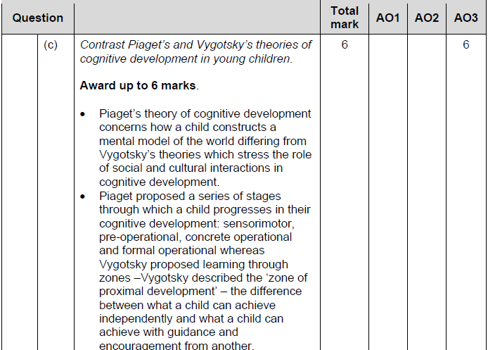
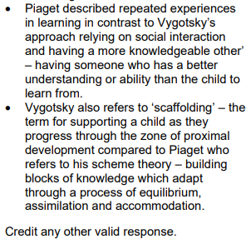
Question 1 (c) mark scheme

Slide 24
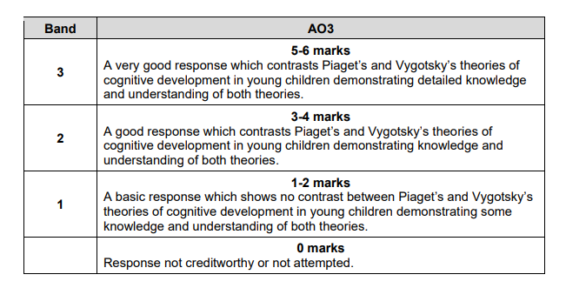
Question 1 (c) mark scheme

Slide 25
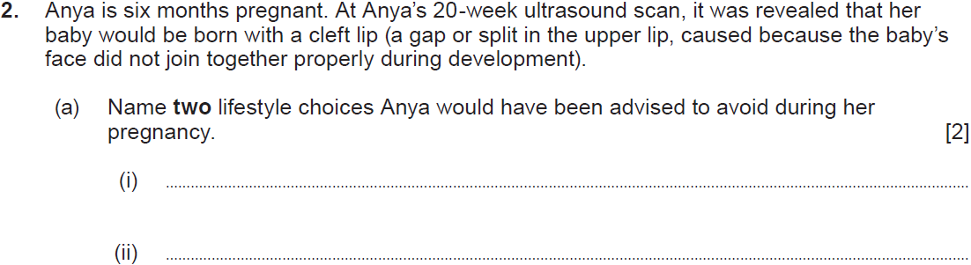
Question 2 (a)

Slide 26
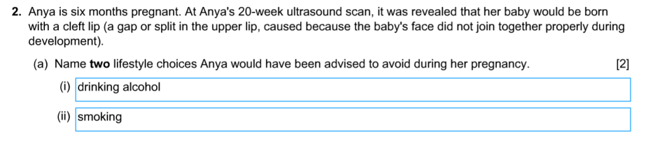
Question 2 (a) Candidate answer

Slide 27
Question 2 (a) Candidate answer with examiner’s comments
2 marks awarded
The candidate named two correct lifestyle choices Anaya would have been advised to avoid – drinking alcohol and smoking. Further answers may have included drug misuse, any food carrying a risk of Listeria, eating raw or undercooked meat and eggs, along with any relevant situation causing high blood pressure.

Slide 28
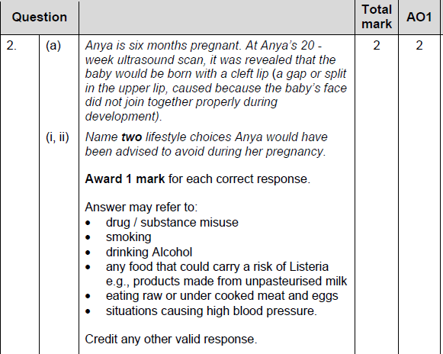
Question 2 (a) mark scheme

Slide 29
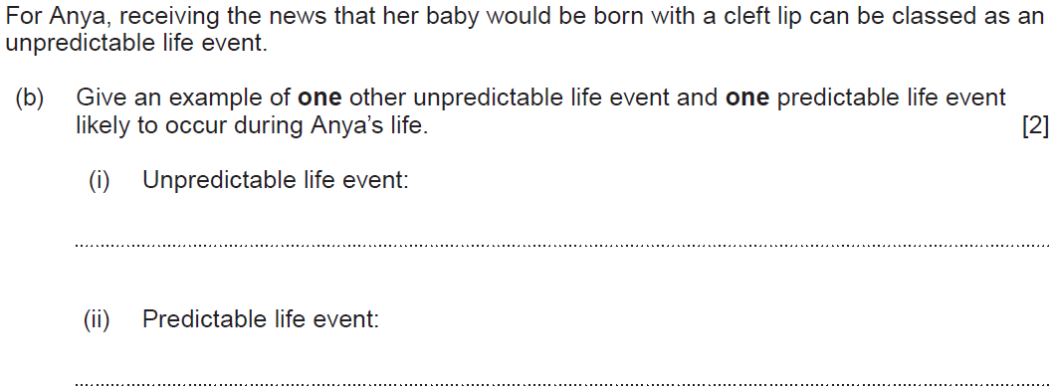
Question 2 (b)

Slide 30
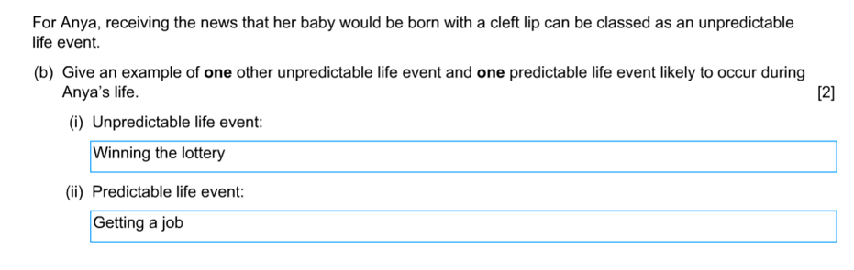
Question 2 (b) Candidate answer

Slide 31
Question 2 (b) Candidate answer with examiner’s comments
2 marks awarded
The candidate named correctly one other unpredictable and one predictable life event likely to occur during Anya’s life. Further unpredictable events may include accidents, getting a serious illness, breakdown of a relationship and redundancy. Predictable events may include getting married, settling down with a partner, moving into your own home, becoming a parent, starting work.

Slide 32
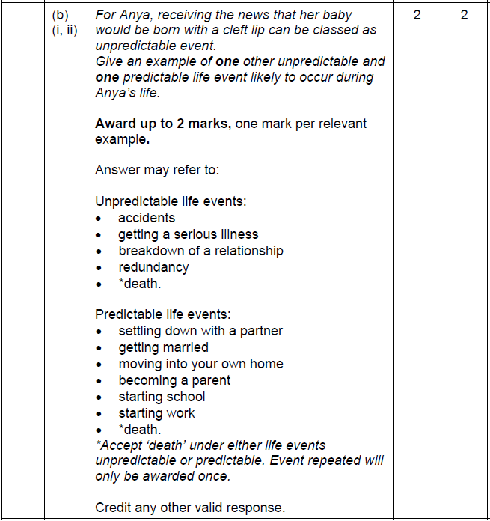
Question 2 (b) mark scheme

Slide 33
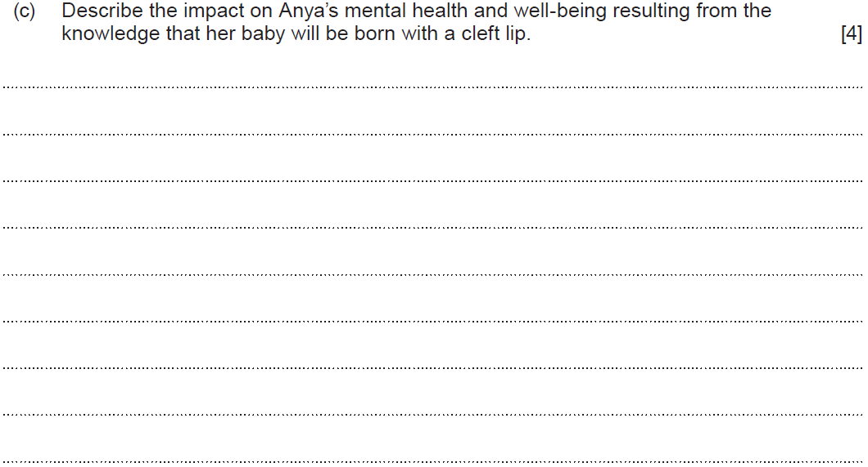
Question 2 (c)

Slide 34
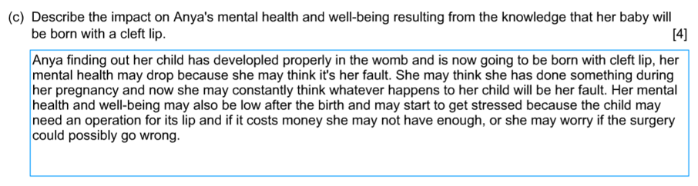
Question 2 (c) Candidate 1 answer

Slide 35
Question 2 (c) Candidate 1 answer with examiner’s comments
3 marks awarded
A good description of the impact on Anya’s mental health and well-being resulting from the knowledge that her baby will be born with a cleft lip.
The candidate focused on the negative impact the news may have. The response correctly addressed her mental state and identified that Anya may start to get stressed, think it will be her fault and worry about the impact financially along with if things go wrong. Reference could also have been made to developing post-natal depression once the baby is born rather than referring to low health and well-being. Further points could include the negative impact on Anya’s self-esteem and referred to any positive outcomes such as the effect on her resilience in coping with the situation.

Slide 36
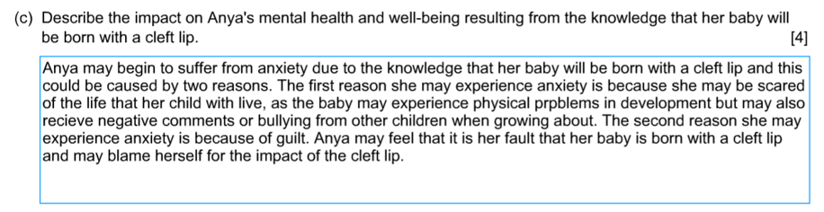
Question 2 (c) Candidate 2 answer

Slide 37
Question 2 (c) Candidate 2 answer with examiner’s comments
3 marks awarded
A good description of the impact on Anya’s mental health and well-being resulting from the knowledge that her baby will be born with a cleft lip.
The candidate focused on the negative impact the news may have. The response correctly addressed the impact of anxiety, and that Anya may blame herself. Reference could also have been made to developing post-natal depression once the baby is born, concerns about attachment to her baby, the negative impact on Anya’s self-esteem, and referred to any positive outcomes such as the effect on her resilience in coping with the situation.

Slide 38
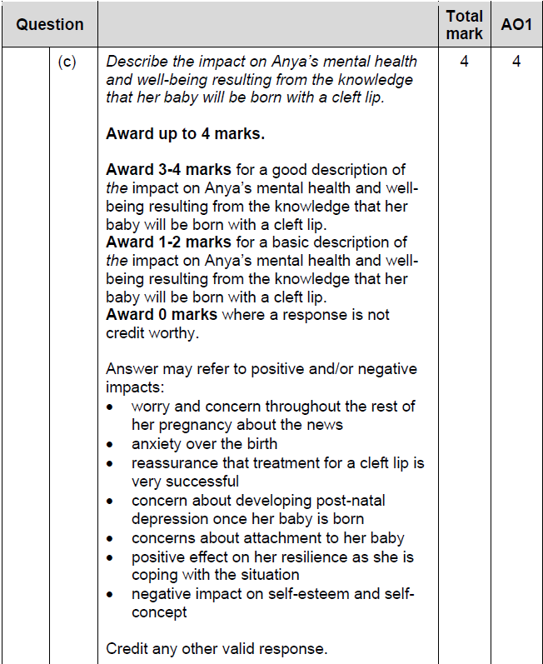
Question 2 (c) mark scheme

Slide 39
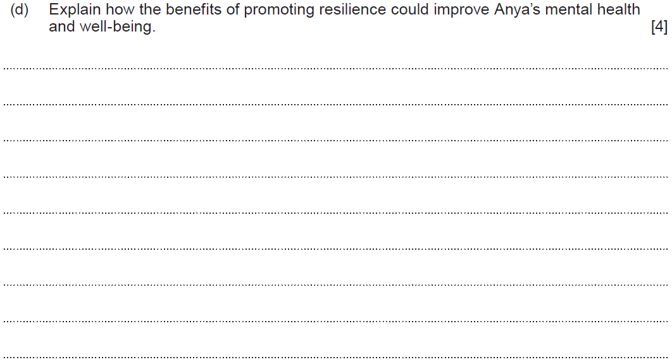
Question 2 (d)

Slide 40
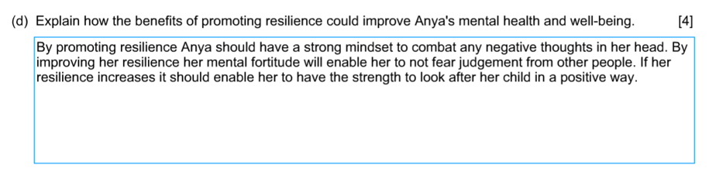
Question 2 (d) Candidate 1 answer

Slide 41
Question 2 (d) Candidate 1 answer with examiner’s comments
2 marks awarded
A basic explanation of how the benefits of building resilience would improve Anya’s mental health and well-being.
The candidate recognises that promoting resilience will help Anya’s mindset to combat negative thoughts and have the strength to look after her child. The candidate also recognises that it would enable Anya not to fear judgement from others. Addressing a wider range of benefits – such as feeling a sense of control, coping with challenges, making the most of opportunities, having a positive outlook, building problem-solving skills, optimistic outlook and increased self-esteem – would have gained additional marks for the candidate.

Slide 42
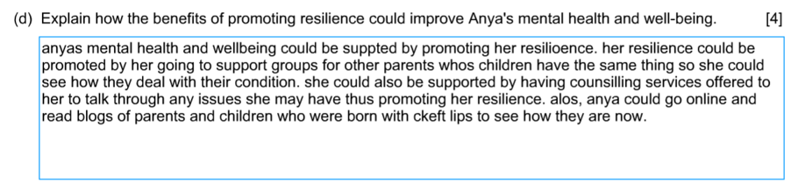
Question 2 (d) Candidate 2 answer

Slide 43
Question 2 (d) Candidate 2 answer with examiner’s comments
1 mark awarded
A basic explanation of how the benefits of building resilience would improve Anya’s mental health and well-being.
The candidate has incorrectly read this question and explained with examples how Anya’s resilience could be promoted rather than the benefits. One mark was awarded for recognising the positive benefit of an identified service such as counselling to talk through issues and promote resilience.
Addressing the benefits directly – such as helping Anya to get over the news, having increased self- esteem, accepting help, having a positive outlook, feeling in control and empowered – would have enabled the candidate to gain a higher mark.

Slide 44
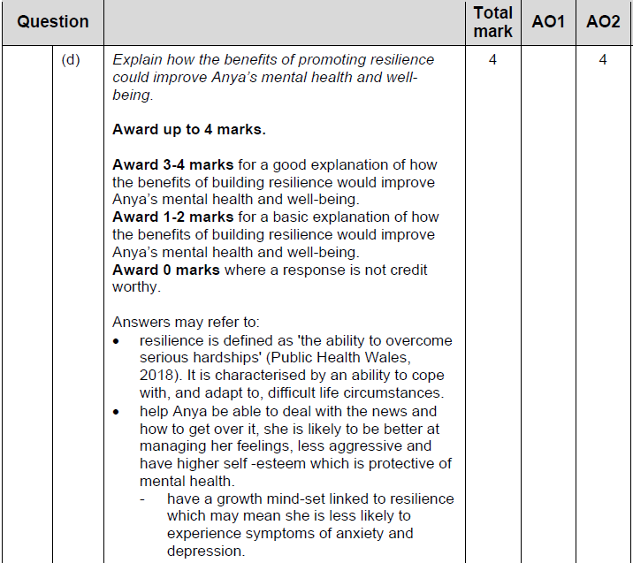
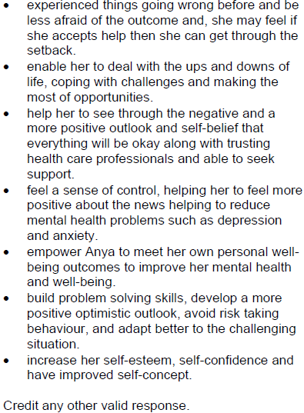
Question 2 (d) mark scheme

Slide 45
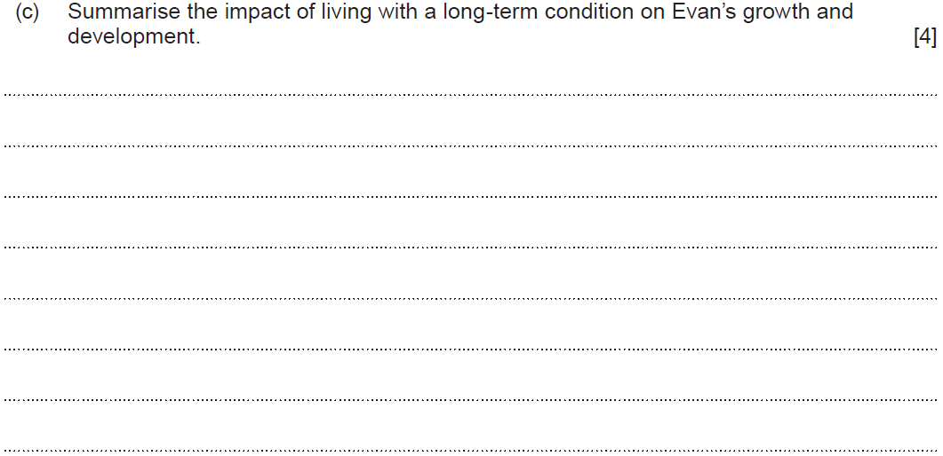
Question 5 (c)

Slide 46
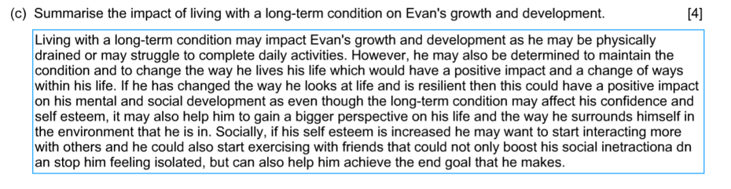
Question 5 (c) Candidate 1 answer

Slide 47
Question 5 (c) Candidate 1 answer with examiner’s comments
4 marks awarded
A good summary of the impact of living with a long-term condition on Evan’s growth and development.
The candidate has addressed a wide range of physical, social, and emotional areas of development that would impact on Evan’s growth and development. The candidate has summarised the impact using both negative and positive points. They begin by firstly describing the negative impact on Evan physically and then link this to a positive comment relating to how he may be determined to have a positive impact and change his life. They go further to discuss his resilience, self-esteem and end their answer by referring to his end goals. The candidate has used subject-specific terminology throughout the question and used the command verb at the start of the question correctly.

Slide 48
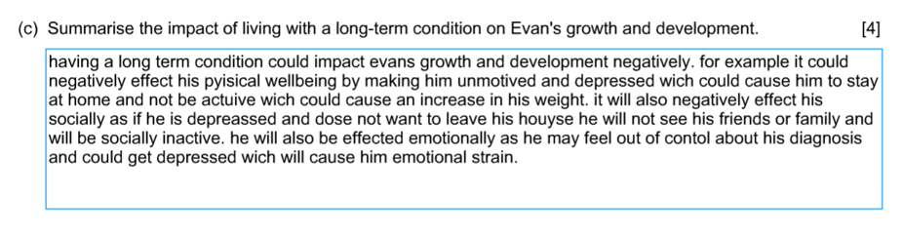
Question 5 (c) Candidate 2 answer

Slide 49
Question 5 (c) Candidate 2 answer with examiner’s comments
3 marks awarded
A good summary of the impact of living with a long-term condition on Evan’s growth and development.
The candidate has addressed the negative impact on Evan’s growth and development physically, socially, and emotionally. They recognise that this could lead to depression, and the long-term impact on his health such as an increase in weight.

Slide 50
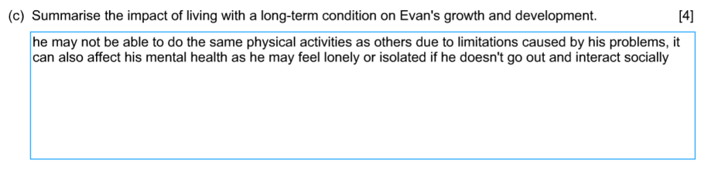
Question 5 (c) Candidate 3 answer

Slide 51
Question 5 (c) Candidate 3 answer with examiner’s comments
2 marks awarded
A basic summary of living with a long-term condition on Evan’s growth and development.
The candidate has briefly summarised the impact on Evan, referring to his limitations physically, and has then addressed social factors including isolation and inability to go out and interact socially. No reference is made to any positive factors and further points could have been identified to gain higher marks. These may have included increased anxiety due to Evan’s diabetes, feeling out of control, lower self-esteem and confidence. Positive points may have included feeling more resilient to understand and deal with his condition, feeling confident with support from family and professionals around him.

Slide 52
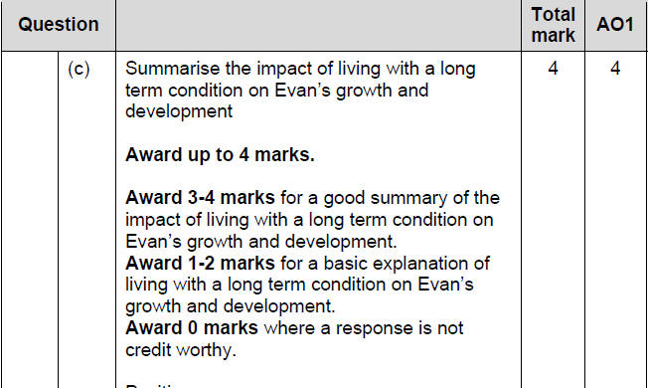
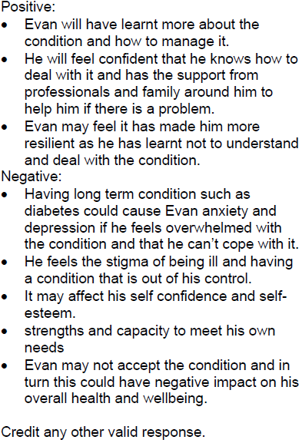
Question 5 (c) mark scheme

