Slide 1



CCPLD Level 3: Practice and Theory
Unit 330
Autumn Network 2023

Slide 2



This event is supported and facilitated by representatives and subject specialists from WJEC and City and Guilds.
WJEC
Amy Allen-Thomas
Subject Officer – Children’s, Care, Play, Learning and Development
Level 2 CCPLD: Core
Level 2 CCPLD: Practice and Theory
Level 3 CCPLD: Practice and Theory
WJEC
Lianne Haymer
Principal Examiner – Children’s, Care, Play, Learning and Development
Level 3 CCPLD: Practice and Theory
City & Guilds and WJEC continue to work collaboratively and in partnership with the following organisations who will also be contributing to this event:
Qualifications Wales
Social Care Wales
Health Education and Improvement Wales

Slide 3
Audio Recording
The presenter is required to make an audio recording of this event. This is a control designed to ensure that WJEC is able to demonstrate compliance with regulatory Conditions of Recognition; specifically, conditions relating to the confidentiality of assessment materials.
The recording will be made available to the qualifications regulator if required, but it will not be shared with any other third parties. The recording will be stored securely by WJEC for a period of three years and then permanently destroyed.
Please note that delegates are NOT PERMITTED to make an audio or video recording of any aspect of this event.

Slide 4

Using Teams
During this Teams session, it would be beneficial to all if the following protocols are adhered to:
Microphones to be muted when not speaking
Use the ‘raise your hand’ feature to ask a question or use the chat function
Activate your camera if you wish to do so
Technical problems:
If you experience technical problems with your sound or your web camera, this is often out of our control, but in the first instance we advise you leave and re-join the meeting or contact your own IT support.

Slide 5
Event Materials
This PPT presentation will be sent to the email address(es) you provided on registration.

Slide 6

Aim and objectives
This online session will provide participants with an opportunity to:
Listen to Principal Examiner feedback and review example answers on Unit 330 from June 2023 examination
Changes to Level 3 CCPLD: Practice and theory specification
Question and answer opportunities with the technical adviser and subject specialist
New Mailbox for WJEC CCPLD Qualifications
CCPLD@wjec.co.uk

Slide 7
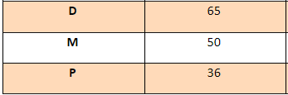
Entries June 2023
Paper
Onscreen
Paper
 | Paper | Onscreen
Number of entries | 88 | 68
Mean mark | 45 | 49.9

Slide 8
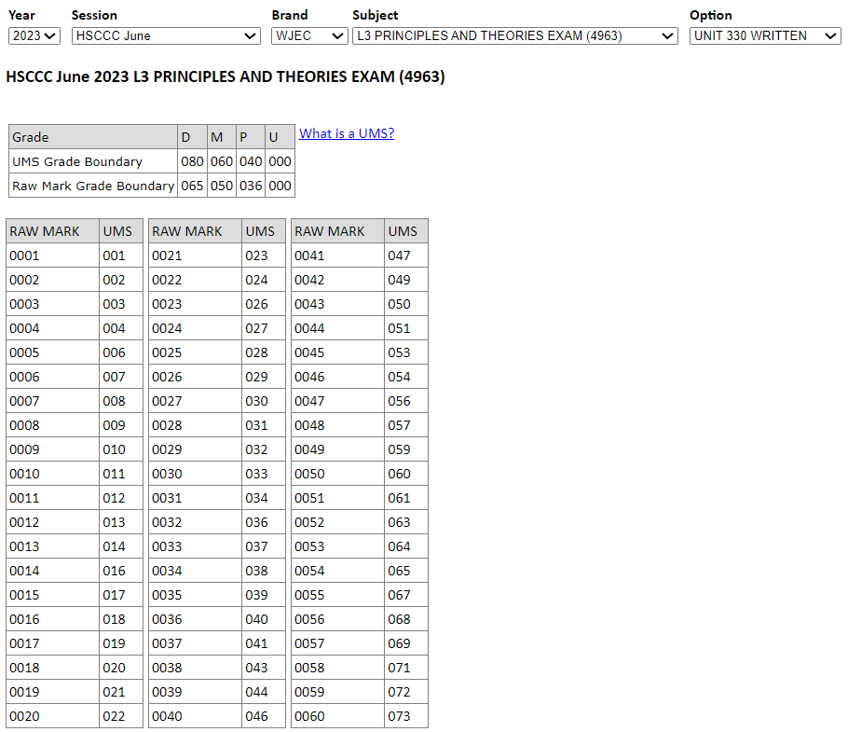

UMS calculator
https://www.wjecservices.co.uk/MarkToUMS/default.aspx
Unit 330 and 331 UMS combined grade

Slide 9
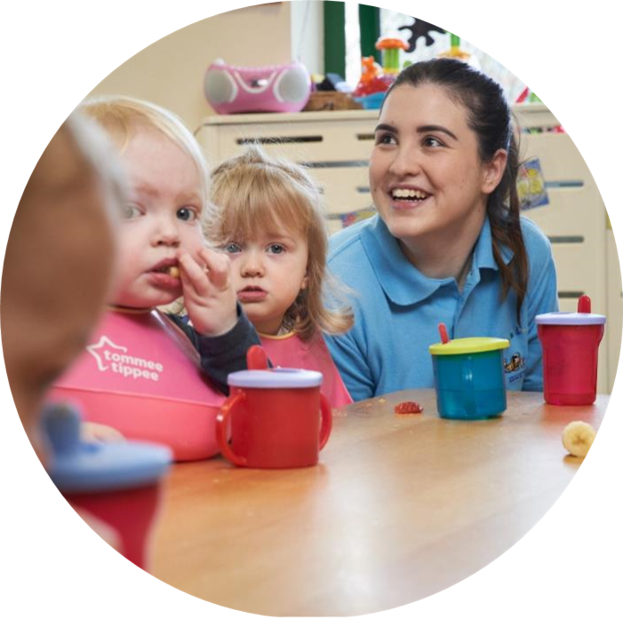
Unit 330 – Summer 2023
Support Pack

Slide 10
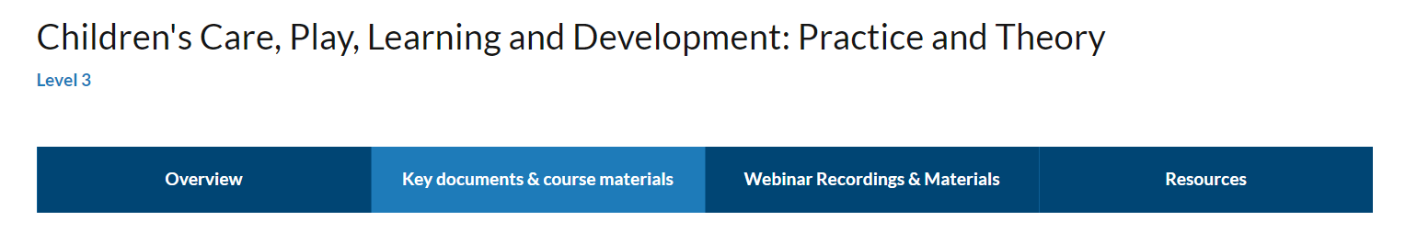
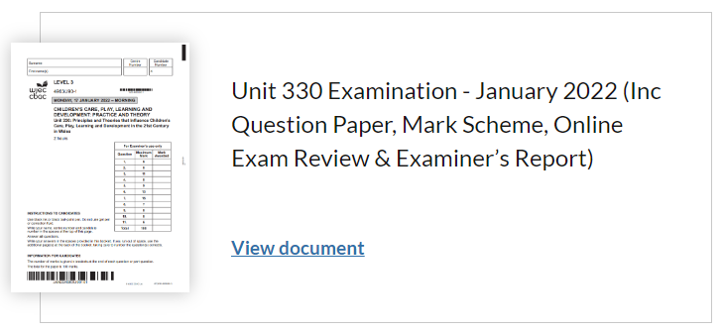
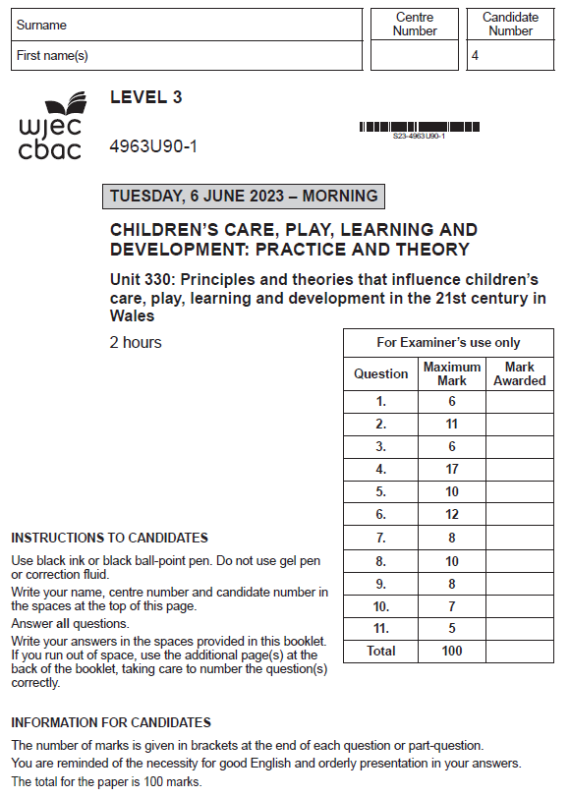
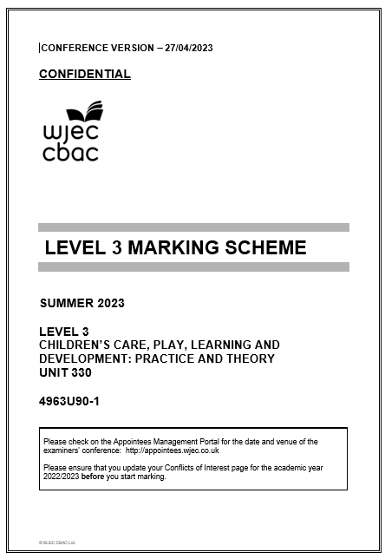
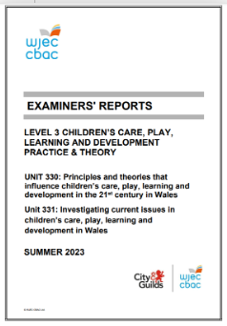
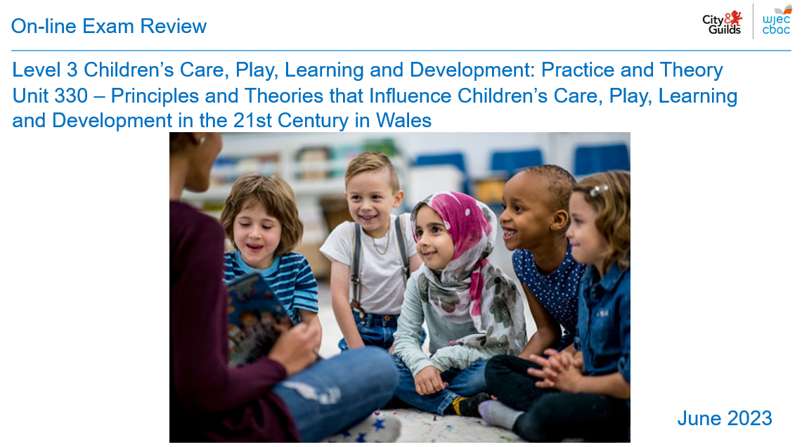
Level 3 Children's Care, Play, Learning and Development: Practice and Theory (healthandcarelearning.wales)
Summer 2023

Slide 11
Principal Examiner Feedback
Unit 330 – June 2023

Slide 12
High level feedback
The examination was completed on-line and through paper copies.
The questions proved to be accessible to the majority of candidates and timing of the paper was gauged well as candidates responded well and with detail to all questions provided.
Responses were generally clear and examiners were able to understand text, some learners wrote in very large writing and they ran out of space quickly although more often than not, they made use of additional sheets to complete their response.
Responses were enhanced by the opportunity to complete online through clarity and expanded space for their responses, many learners benefit through being able to type rather than write their answers, to amend and correct as they respond.
All questions were attempted and no question proved to be more challenging than what has been used in any other paper for this unit.
The candidate answers varied in the detail provided in their responses and the command verbs were acknowledged with successful navigation of writing skills to ensure the highest marks can be achieved, this is especially significant in the higher assessment outcome when referring to specific question types.
Very few candidates responded with bullet points where the response required an explain or a discuss, which was very positive to see.

Slide 13
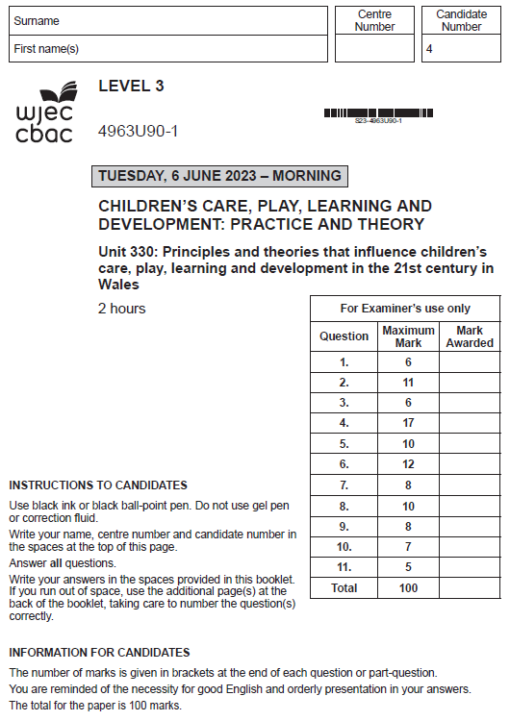
Unit 330: Principles and Theories that Influence Children’s Care, Play, Learning and Development in the 21st Century in Wales
Online Examination Review (OER)

Slide 14
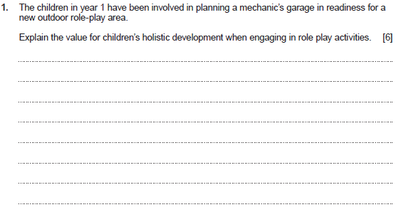
Question 1 and mark scheme
Command Verb: Explain
Provide details and reasons for how
and why something is the way it is
Response may refer to:
Role play games are important for your child’s development e.g. to build confidence/creativity/ communication/physical development and problem-solving abilities.
Playing make-believe allows children to act out real-life roles/practice many different skills e.g. such as literacy/numeracy skills
Children learn through observing/imagination/ experiential/hand-on experiences
Playing make-believe offers developmental learning opportunities
Offering opportunities through experimenting with the social and emotional roles of life
Experiencing role playing around the theme of mechanic garage will help children to learn about the role and functions of a garage
Children can experience the use and function of related new vocabulary/terminology/key terms etc.
Gross motor and fine motor skills through the implementation of various activities and experiences through the new role play area e.g. fixing, mending, washing,
Communication through experiences of the environment supporting knowledge and understanding of the job roles e.g. setting up an office to pay for the work to be done on cars
Literacy skills to be developed e.g. communication/manners/turn-taking/requests/ note taking/orders etc.
Numeracy skills to be developed e.g. orders/ ordering and sequence/payments/counting/use of coins and notes
Practicing real-life scenarios through imaginative role-play
Participating in pretend play will require children to develop their cognitive thinking skills
Children can learn how to assess problems, and learn how to solve them
Transfer role-play experiences into real-life situations
Role-play helps to expose children to new vocabulary
Planning and experiencing real life experiences and developing their own understanding through role-play
Enables children to experiment in a safe environment
This list is not exhaustive.
Credit any other relevant response.
Award up to 6 marks.
Award 0 marks for a response that is not creditworthy.
Award 1-2 marks for a basic explanation which shows limited knowledge and understanding of the value for children’s holistic development when engaging in this educational experience.
Award 3-4 marks for a good explanation which shows some knowledge and understanding of the value for children’s holistic development when engaging in this educational experience.
Award 5-6 marks for a very good explanation which shows sound knowledge and understanding of the value for children’s holistic development when engaging in this educational experience.

Slide 15
Question 1 Candidate’s answer with Examiner’s comments
Role play activities are extremely important when it comes to children's holistic development. role playing can support their physical development, depending on what kind of pretend game they are playing. For example, they could be running around on a field pretending to be chased by the police, which would develop their gross motor skills, strength, agility and muscles. It can also help their intellectual/cognitive development, as they would be expanding on their creativity and imagination in order to make these imaginary games come to life while playing with their friends. For example, they could be imagining that they're a king or queen, which they would also have to be imagining what a castle looks like, what other people are in a castle etc., in order to make the game as real as they can. It can also support their language skills and development, because they would be using a wider vocabulary and discover new words and meanings depending on the game they are playing, e.g. an astronaut would need to know key words about space etc. It would also support their emotional development, as they would be able to express and communicate their emotions through their pretend play, which would lead to being better at communicating their feelings in the future. It would also help their social development, as they would be working within a group of children, or a close friend, in order to come up with a game and follow through with it, developing their social skills, communication skills, ability to cooperate well and work within a team. It will also develop their confidence and independence, as it gives them the opportunity to think for themselves and put their thought and opinions out there.
Principal examiner feedback​
​
This response provides a very good explanation of the value for children’s holistic development when engaging in role play activities. There is a wide range of developmental areas addressed which provide knowledge and understanding of how children learn, and the importance of role play as a learning experience. The response is detailed and shows a well written expression of knowledge, and an overall sound explanation with valuable experiences to support the whole discussion. This response has been awarded within the highest mark banding.
Marks awarded 6/6

Slide 16
Question 1 Candidate’s answer with Examiner’s comments
When engaging in role play activities, it helps the children's social development. This is because they could be playing with other children. They could be sharing the toys or things they are playing with. They could also be taking turns for example, the different roles and characters they are using. Role play activities also helps a childs language development. This is because they are speaking and communicating to each other and they could be learning new words as they play. It also helps the childs cognitive development because they could be learning as they as playing. For example, they could be role playing teachers and they could be counting and learning the times table or working with numbers. Role play activities can also help the childs emotional development because they will feel different emotions such as happiness if they are playing nicely or they could be sad and angry if they are playing with someone else and they steal the role they want to play or a object they are playing with. It also helps their physical development because they will be moving around or running around. They could be role playing runners or sports people, this will develop their gross motor skills. Role play can also develop their fine-motor skills if they are playing with objects and toys or climbing. Role play also helps the child to develop imagination skills because they are role playing a character or making up a life or story or be whoever they want to be.
Principal examiner feedback​
​This example demonstrates how providing an effective response can be awarded with the highest marks. The candidate has responded to the question command verb and provided an explanation which meets the expectation of the question. The response is methodical in the way it addresses a range of holistic development learning areas (as highlighted). The knowledge and understanding provided allows for a very good explanation of the value of role play and how role play supports and enhances each of learning areas and skills.
Marks awarded 6/6

Slide 17
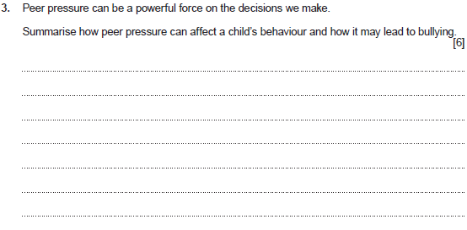
Question 3 and mark scheme
Command Verb: Summarise
Select and present the main points (without detail)
Award up to 6 marks.
Award 0 marks for a response that is not creditworthy.
Award 1-2 marks for a basic summary which shows limited knowledge and understanding of how peer pressure can affect a child’s behaviour and lead to bullying.
Award 3-4 marks for a good summary which shows some knowledge and understanding of how peer pressure can affect a child’s behaviour and lead to bullying.
Award 5-6 marks for a very good summary which shows sound knowledge and understanding of how peer pressure can affect a child’s behaviour and lead to bullying.
Response may refer to:
Peer pressure creates an expectation to conform to group
Children are influenced by their peers and feel pressure / to meet the needs of the group / to be liked / to fit in / to have friends
Children learn from one another
Feel an internal pressure to meet the group behaviours
Peer pressure can lead to bullying as children copy the behaviour of their friends
Pressure from others in the group to participate in bullying
The desire to fit in
An act of self-preservation
Fear of being bullied / tormented / left out themselves
The need to conform to the behaviours / attitudes / personal habits of a group
Peer pressure creates behaviour that would not normally occur
Would rather the negative behaviour be against someone else and not them
Fear of repercussions if behaviours / expectations not carried out
This list is not exhaustive.
Credit any other relevant response.

Slide 18
Question 3 Candidate’s answer with Examiner’s comments
Peer pressure can hugely affect a child's behaviour and can cause serious issues down the line, such as bullying. Peer pressure can cause a child to do something, even if they don't want to, just because all of their friends are doing it and they want to fit in, such as vaping, drinking, doing drugs etc. It could make them feel embarrassed if they aren't doing what everyone else is doing, leading to others singling them out and targeting them by bullying them, both online and in person. It could severely damage a child's mental health, as they may be doing everything they can to fit in and do what everyone else is doing, leading them to lose their own sense of identity and become a follower. It makes them too scared to speak up and voice their own opinions, or say no, because the pressure of fitting in to society is too strong for them to cope with, so they end up giving in and staying quiet. It could lead to them making huge mistakes and damaging life choices, such as smoking. If the group of children that they are with begin bullying a random person, it could even cause the child to join in with the bullying, even though they are fully aware of how wrong it is, because they are too scared to speak up and be different.
Principal examiner feedback​
​
This response offers a clear summary of how peer pressure can affect a child’s behaviour and how it may lead to bullying. There a firm understanding shown within this response of the types of situations or experiences that may lead to changes in behaviour. Also, the impact of these behaviours and how they may lead to bullying others. This response summarises the need to fit in with peer groups and to often feel compelled to copy the behaviour or actions of what others do. Some areas addressed were targeting others and bullying, the fear of speaking out and joining in with the negative behavioursof others through peer pressure. This is an example of an excellent and clearly addressed response.
Marks awarded 6/6

Slide 19
Question 3 Candidate’s answer with Examiner’s comments
Peer pressure can affect a child's behaviour because it can make them feel helpless and puts them in a horrible situation. Peer pressure will make the child do things they don't want to do which could affect their mental health and make them feel upset. Peer pressure could lead to bullying because if they child stands up for themselves or says they don't want to do something then they could be picked on for being a 'whimp' and not doing what they asked which could also lead to physical harm such as pushing or hitting. This may mean the child becomes quiet and has little friends and might disengage with activities and people in school. It could also affect this child's behaviour if they give in to peer pressure and do the thing they are asked to do. This could be something bad which they would be getting into trouble for and shouted at. This could also make the child feel upset because they don't want to be shouted at.
Principal examiner feedback​
​
This response highlights the key areas associated with peer pressure and the effects of others on a child’s behaviour, which may lead to bullying. This response focuses on the impact of how children can become bullies by be bullied themselves. Addressing how children may participate in actions or behaviours themselves through being coerced by their peer group, and through a pressure to conform. Some areas highlighted relate to the fear of being picked on by the peer group, being called names or being a victim of physical harm. This response offers a clear summary of the negative impact of peer pressure on a child’s behaviour.
marks awarded 5/6

Slide 20
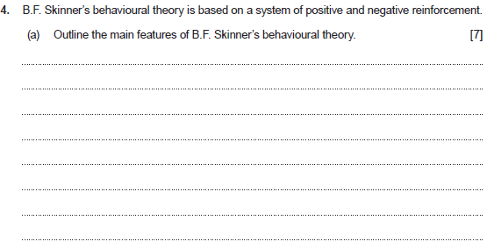
Question 4(a) and mark scheme
Command Verb: Outline
Set out the main points/provide a brief description or main characteristics
Response may refer to:
Skinner studied operant conditioning by conducting experiments using animals which he placed in a 'Skinner Box'
Skinner identified three types of response/ operant that can follow behaviour
Neutral operants – responses from the environment that neither increase or decrease the probability of a behaviour being repeated
Reinforcers –- reinforcers can be either positive or negative/responses from the environment that increase the probability of a behaviour being repeated
Punishers – punishment weakens behaviour/responses from the environment that decrease the likelihood of a behaviour being repeated
Skinner showed how positive reinforcement worked by placing a hungry rat in his Skinner box.
The box contained a lever on the side, and as the rat moved about the box, it would accidentally knock the lever.
A food pellet would drop into a container next to the lever.
The rats quickly learned to go straight to the lever after a few times of being put in the box.
The consequence of receiving food if they pressed the lever ensured that they would repeat the action again and again.
Positive reinforcement strengthens a behaviour by providing a consequence an individual finds rewarding
Skinner believed that the best way to understand behaviour is to look at the causes of an action and its consequences
Behaviourism is based on measuring behaviours
There are two types of reinforcements in the theory of B. F. Skinner on behaviourism and operant conditioning
Positive reinforcement, an element that acts as a reward/usually meets some basic needs/generates a pleasurable response
Negative reinforcement, an element that generates a response of pain/displeasure/ discomfort/acts as a punishment
Operant conditioning is a method of learning that occurs through rewards and punishments for behaviour\an individual makes an association between a particular behaviour and a consequence
This list is not exhaustive.
Credit any other relevant response.
Award up to 7 marks.
Award 0 marks for a response that is not creditworthy.
Award 1-2 marks for a basic outline which shows limited knowledge and understanding of the main features of B.F. Skinners behavioural theory.
Award 3-4 marks for a good outline which shows some knowledge and understanding of the main features of B.F. Skinners behavioural theory.
Award 5-6 marks for a very good outline which shows sound knowledge and understanding of the main features of B.F. Skinners behavioural theory.
Award 7 marks which shows an excellent outline which shows detailed knowledge and understanding of the main features of B.F. Skinners behavioural theory.

Slide 21
Question 4(a) Candidate’s answer with Examiner’s comments
Skinners theory is based on Operant Conditioning. Operant conditioning is a method of learning that uses both rewards and punishments to modify behaviour, for example, if a child is rewarded for displaying positive behaviour, (such as sharing, being kind etc) they are more likely to repeat that behaviour, as they know it comes with a positive outcome. Similarly, if a child is punished for displaying negative behaviour (such as hitting another child, not sharing, being rude etc), they are less likely to repeat that behaviour, as they know it comes with a negative outcome and want to avoid another punishment. In Skinner's experiment, he used a Skinner Box. Inside of this box, there was a red light, a green light and a lever. Skinner placed a hungry rat inside of this controlled environment. If the rat pressed the lever when the green light was on, the rat would receive a food pellet to eat, however, if the rat pressed the lever when the red light was on, the rat would then receive a mild electric shock. As a result of this, after a while, the rat soon learnt to only press the lever when the green light was on, in order to receive some food, and to avoid the lever when the red light was on, in order to avoid a mild electric shock.
Principal examiner feedback​
​
This response shows a very good outline of the main features of B.F Skinners behavioural theory. The response provided highlights a range of specific features which show a high level of knowledge and understanding of theoretical behaviorism. This candidate outlined the mechanisms and purpose of the ‘Skinner box’ which was used to conduct the experiment, then attempted to outline how the experiments aimed to condition the behaviour of rats. This is a very good response which would have been further enhanced with references to specific theoretical terminology, for example by providing an outline of the features of positive reinforcement and negative reinforcement within the behavioural theory, which were aimed to shape and condition the required behaviour. Marks awarded 5/7

Slide 22
Question 4(a) Candidate’s answer with Examiner’s comments
B.F. Skinners theory is called operant conditioning. He believes behaviour is learned from consequences. He believes that if a child is rewarded for their behaviour, then the child is more likely to show positive behaviours. This is called positive reinforcement. These rewards could be stickers or certificates which is shown and used in schools. If a child is punished, then the child is less likely to show them behaviours which is called negative reinforcement. This is also shown in schools as the child could receive a detention if they are older or a time out or miss play time. If came to this conclusion because of his experiment which is called the Skinners box. He placed a rat in a box with a lever and when the rat accidently hit the lever then food came out. The rat quickly learned that knocking the lever meant food. This shows the positive reinforcement. The rat was then placed in a box with a horrible electric current which cause the rat to move about in discomfort. The rat accidently hit the lever in doing so which cause the current to stop. The rat then realised that the lever stops the current so hit it every time it was placed in the box. This demonstrates negative reinforcement.
Principal examiner feedback​
​
This response provides an example of the required further theoretical terminology. This response has provided a very good outline and addresses the key areas of operant conditioning. Full marks were not awarded for this response on the whole as there is some uncertainty in the candidate’s response relating to the purpose of the experiment through the discussion of lever as the outline is concluded. Overall, a very good response has been provided and this answer is an excellent example for learner progression, based on the varied types of question responses relating to the the command verbs.
Marks awarded 6/7

Slide 23
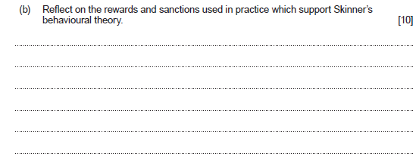
Question 4(b) and mark scheme
Command Verb:Reflect
Evaluate and/or consider
Response may refer to:
Rewards
Rewards provided based on the positive aspects important to human behaviour
The feelings associated with behaviour that is controlled by conditioning
Strategy of A, B, C behaviour model where the behaviour is identified, and consequences are used to reinforce or prevent the behaviour
Strategy of A, B, C behaviour model/ Antecedent – the event or ‘trigger’/Behaviour – the behaviour i.e. good or bad/Consequence – the positive or negative results
Reward encourages further good behaviour
Positive reinforcement encourages positive behaviour
Variety of strategies that may be used e.g. Visual positive enforcements - displays, charts, tokens, prizes, certificates
Variety of strategies that may be used Verbal positive enforcements - praise and encouragement, feedback to parents/carers, genuine appreciation
When previous behaviours have been rewarded, children are likely to repeat those behaviours happily and willingly,
When children feel that they are doing what they 'want' to be doing
Positive reinforcement to encourage good behaviour
Sanctions
Children are free to behave in any manner that they choose, as long as they are willing to accept the consequences of their actions.
If children choose behaviours in order to avoid a repeat of negative reinforcement, they may behave appropriately
Children may feel that their freedoms are being suppressed
Behaviour modification typically consists of changing the consequences of an action or applying new consequences to guide behaviour.
Control the behaviour of their children by using negative reinforcement
Controlling misbehaviour or disregarding rules result in sanctions/punishments
Reserving negative reinforcement techniques only as a last resort
Provide children with appropriate behavioural guidelines while allowing them their dignity
This list is not exhaustive. Credit any other relevant response.
Award up to 10 marks.
Award 0 marks for a response that is not creditworthy.
Award 1-2 marks for a limited response which shows limited knowledge and understanding to reflect on the rewards and sanctions used in practice which support Skinners behavioural theory.
Award 3-4 marks for a good response which shows some knowledge and understanding to reflect on the rewards and sanctions used in practice which support Skinners behavioural theory.
Award 5-7 marks for a very good response which shows sound knowledge and understanding to reflect on the rewards and sanctions used in practice which support Skinners behavioural theory.
Award 8-10 marks for an excellent response which shows detailed knowledge and understanding to reflect on the rewards and sanctions used in practice which support Skinners behavioural theory.

Slide 24
Question 4(b) Candidate’s answer with Examiner’s comments
Operant conditioning applies to childcare settings such as nurseries, schools etc in many ways. For example, if a child is seen behaving positively (listening to instructions, being kind to classmates, sharing their toys etc.) in the classroom, and they are given a reward such as a sticker or extra play time, that same child is more likely to repeat that positive behaviour, both in school and at home, as they are aware that it comes with a reward and would like to experience that positive outcome again. Similarly, if a child is caught displaying negative behaviour (such as hitting or kicking another child/member of staff, being rude and uncooperative, blatantly ignoring instructions etc.) in the classroom, and they are given a punishment, such as a time out or getting told off by the teacher, then they are less likely to repeat that kind of negative behaviour, both in school and at home, due to the fact that they have been made aware that acting like that will result in a negative outcome / punishment, and they would rather not experience that again. This also applies to any other children in the classroom that has witnessed both the behaviours displayed and the outcomes received, because if they see another child getting a reward, then they will improve their behaviour in order to also receive a reward, and if they see another child getting punished, they will avoid repeating the behaviour that they saw, as they know it has a negative result and want to avoid that. It is an opportunity for children to learn the kinds of behaviours that they should be showing in different situations, and will allow them to be able to differentiate between what is right and wrong, good and bad. This also means that they will be able to identify the behaviours themselves, and approach their classmates and support them in acting positively, which would consequently improve the behaviour of the whole class, as well as improving the children's holistic development, supporting their cognitive, social and communication skills.
Principal examiner feedback​
​A clear, detailed and well-appointed response which provides an excellent reflection on the rewards and sanctions, which are used in practice and support Skinner’s behavioural theory. There are firm links throughout this response which discuss a range of examples from practice, such as, the types of behaviours that children may exhibit, and the positive or negative responses to condition positive behaviour outcomes. There is a detailed understanding of the rewards and sanctions used in practice which are well-balanced and equally addressed to meet the question expectation. This response provides a variety of strategies and has been awarded within the highest mark banding. Marks awarded 8/10

Slide 25
Question 4(b) Candidate’s answer with Examiner’s comments
In schools and practices rewards are given to children who show positive behaviours such as doing all their work or showing kindness. The child could receive a sticker or class dojo points which leads to a prize at the end of the week. Some schools also do a star of the week where they get a certificate which says what they have done to receive the award during the week. Standing in front of the school with this certificate will make the child feel proud and happy. Giving these rewards to the children mean they will continue with these positive behaviours and could make other children do the same because they will want a reward as well. If a child shows negative behaviour then they could be given a punishment such as staying in at break or dinner time and missing out on play. Seeing their friends having fun playing and this punishment will make the child not want to show those negative behaviours again because they don't want to end up staying in again. Also just getting shouted at by the teacher may make they not want to do what they did again which could be shouting out or not listening to the teacher. This supports and shows the positive and negative reinforcements in Skinners theory.
Principal examiner feedback​
​This response shows a good understanding of the purpose of rewards and sanctions and provides some reflection of practice. Although, this candidate has provided a valued response relating to the rewards and sanctions, it does lack any reference to the significance of Skinner’s behavioural theory which is stated to be a reflected as part of the question. Further detail with a clear reflection of positive and negative reinforcers could have enhanced this response further, and possibly shown a higher-level of knowledge and understanding of Skinners behavioural theory.
Marks awarded 6/10

Slide 26
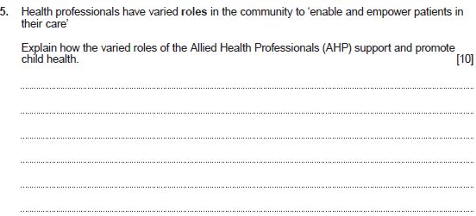
Question 5 and mark scheme
Command Verb: Explain
Provide details and reasons for how and why something is the way it is
Award up to 10 marks.
Award 0 marks for a response that is not creditworthy.
Award 1-2 marks for a basic explanation which shows limited knowledge and understanding of how the varied roles of the Allied Health Professionals (AHP) support and promote child health.
Award 3-4 marks for a good explanation which shows some knowledge and understanding of how the varied roles of the Allied Health Professionals (AHP) support and promote child health.
Award 5-7 marks for a very good explanation which shows sound knowledge and understanding of how the varied roles of the Allied Health Professionals (AHP) support and promote child health.
Award 8-10 marks for an excellent explanation which shows detailed knowledge and how the varied roles of the Allied Health Professionals (AHP) support and promote child health.
Mark Scheme Cont.

Slide 27
Question 5 and mark scheme
Response may refer to:
Art therapists – use of art as a form of supportive psychotherapy to encourage clients to explore a variety of issues including emotional, behavioural or mental health problems/learning or physical disabilities/life-limiting conditions/neurological conditions or physical illnesses/supporting people specific needs/provides supportive communication and expression
Drama therapists – use of performance arts as a form of supportive psychological therapy/ provides exploration for a wide variety of different issues/supports needs e.g. autism/ physical and sexual abuse/mental illness/ psychological/emotional and social changes.
Music therapists – engage support through live musical interaction to promote an individual’s emotional wellbeing and improve their communication skills/support through psychological intervention/providing a unique connection to music/develop communication skills/improve self-confidence/independence/ enhance self-awareness/awareness of others/ improve concentration and attention skills/ beneficial for individuals of all ages and physical abilities from new-born babies to end-of-life care
Chiropodists/podiatrists – Podiatrists provide essential assessment, evaluation and foot care for both long term and acute patients e.g. patients with diabetes/cerebral palsy/arterial disease/nerve damage/sports related injuries/ providing surgical intervention and health care for patient well-being
Dietitians – assess, diagnose and treat diet and nutritional problems at an individual and a broader public health level/providing public health and scientific research e.g. on food/ health/disease. Supports people to make appropriate lifestyle and food choices. Dietitians advise and influence food and health policies
Occupational therapists – work with people of all ages with a wide range of problems resulting from physical/mental/social or developmental difficulties. Support people with a range of interventions to enable/support participation e.g. caring for themselves/caring for others/learning/playing/interacting with others. Positively supports physical and psychological health/wellbeing and rehabilitation/ supporting care pathways/ broader public health and social care environments.
Operating Department Practitioners – support patients of all ages during each phase of the patient’s perioperative care/anaesthetic – provide patient-centred care and prepare specialist equipment and drugs/surgical – prepare all the necessary equipment and instruments for operations and providing these to the surgical team during the operation/ recovery – supporting the patient throughout their time in the recovery and fitness
Physiotherapists – uses physical approaches to promote/maintain and restore physical/ psychological/social well-being/support through partnership to improve physical ability and potential supporting through advice/treatment, rehabilitation/health promotion and supporting behavioural change/promoting health and well-being through therapeutic exercises/electro-physical approaches to meet individual need.
Speech and language therapists – help to overcome or adapt to a variety of disorders of speech, language, communication needs e.g. helping young children to access education/ reducing life-threatening swallowing problems/ help with physical and psychological needs/ support and care with eating, drinking and swallowing/support with speaking and communicating/supporting children with delayed speech/treating and supporting speech impaired by illness or injury/help with overcoming stammering, mutism, voice disorders/supporting the health and well-being of children with mild, moderate or severe learning difficulties
Diagnostic radiographers – use a range of techniques/produce high quality images to diagnose an injury or disease/responsible for providing safe and accurate imaging/ examinations/report/key for patient care pathways/Breast Screening/Ultrasound monitoring of pregnancy
Therapeutic radiographers – play a vital role in the treatment of cancer/responsible to plan and deliver radiotherapy/manage the patient care pathway/providing care and support for patients throughout their radiotherapy treatment
Learner can discuss a variety of roles, and this does not need to be linked to specific roles as stated above.
This list is not exhaustive.
Credit any other relevant response.

Slide 28
Question 5 Candidate’s answer with Examiner’s comments
There are many varies roles of the Allied Health Professionals, also known as AHP. Each of these roles provide the best possible support that they can for a child, and promote the children's health and well-being, which is one of their main priorities. A health visitor can provide meeting and appointments with the parents, take on occasional check ups on the child's health, well-being and development. as well as how the parents are getting on and seeing if there are any issues with anything and giving them the most, best support that they could possibly give in order to ensure the best upbringing and health for the child. A social worker is there to help with any possible familial issues such as neglect, abuse (both physical and emotional), drug misuse, alcohol misuse etc, and give as much advice and support as possible in order to ensure a safe, secure, positive and heathy upbringing for a child, as the first few years of a child's life are the most important for their development and any issues and severely impact them as individuals in the future, both physically and mentally. An ALNCo (additional learning needs coordinator) can be found in schools and are there to give the appropriate support and guidance to any children in education with an ALN ( ADHD, autism. dyslexia, down syndrome, OCD, and more), being there to support them in whatever aspect of their education that they struggle with in order to ensure that they have to best possible educational experience as possible, and are able to fully understand and comprehend the information given to them, to get the most out of the education and setting them up for a good future.
Principal examiner feedback​
​
This question provided candidates with the opportunity to explain the varied roles of the Allied Health Professionals (AHP), which may have been discussed generically or specifically. This response is an example of how marks cannot be awarded when the correct roles required within the question are not addressed. One mark was provided for the brief explanation at the start based on a generic explanation, although the remainder of the response discusses the role of a health visitor, a social worker and an ALNCo. Unfortunately for this candidate, none of the roles provided are part of the Allied Health Professionals, and therefore are not creditworthy.
Marks awarded 1/10

Slide 29
Question 5 Candidate’s answer with Examiner’s comments
Allied health professionals like speech and language therapists support and promote a child's health as they help children who struggle to speak or communicate. They support and promote a child's health by helping children to speak and use language by doing exercises with their mouths, doing activities with the children, helping them with pronunciation and moving their mouths and practicing sounds, letters and words with the children. They support and promote children's health as they help to develop a child's self esteem and self confidence.
Allied health professionals such as dietitians support and promote a child's health by proving children and their families with knowledge and information on the child's dietary needs and requirements. They support and promote children's health as they can help children to loose weight or generally improve their health by providing them with information on foods which are appropriate for the child to eat and what is healthy for them and best for their body to consume.
Principal examiner feedback​
​
This response provides an explanation of the varied roles of the Allied Health Professionals (AHPs) and is accurate in its identification of the specific professionals. There is a very good explanation provided which shows sound knowledge and understanding of how speech and language therapists and dietitians support and promote child health. Further explanation could have related to other AHP roles, or a general explanation of how AHPs work within the community within their varied and specialist professions.
Marks awarded 5/10

Slide 30
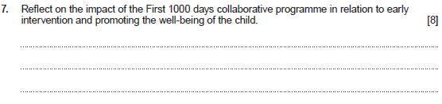
Question 7 and mark scheme
Command Verb: Reflect
Evaluate and/or consider
Wales aims to irradicate child poverty and has three strategic objectives:
To reduce the number of families living in workless households
To improve the skills of parents/carers and young people living in low-income households so they can secure well-paid employment
To reduce inequalities that exist in health, education and economic outcomes of children and families by improving the outcomes of the poorest
First 1000 days provides and support information in variety of focused areas through early intervention to support the well-being of the child and the family/carers:
The risks of obesity during pregnancy
Accessible and appropriate physical activity opportunities
Community cookery groups
Effective weight loss programmes/supporting women to lose weight after pregnancy/before the next pregnancy
A referral pathway for all pregnant smokers into smoking cessation support/Carbon monoxide monitoring in pregnancy.
Develop community interventions to support new parents
Ensure that parents and carers are given consistent and accurate advice and help promote the best nutrition for infants
Deliver a structured programme that encourages breastfeeding
Awareness and distribution of the Healthy Start vitamins scheme
Flying Start Health Visitors to work with families to improve immunisation uptake in the most deprived communities
Support dental/oral health care/Designed to smile programme/healthy diet and proper nutrition/help ensure that the baby receives the minerals and nutrients it needs to develop healthy teeth
Improve safety in the home for vulnerable families/child Safety resources/delivery of Child Safety Equipment Schemes
The early years are fundamental to children’s development/supporting the needs of families/ essential to reducing inequities
The first 1000 days demonstrates the opportunities to make a difference to the lives of parents and babies and narrow the inequalities gap
A number of different programmes and services are in place to support the most vulnerable families in Wales e.g. Families first /Flying start/ Communities First/Integrated Families Support Service (IFSS)/Team around the Family/Healthy Pre-Schools Scheme. In order to break the cycle of deprivation, reduce inequalities and improve health outcomes
This list is not exhaustive.
Credit any other relevant response.
Award up to 8 marks.
Award 0 marks for a response that is not creditworthy.
Award 1-2 marks for a basic reflection which shows limited knowledge and understanding of the impact of the First 1000 days collaborative programme in relation to early intervention and promoting the well-being of the child.
Award 3-4 marks for a good reflection which shows some knowledge and understanding of the impact of the First 1000 days collaborative programme in relation to early intervention and promoting the well-being of the child.
Award 5-6 marks for a very good reflection which shows sound knowledge and understanding of the impact of the First 1000 days collaborative programme in relation to early intervention and promoting the well-being of the child.
Award 7-8 marks for an excellent reflection which shows detailed knowledge and understanding of the impact of the First 1000 days collaborative programme in relation to early intervention and promoting the well-being of the child.
Response may refer to:
The first 1000 days - starting just before a baby is conceived, continuing during pregnancy and up to the age of two
Early interventions produce better outcomes and are cost effective in the long term
Giving every child a healthy start in life is a key focus

Slide 31
Question 7 Candidate’s answer with Examiner’s comments
The First 1000 days collaborative programme has a huge impact on the early intervention and promoting of the well-being of the child, and the parents, throughout the first 1000 days of their life. They provide various types of support and will give as much advice and support the parents and the child(ren) as they possibly can, in order to ensure the best possible upbringing and quality of life for all parties involved. They can provide routine immunisations and screening programmes for the child, in order to ensure that they are fully vaccinated and protected from any dangerous/infectious diseases in their early childhood, and screening to check and detect any possible abnormalities/ issues / problems / dangers and risks to both the mother and the child during pregnancy, in order to begin support as early as they can and do their best to prevent/reduce the dangers and risks for the child's future. They provide support for those children with ALN and speech and language difficulties, like autism, ADHD, OCD, ADD, down syndrome, dyslexia and so much more. They ensure that all of these children have the right access for the right support best suited for them as individuals, as every child is different, and works in a different way. They provide appointments and meetings with the parents of the child in order to discuss any possible issues, to make sure that everything is going as smoothly as possible and give their input/advice/support wherever is deemed necessary. The provide the parents with as much information as possible in order to help and guide them in creating the best possible upbringing and childhood for the child, things such as breastfeeding, diets, foods, exercise, activities to help the child's holistic development, how to help the child sleep, speak, walk, toilet training, anything that is important for parents/carers, especially first time ones, to know.
Principal examiner feedback​
​
This response provides a very good reflection of the First 1000 days programme and the types of support available to parents and children. The response is clear in it’s understanding of the key features within the programme. The response addresses many of the areas which are fundamental to early intervention and promoting the well-being of the child. To enhance this response further there could have been reflection on the long-term impact, for example, in relation to the programmes strategic objectives such as eradicating child poverty, improving parental skills and/or reducing inequality. Overall, this is a very good response. Marks awarded 6/8

Slide 32
Question 7 Candidate’s answer with Examiner’s comments
First 1000 days collaborative programme is aimed from conception to the child’s second birthday. This is age gap is the critical and crucial window of opportunity for the child’s development. This is where the child’s brain develops the fastest. The environment around the child is important at this age for them to grow and develop and a good rate. First 1000 days programme supports this and helps the child grow and develop. This includes appointments, monitoring and assessments to make sure the child is developing properly. There are also scans from when the child is growing in the womb to make sure they are developing correctly. First 1000 days also checks and looks after the mother and father to make sure they are okay and there isn't any risks of harm for the mother. First 1000 also has health professionals to support the child and family and are their if needed.
Principal examiner feedback​
​
This question shows a good reflection of the impact of the First 1000 days programme. There is a firm understanding of the age group which this programme supports and the type of support available. There is a specific discussion relating to the importance of scans to check on development during pregnancy, and also the value of monitoring and assessments to check on progress, growth and development.
Marks awarded 6/8

Slide 33
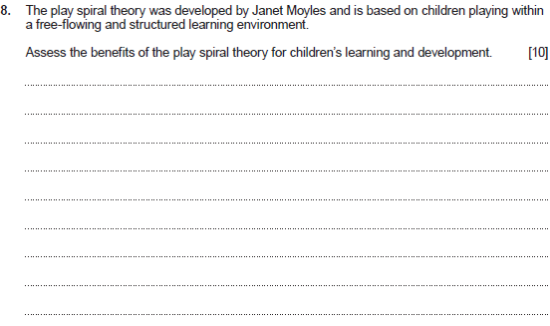
Question 8 and mark scheme
Command Verb: Assess
Make an informed judgement
Response may refer to:
Children are allowed to play freely and move slowly into structured play, and return to free play
The play spiral supports learning and development through personal exploration of free play then guidance and support through adult interaction and knowledge to practice their newfound skills and learning
The play theory allows children to explore new ideas
Children can create their own way of playing
Children progress into structured play when ready
Play provides opportunities for learning through all areas of development e.g. social, physical, intellectual, communication and emotional
The teacher observes readiness for progression and directs the child
Adults support and engage with the child enhancing their knowledge and learning in all areas of development
Adult-led activities and play support learning and development through understanding and providing valuable interaction
Adult-led play provides structure of rules and boundaries/safety within play/inclusion/support to overcome challenges/fairness in play/anti-discriminatory practice/co-operation and negotiation skills/support for relationships and guidance for social and emotional skills
Adult-led play provides opportunities for learning through improving individual competencies and increasing skills
Children try out their most recently acquired skills and competences
Free play is observed to direct the child in their learning and development
Adult-led play will provide resources for learning and development/structure/guidance/support/ direction/teaching
Supports children’s social and emotional development through more adult-child communication and interaction
Children re-enact their past, present and rehearse their future in their role play
Children symbolically represent as they play, making and adapting play props
Children use first-hand experiences from life.
Children make up rules and problem solve as they play
The play spiral theory provides children with the opportunities to explore a resource/toy/ equipment with help first before adults intervene – Adults then provide guided play and teaching on the resource/toy/equipment then allowing free play again
Children play with adults and other children cooperatively
Children coordinate ideas and feelings and make sense of their relationships
Free play boosts a child’s confidence and self-esteem
Teaches children the ability to recover quickly from setbacks / failings
Free play supports a child’s personal resilience
Play may help with overcoming emotional trauma or disturbance
The play spiral theory can encourage expression of views/experiences/frustrations/ opinions/reflection etc.
This list is not exhaustive. Credit any other relevant response.
Award up to 10 marks.
Award 0 marks for a response that is not creditworthy.
Award 1-2 marks for a basic assessment which shows limited knowledge and understanding of the benefits of the play spiral theory for children’s learning and development.
Award 3-4 marks for a good assessment which shows some knowledge and understanding of the benefits of the play spiral theory for children’s learning and development.
Award 5-7 marks for a very good assessment which shows sound knowledge and understanding of the benefits of the play spiral theory for children’s learning and development.
Award 8-10 marks for an excellent assessment which shows detailed knowledge and understanding of the benefits of the play spiral theory for children’s learning and development.

Slide 34
Question 8 Candidate’s answer with Examiner’s comments
Janet Moyles Play Sprial is extremely beneficial for children's overall holistic learning and development. The whole concept of the play spiral, is that a child is given something to play with independently/is allowed to explore their environment and play with whatever they choose first, in order to allow them to discover and explore things for themselves first. Then, after a while, an adult/teacher joins the child's play, and guides/directs/supports their play in a more structured manner, or in other words, shows them "how to". Then, the adult leaves the child alone again, and lets them play with their toys/materials independently, but this time, with the knowledge of how to use the object. This process is then repeated a number of times until the child can fully understand what to do. If you look at an image of the play spiral, there is a word at the top; Accretion. The term "accretion" refers to the gradual accumulation of knowledge, meaning that at the end of the play spiral, the child will be fully confident and able to do it properly, independently. This improves the child's holistic development in many ways. It helps the child with their physical development, both gross and fine motor skills, balance, hand eye coordination etc, if the thing they are doing is physical, like football, balancing activities, catch etc. It helps their cognitive development as they are using their imagination and creativity first, to figure out how to use the object on their own, and then they watch as someone else uses it and copies their actions, improving their memory and focus as well. It helps their language development, as they can see what kind of language and vocabulary is used when that object/toy is being played with, and repeat it in their own independent play. It helps their emotional development as if hey are doing a creative task, they can use the materials/colours as a way of expressing their emotions and feelings in a way that words cannot. It helps their social development as they are communicating with other children / adults, listening to them, folllowing instructions, cooperating effectively and speaking up and getting involved. It helps their teamwork skills and grows their independence and confidence along the way. An example of the play spiral in a setting, is a child finds a string and some beads. at first, they don't know what to do with it, so they find their own way of playing with it, however they want to. eventually, an adult comes along and shows them how to thread the bead onto the string, and take them off again, and make little patterns etc. The adults then leaves, and the child is able to mimic and repeat the actions of the adult, by putting beads on and off the string in whatever order they please, which also supports their fine motor skills.
Principal examiner feedback​
​This response is an example of an excellent high-level assessment, which shows detailed knowledge and understanding of the benefits of the play spiral theory for children's learning and development. There is a firm understanding shown of the theory structure and the structure of the learning environment to successfully implement Janet Moyles progression of free-flowing learning opportunities. There are key areas of expression within this response which show an understanding of the theoretical terminology and how the play spiral theory benefits learning in varied areas. Overall, an excellent response. Marks awarded 10/10

Slide 35
Question 8 Candidate’s answer with Examiner’s comments
Janet Moyles' play spiral theory will help the child's language development. This is because the child will be communicating and playing with the adult and could learn new words. Moyles' play spiral theory is where the adult will lead a play with the child and then the child will play freely. Then the adult will model that play and then finally it will be a child- led play and the child will play freely with the new skills learned from the adult. This theory will also help the child's emotional development because the child could feel different emotions such as happiness. It will also help the child's cognitive development because they will be learning new skills. Playing is the best way for a child to develop and they are playing independently and with an adult. Moyles believes children learn best this way and observing adults.
Principal examiner feedback​
​
This is a section of a question response which highlights where the candidate assesses the benefits of Janet Moyles play spiral theory. The candidate provided a very good assessment overall and was able to relate well the benefits for children's learning and development. There is a positive discussion of how the play spiral supports personal free play, the benefits of exploration and an assessment of the role of the adult. This response includes a good understanding of how the play spiral incorporates adult support and provides repetitive guidance as the child learns a new skill with support and independence.
Marks awarded 6/10

Slide 36
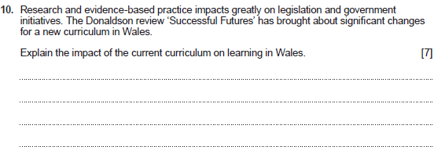
Question 10 and mark scheme
Command Verb: Explain
Provide details and reasons for how
and why something is the way it is
The new curriculum to be delivered from September 2022
The curriculum has been made in Wales but shaped by the best ideas from around the world
To reflect the changes in society and create a purposeful learning environment
To prepare young people for modern life and the future work force
To increase experiences of modern-day technology digital skills/adaptivity/creativity/ knowledge
Improvements to how we assess children and young people in education / support children with additional learning needs and teacher and practitioner training and accountability
Teachers will have more freedom to teach in ways they feel will have the best outcomes for their learners
Learning will include skills and experiences, as well as knowledge
Subjects will be grouped into six Areas of Learning and Experience:
Expressive Arts
Health and Well-being
Humanities
Languages
Literacy and Communication Mathematics and Numeracy
Science and Technology
More focus on ensuring that all pupils understand their assessments/where they are on their personal progression/what they need to do next in order to progress/encouraging children to take responsibility for learning
More focus on challenging children and young people to be the best they can be/providing opportunities for problem solving/creativity/ critical thinking etc.
Focuses on creating real-life opportunities for learning/learning from professionals/ experiences outside school/setting tasks that build on knowledge of experiences and skills
There will be improvements to the way we support children with additional learning needs
To increase the standards of literacy and numeracy and improve outcomes
There will be more focus on physical and mental well-being/creating readiness to learning at school/being able cope with the demands of life
The new school curriculum is designed to help all children and young people become:
Ambitious, capable learners, ready to learn throughout their lives
Enterprising, creative contributors, ready to play a full part in life and work
Ethical, informed citizens of wales and the world
Healthy, confident individuals, ready to lead fulfilling lives as valued members of society.
This list is not exhaustive. Credit any other relevant response.
Award up to 7 marks.
Award 0 marks for a response that is not creditworthy.
Award 1-2 marks for a basic explanation which shows limited knowledge and understanding of the Donaldson review to clarify the impact of the new National curriculum on learning in Wales.
Award 3-4 marks for a good explanation which shows some knowledge and understanding of the Donaldson review to clarify the impact of the new National curriculum on learning in Wales.
Award 5-7 marks for a very good explanation which shows sound knowledge and understanding of the Donaldson review to clarify the impact of the new National curriculum on learning in Wales.
Response may refer to:
The new curriculum is aimed at schools and funded non-maintained settings e.g. day care/ play groups/cylch meithrin/private day nurseries
Enable learners to make progress towards the four purposes.
Be broad and balanced.
Be suitable for learners of differing ages, abilities and aptitudes.
Provide for appropriate progression for learners and includes a range of provision - linked to ages / abilities and aptitudes

Slide 37
Question 10 Candidate’s answer with Examiner’s comments
The current curriculum in Wales has a huge impact on the learning and development of children in Wales. It gives them access to a huge amount of knowledge and information that it critical to know and understand throughout their lives and their futures. Mathematics allows the children to excel in addition, subtraction, multiplication, division and so much more. It also means that in the future, they will be able to properly understand and take care of their finances and more. The three sciences, chemistry, biology and physics, give children and young people the opportunity to learn more about the world they live in, how it works, why different things happen and what the functions of everything is. Literacy allows children to express themselves through their writing and learn more about the English language and how to string together sentences, create stories and expand on their general knowledge of the vocabulary, the words and their meanings. Art and design, and music, also allows children to express themselves, their thoughts and feelings through creative projects, painting, colouring, drawing, sketching, singing, writing music, playing the piano, guitar, drums and so much more. Welsh, French or any language is so good for supporting and expanding their understanding of languages, the world and the different cultures in the different countries etc. It gives them a more open mind and open up so much more opportunities for them in the future. There is so much to be learnt and taught within the curriculum and it greatly benefits the children's learning and development, for the present and their future.
Principal examiner feedback​
​This response provides a good explanation of the impact of the current curriculum in Wales on learning. There is an emphasis on the life skills that can be gained through the implementation of the curriculum, and also the benefits for the future. This is a good response which would have gained higher marks with further detail and explanation. For example, an explanation of the focus for the new curriculum from the Donaldson report or explaining the progression and/or impact to be gained from the curriculums four purposes. Overall, a very good response which shows positive understanding and knowledge in this area.
Marks awarded 4/7

Slide 38
Question 10 Candidate’s answer with Examiner’s comments
The National curriculum for Wales is the current curriculum for the ages 3-16 which is everything you are taught and learn in school. This is the key subjects and areas of learning you are taught such as English, maths and science. The national curriculum can also provide extra curriculum activities such as outdoor learning such as forest school. Forest school can help the child develop physically because they are moving but also help develop their cognitive skills because they can learn whilst being outside. The early years curriculum is for ages 3-7. This is more of a hands on learning approach and the child learns from experiences and opportunities in school. The children also learn from the environment around them. These are the best ways a child can learn and develop. The new curriculum for Wales is the newest curriculum which is being phased in. This is the key areas of learning and subjects you will be taught. It is more child led because this is seen to benefit the child because they will be happier and develop better.
Principal examiner feedback​
​This response relates to the national curriculum and not the new curriculum in Wales which is stated in the question and highlighted specifically with reference to the Donaldson review. One mark was provided for some explanation of the value of learning experiences and opportunities. The response concludes with an understanding of the current curriculum being phased in, although the response cannot be credited any further than a basic explanation.
Marks awarded 1/7

Slide 39
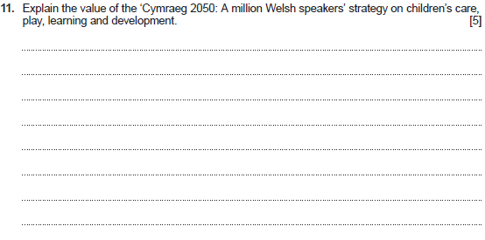
Question 11 and mark scheme
Command Verb: Explain
Provide details and reasons for how
and why something is the way it is
Response may refer to:
To provide children with the best start in the language/expanding support for families to transmit the language in the home
To expand Welsh-medium provision in the early years as an access point for Welsh-medium education
To increase the number of primary teachers who can teach in Welsh
To create a statutory education system which increases the number of confident Welsh speakers
To develop post-compulsory education provision which increases rates of progression and supports everyone/increases whatever their command of the language/to develop Welsh language skills for use socially and in the workplace
To provide resources and qualifications needed to support increased provision
Identifying the strategic themes: increasing the number of Welsh speakers/increasing the use of Welsh/creating favourable conditions – infrastructure and context
To increase the percentage of the population that speak Welsh daily
To increase the provision of each school receiving Welsh-medium education
Aims to transform how Welsh is taught to all learners to increase school leavers speaking Welsh to 70% by 2050
Aims to reform the post-16 Welsh-medium/ bilingual education and skills to support a successful economy
Review the Welsh language legislation to ensure it offers a strong learning foundation for the use of Welsh
Increase the understanding of bilingualism/ multilingualism
How practice within settings are addressing the strategy
This list is not exhaustive.
Credit any other relevant response.
Award up to 5 marks.
Award 0 marks for a response that is not creditworthy.
Award 1-2 marks for a basic explanation which shows limited knowledge and understanding of the impact of the Cymraeg 2050; A million Welsh speakers’ strategy on children’s care, play, learning and development.
Award 3-4 marks for a good explanation which shows some knowledge and understanding of the impact of the Cymraeg 2050; A million Welsh speakers’ strategy on children’s care, play, learning and development.
Award 5 marks for a very good explanation which shows sound knowledge and understanding of the impact of the Cymraeg 2050; A million Welsh speakers’ strategy on children’s care, play, learning and development.

Slide 40
Question 11 Candidate’s answer with Examiner’s comments
The Cymraeg 2050: A million Welsh speakers strategy is very important in childcare and can hugely benefit children's play, learning and development in many ways. For example, by incorporating the Welsh language into children's songs/games/having Welsh words scattered around the room, is great for improving a child's language skills, both in English and Welsh, and can improve their cognitive development because learning two languages, Welsh and English, and becoming bilingual, a child has an increased skill set and will hugely support them in the future. It can allow them to gain access to a wider range of job opportunities and will allow them to communicate with fluent Welsh speakers, expanding their knowledge and understanding of the Welsh language, and it's culture and people. It supports their social development as they are able to communicate with those who can't speak English, only Welsh, broadening their social life. It is overall amazingly beneficial to a child to become bilingual and enhance their abilities and cognitive functions, and the cymraeg 2020 strategy is doing everything they can to give young children more exposure to the Welsh language and culture.
Principal examiner feedback​
​
This question enabled candidates to explain the value of ‘Cymraeg 2050’. This candidate provided a very good response of the value of the strategy for children's learning and development and was able to express clear links to the skills that the Welsh language can bring. There are links in the explanation which relate to the current benefits and and the impact the curriculum aims to achieve in the future. This response shows good examples of practical situations of learning environments for children, and the value of the strategy for creating favourable learning conditions.
Marks awarded 5/5

Slide 41
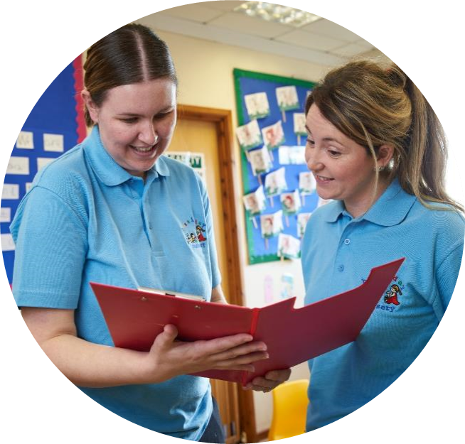
3 A level qualification

Slide 42
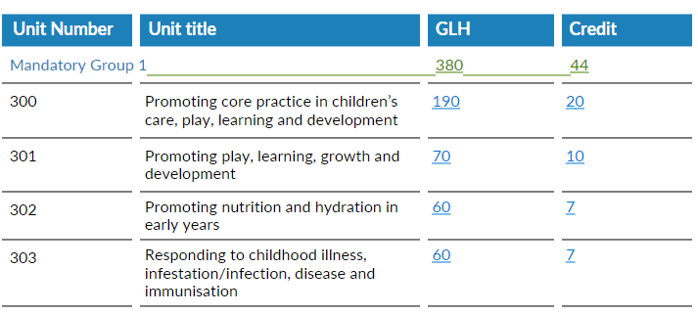
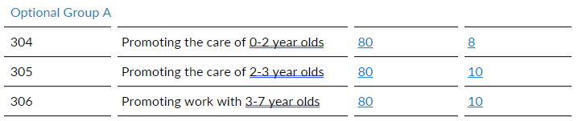
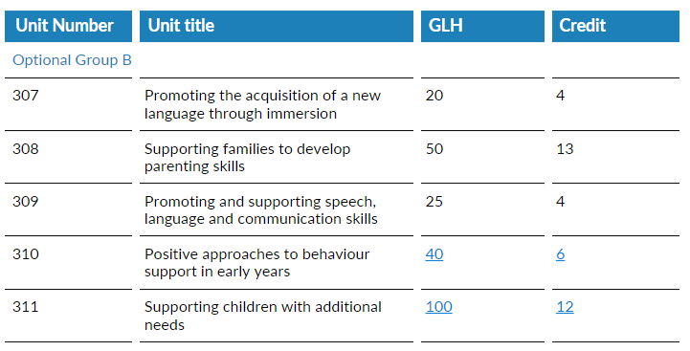
Credit values and units
Structure
To achieve the Level 3 Children’s Care, Play, Learning and Development: Practice and Theory qualification learners must achieve a minimum of 70 credits from the Practice units:
44 credits must be achieved from the Mandatory group 1
A minimum of 8 credits must be achieved from Optional Group A
The balance of 18 credits can be achieved from units in Optional Groups A, B or C
and,
enter Unit 330 and Unit 331 (Mandatory Group 2). The minimum UMS mark required for the qualification grade must be achieved. The uniform marks obtained for units 330 and 331 will be added together and the qualification grade will be based on this UMS total
achieve unit 332 .(Mandatory Group 3)

Slide 43
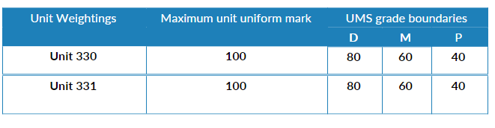
Grading the qualification
The WJEC Level 3 Children's Care, Play, Learning and Development: Practice and Theory qualification is awarded on a six-point grade scale: A*-E. The attainment of learners who do not reach the minimum standard for an E grade will receive a U (unclassified) grade and will not receive a qualification certificate.
A Uniform Mark Scale (UMS) is used in unitised specifications as a device for reporting, recording and aggregating candidates' unit assessment outcomes. The UMS is used so that candidates who achieve the same standard will have the same uniform mark, irrespective of when the unit was taken.
Uniform marks correspond to unit grades as follows:
 | Qualification Grade
Max UMS | A* | A | B | C | D | E
200 | 180 | 160 | 140 | 120 | 100 | 80
The A* grade is only available at qualification level only. There is no A* at unit level.
achieve a Pass in the practice units and in unit 332, and
(ii) obtain the minimum UMS mark for the qualification grade. The uniform marks obtained for units 330 and 331 will be added together and the qualification grade will be based on this UMS total.

Slide 44
Points to consider
Available to new learners starting Sept 23
Year 2 learners will follow the same 2 A level specification
Transfer to practice – please consider optional unit selection
Unit 332 finish date and submission for EQA

Slide 45
Unit 330 - Exam
18th January 2024 AM

Slide 46

Event Evaluation
https://www.surveymonkey.co.uk/r/WJEConline2023-24

Slide 47


Diolch
Thank you

Slide 48
Contacts:
Contact our specialist Subject Officers, Technical Adviser and administrative support team for your subject with any queries.
WJEC
Amy Allen-Thomas - Subject Officer
Tania Lucas – Subject Support Officer
E-mail: ccpld@wjec.co.uk
City & Guilds
Suzi Gray – Technical Adviser
Quality: hclw.quality@cityandguilds.com
General/Customer Support: hclw.customer@cityandguilds.com

