Slide 1

CCPLD Level 2: Practice and Theory
(Unit 216)
Autumn Network 2023

Slide 2



This event is supported and facilitated by representatives and subject specialists from WJEC and City & Guilds.
WJEC
Amy Allen-Thomas
Subject Officer – Children’s, Care, Play, Learning and Development
Level 2 CCPLD: Core
Level 2 CCPLD: Practice and Theory
Level 3 CCPLD: Practice and Theory
City & Guilds and WJEC continue to work collaboratively and in partnership with the following organisations who will also be contributing to this event:
Qualifications Wales
Social Care Wales
Health Education and Improvement Wales
WJEC
Sian Bevan
Principal Examiner – Children’s, Care, Play, Learning and Development
Level 2 CCPLD: Practice and Theory

Slide 3
Audio Recording
The presenter is required to make an audio recording of this event. This is a control designed to ensure that WJEC is able to demonstrate compliance with regulatory Conditions of Recognition; specifically, conditions relating to the confidentiality of assessment materials.
The recording will be made available to the qualifications regulator if required, but it will not be shared with any other third parties. The recording will be stored securely by WJEC for a period of three years and then permanently destroyed.
Please note that delegates are NOT PERMITTED to make an audio or video recording of any aspect of this event.

Slide 4

Using Teams
During this Teams session, it would be beneficial to all if the following protocols are adhered to:
Microphones to be muted when not speaking
Use the ‘raise your hand’ feature to ask a question or use the chat function
Activate your camera if you wish to do so
Technical problems:
If you experience technical problems with your sound or your web camera, this is often out of our control, but in the first instance we advise you leave and re-join the meeting or contact your own IT support.

Slide 5
Event Materials
This PPT presentation will be sent to the email address(es) you provided on registration.

Slide 6

Aim and objectives
This online session will provide participants with an opportunity to:
Our objective for this network session:
Listen to Principal Examiner feedback on Unit 216 from June 2023 examination
Review responses with Principal Examiner
High level feedback from L2 working group
Question and answer opportunities with the technical adviser and subject specialists
New Mailbox for
WJEC CCPLD Qualifications
CCPLD@wjec.co.uk

Slide 7
June 2023
 | Paper | Onscreen
Number of entries | 98 | 52
Mean mark | 31.6 | 37.2
Pass mark: 29/70

Slide 8
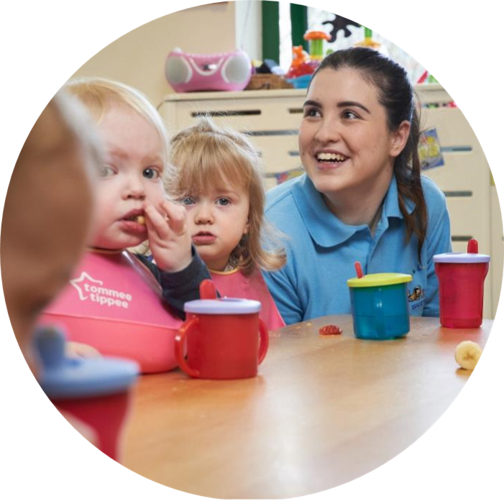
June 2023
Support Pack

Slide 9

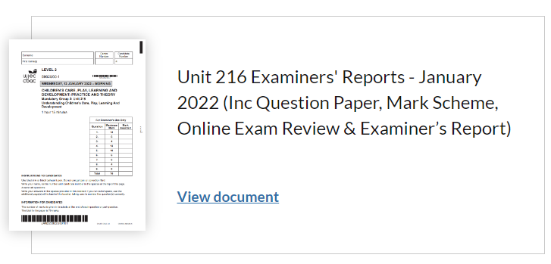
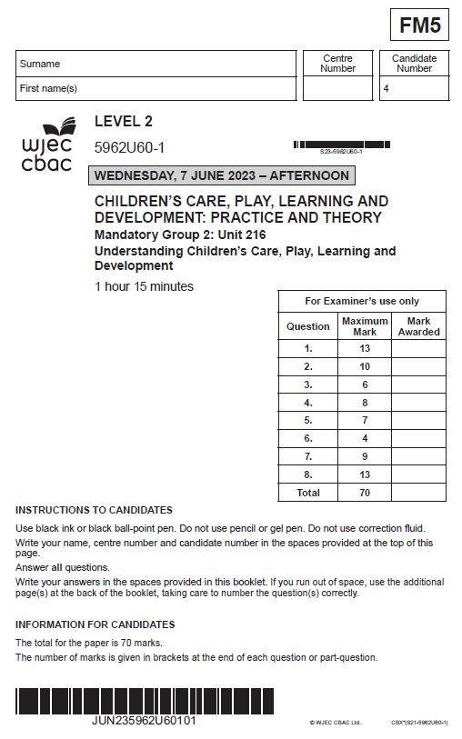
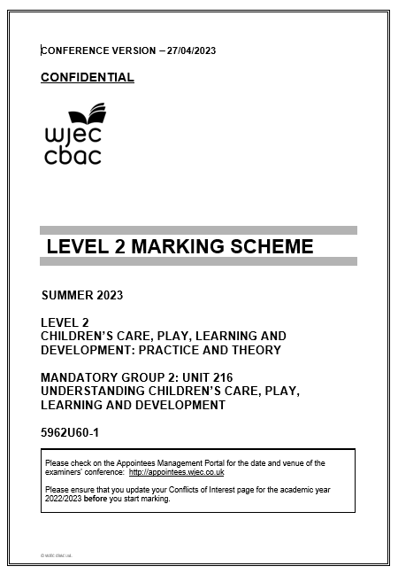
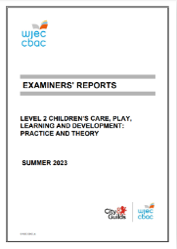
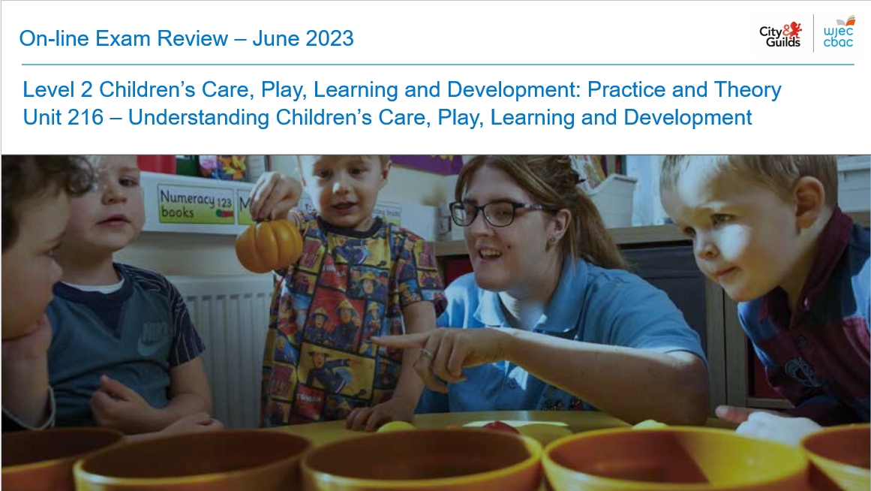
Summer
2023

Slide 10
Principal Examiner Feedback –
June 2023

Slide 11
High level feedback
The content of this paper presented a range of question types covering the content of Unit 216 as set out in the specification.
Application of knowledge and understanding was attempted in some of the answers presented. However, it appeared that some learners found this difficult in places.
Additions or changes made to the mark scheme during conference contributed to positive marking allowing additional marks to be awarded using the credit any other response guidance.
Only some learners attempted to answer all questions whilst leaving some questions blank. This indicated limited understanding of some areas of the specification.
Although there was a general understanding of command verbs some learners lost valuable marks where command verbs were not followed resulting in bullet pointed responses.
Advanced information had been made available for this paper to support learners recent blended learning experience. Many centres indicated good use of this information. Some responses, particularly at questions 4 and 5, indicated to examiners that clear Advanced information based on Outcome 4.1 had not been sufficiently utilised in delivery.

Slide 12
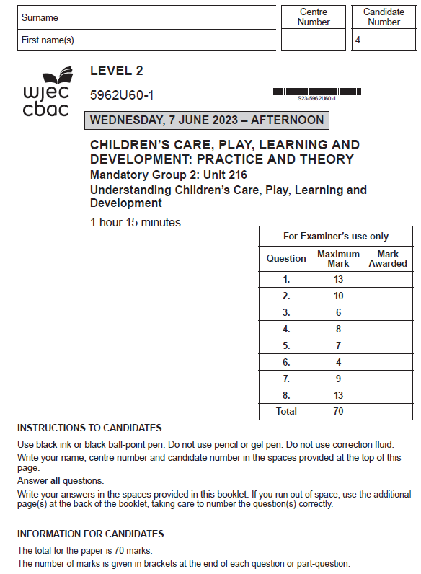
Unit 216 – Understanding Children’s Care, Play, Learning and Development

Slide 13
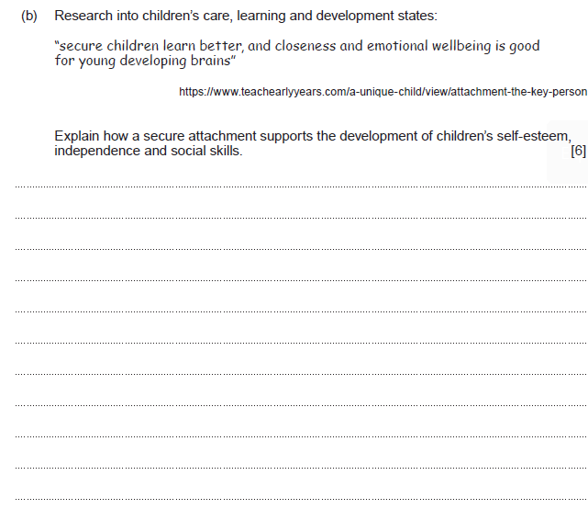
Question 1(b) and mark scheme
Command Verb: Explain
Provide details and reasons for how and why something is the way it is
Award 0 marks where response is not creditworthy.
Award 1-2 marks for a basic explanation which shows some knowledge and understanding of ways that secure attachment supports the development of children’s self-esteem, independence, and social skills.
Award 3-4 marks for a good explanation which shows good knowledge and understanding of ways that secure attachment supports the development of children’s self-esteem, independence and social skills.
Award 5-6 marks for a very good explanation which shows detailed knowledge and understanding of ways that secure attachment supports the development of children’s self-esteem, independence and social skills.
Response may refer to:
Securely attached children are often:
More confident in their approach to life
Keen to explore their environment
More sociable and keen to co-operate with others.
Less aggressive
Have less issues with behaviour problems
Able to deal with stressful situations
Able to build meaningful relationships
More open to learning
Happy to work with others/take part in group tasks
Willing to make own choices and decisions
Able to deal with transitions in a positive way
Able to control anger and deal with conflict appropriately
Willing and able to care for themselves and those around them
Able to empathise with others
Emotionally safe and have good mental health.
This list is not exhaustive.
Credit any other relevant response.

Slide 14
Question 1(b) Candidate’s answer with Principal Examiner’s comments
Secure attatchments supports the development of children's self esteem, independence and social skills in many different ways. Secure attachments support childrens self-esteem because as they feel safe, and loved by someone else as a result of a secure attatchment, they will feel worthy of love and develop a positive self image. Secure attachments support the development of a child's independence because they are secure enough in their relationship with their primary care giver that they can go off an do their own thing and gain more valuable experiences, but they know that their care giver will always be there for them if the child needs them and they can always go back to them because they are the child's safe person. Secure attachments help support the development of a child's social skills because the child will learnand copy said person, and because they have developed a secure attatchement they will teach the child what is the aprropriate way to act in public and how not to act. The development of a child's self esteem will be supported by secure attachments because the child will develop a sense of belonging, and self worth because they are being treated correcttly. Secure attachments support the development of independence because the child does not have to feel guilty about wanting to spend time with their friends independently because a secure attachment will not make them feel guilty for doing the things they need to do in order to grow and develop. Secure attachments support the development of a child's social skills because they are able to go an meet their friends without an adult which then promotes friendship and bonds which is crutial for future development, a child who has a secure attachment knows how to act appropriately in public.
Principal Examiner feedback
The command verb required learners to give an explanation, which this learner has done to an excellent standard. The response develops appropriately where the learner uses the word “because” to support the explanation with examples which indicates very good understanding of attachment.
The learner has also ensured development of each area in the question, self-esteem, independence and social skills are logically explained.
Marks awarded 6/6

Slide 15
Question 1(b) Candidate’s answer with Principal Examiner’s comments
A secure attachment ensures a child feels safe in their environment and this helps them to develop healthy bonds with others adults and children as well as positively showing them how they should expect to be treated. A child with a secure attachment, have a key person to talk to or boost their confidence if they are struggling with anything, they know they can open up about what is on their mind and have someone push them in the right direction. The child will learn to take risks and enjoy their learning experience, trying new activities or maybe playing with new people which would not seem as daunting as they have a support method/system in place.
Principal Examiner feedback
Again, we have a very good explanation where this learner has developed an answer in the top band mark. The examiner would have focussed marks on the inclusion of words such as confidence, risks and enjoying learning experiences as well as showing understanding of feeling safe and the development of
healthy bonds.
Social development has also been explained where the learner mentions playing with new people.
Marks awarded 5/6

Slide 16
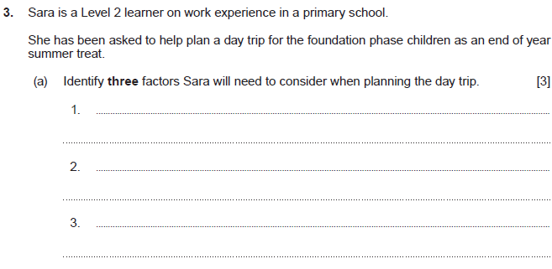
Question 3(a) and mark scheme
Command Verb: Identify
Provide/name/select/recognise brief facts or examples (from a given source or from recall)
Award 0 marks where response is not creditworthy.
Award 1 mark for each factor identified.
Up to a maximum of 3 marks.
Response may refer to:
• Cost
• Suitability for age group
• Weather
• Facilities – indoors/outdoors
• Ratios of children to staff
• Parental/carer consent
• Parental/carer involvement
• Safety/risk assessment
• Learning opportunities/activities
• First aid kit
• Registers
• Duration of trip
• Medical needs/allergies
This list is not exhaustive.
Credit any other relevant response.

Slide 17
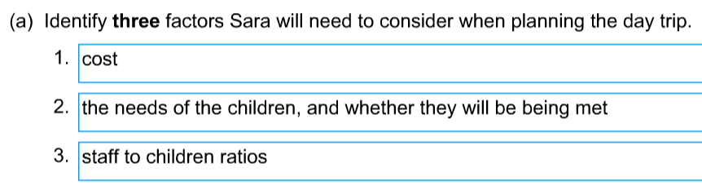
Question 3(a) Candidate’s answer with Principal Examiner’s comments
Principal Examiner feedback
A full 3 out of 3 marks awarded here. The answers are clear and precise.
Marks awarded 3/3

Slide 18
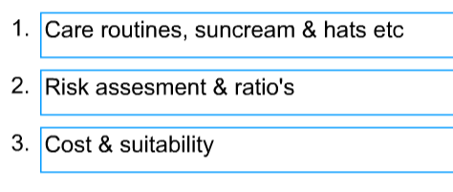
Question 3(a) Candidate’s answer with Principal Examiner’s comments
Principal Examiner feedback
Again, a full 3 marks. This learner has attempted to expand answers however the examiner would only have awarded for the first answer in each line.
Marks awarded 3/3

Slide 19
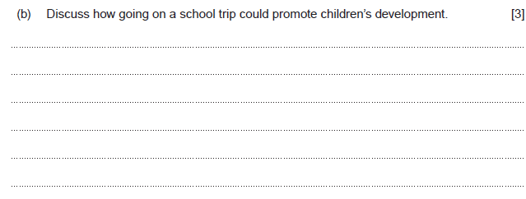
Question 3(b) and mark scheme
Command Verb: Discuss
Examine an issue in detail/in a structured way, taking into account different ideas
Award 0 marks where response is not creditworthy.
Award 1 mark for a basic discussion which shows little knowledge and understanding of how going on a school trip could promote children’s development.
Award 2 marks for a good discussion which shows good knowledge and understanding of how going on a school trip could promote children’s development.
Award 3 marks for a very good discussion which shows detailed knowledge and understanding of how going on a school trip could promote children’s development.
Response may refer to:
Provides opportunities for play
Supports social skills, encourages friendships
Enables children to have fun and enjoy suitable age and stage appropriate activities
Promotes listening skills through play
Supports emotional well- being and emotional skills through sharing and turn taking in play.
Provides physical activities and outdoor play experiences
Supports safe separation from carers during transition
Promotes independence and confidence building
This list is not exhaustive.
Credit any other relevant response.

Slide 20
Question 3(b) Candidate’s answer with Principal Examiner’s comments
Going on a school trip can promote children's development because they are being given an opportunity to be independent and go somewhere without their parents, school trips also provide a chance for them to connect more with their friends. School trips supports children's development because they allow children to learn more about the world they live in and futhering their intellectual development whilst giving them opportunities to have fun. School trips support the physical development of children by taking them to place where they have to walk (the zoo) or places tjhey can climb (the park.) School trips provide positive experiences which will support children's development because positive experiences promotes healthy brain development.
Principal Examiner feedback
A well-deserved full marks awarded to this learner. The response is developed in line with the higher band and there is clear use of the command verb.
You can see a logical progression as the learner refers to the question and details the type of development being discussed. This is particularly evident where they give trip examples to support physical development.
Marks awarded 3/3

Slide 21
Question 3(b) Candidate’s answer with Principal Examiner’s comments
School trips can promote children's development in different ways. For example; Physical development occurs with any walking or running that the children partake in during the trip. Intellectually, the children would be able to learn about the area that they go to weather that is the beach and they look at the different types of animals found there (clams, jellyfish etc). Emotional & social with this being a group trip wich will have all the other children they share a class with, this allows them to make new memories and friendships.
Principal Examiner feedback
This learner has also developed a thorough response which includes examples. These examples again indicate clear understanding of the importance of trips and how development can be promoted.
Dividing into sections shows how the learner considers different aspects of development and supports clear structure.
Marks awarded 3/3

Slide 22
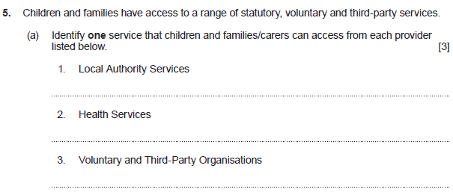
Question 5(a) and mark scheme
Command Verb: Identify
Provide/name/select/recognise brief facts or examples (from a given source or from recall)
Award 1 mark for each correct response from the lists below up to a maximum of 3 marks.
Response may refer to:
Local Authority Services:
Family Information Service (FIS)
Housing associations
Housing services
Leisure services
Social services
Youth services
Education services
Health Services:
Allied health professions
Baby clinic
Family planning clinic
Dental practice
Hospice
Hospital
Optician
GP
Health visitor
Voluntary and Third-party organisations:
Barnardo’s
Citizens Advice Bureau
Gingerbread
Mencap
Mind
NSPCC
Relate
Religious organisations
Food banks
Youth clubs
Young minds
Unpaid care including friends, family, and neighbours.
This list is not exhaustive. Credit any other relevant response.

Slide 23
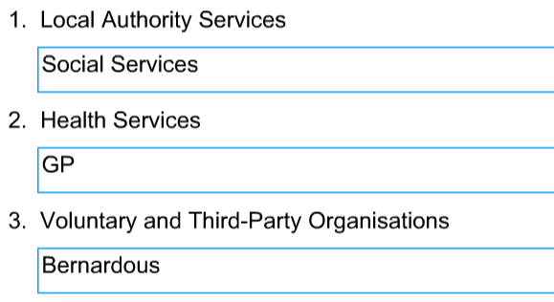
Question 5(a) Candidate’s answer with Principal Examiner’s comments
Principal Examiner feedback
This learner did manage to gain a full 3 marks for the responses offered here.
Answers a as required and clearly placed in the correct services.
Marks awarded 3/3

Slide 24
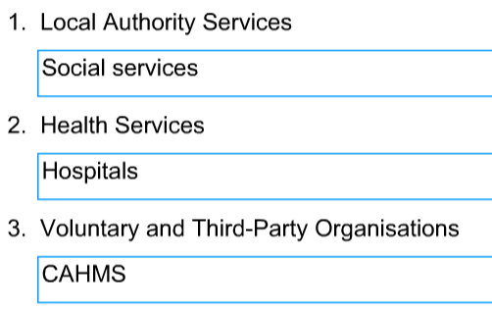
Question 5(a) Candidate’s answer with Principal Examiner’s comments
Principal Examiner feedback
I mark was lost here for the incorrect identification of CAHMS as a voluntary service.
The remaining 2 answers are place correctly.
Marks awarded 2/3

Slide 25
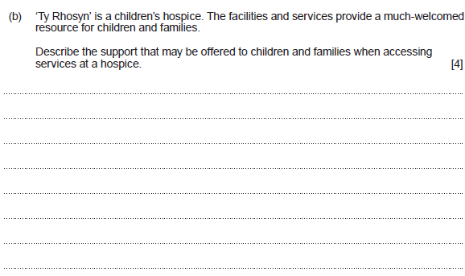
Question 5(b) and mark scheme
Command Verb: Describe
Provide characteristics/main features or a brief account
Award up to 4 marks
Award 0 marks where response is not creditworthy.
Award 1-2 marks for a basic description which shows limited knowledge and understanding of the support that may be offered to children and families when accessing the services at the hospice.
Award 3-4 marks for a good description which shows good knowledge and understanding of the support that may be offered to children and families when accessing the services at the hospice.
Response may refer to:
Support groups for family members
Specialist therapies
Practical help for children and young people with life limiting conditions.
People to talk to and get advice from
Family fun days
Respite support
Equipment and resources on loan
This list is not exhaustive.
Credit any other relevant response.

Slide 26
Question 5(b) Candidate’s answer with Principal Examiner’s comments
Ty Rhosyn can offer support in many different ways. Ty Rhosyn can offer counselling for a pateients family if they need help dealing with what they are witnessing. The hospice can offer support to sick children by giving them meals and a safe, happy place to stay while they are recovering. They can offer support to families and children by giving them advice on how to help the patient when they are allowed to go home, and advice on how to look after their own mental health too. Ty Rhosyn can help support families and children by refering them to the revelevent services that may be able to help them.
Principal Examiner feedback
The examiner has awarded 3 marks out of the available 4.
These marks may have been given where the learner has developed a description of the type of support offered without showing clear understanding of what a hospice is. Counselling is mentioned along with support for sick children and referring to other services.
Marks awarded 3/4

Slide 27
Question 5(b) Candidate’s answer with Principal Examiner’s comments
Hospice is a place that families who are not well off can go to find free support for unwell/terminally ill children. here thy have round the clock care and support with councelling offered and support for the families of the loved ones. They allow them to enjoy the last moments and make the most of what time they do have left. they offer after care for families to ensure that their well-being is thought of.
Principal Examiner feedback
This learner indicates clear understanding of what a hospice is from the outset of the response. The use of terminally ill children and round the clock care for families as well as children support the full 4 marks awarded.
Marks awarded 4/4

Slide 28
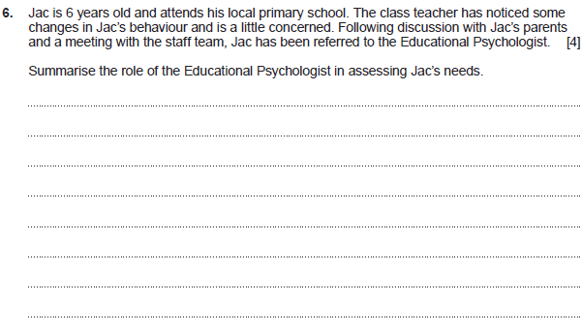
Question 6 and mark scheme
Command Verb: Summerise
Select and present the main points (without detail)
Award 0 marks where response is not creditworthy.
Award 1 mark for a basic summary which shows little knowledge and understanding of the role of the Educational Psychologist in assessing Jac’s needs.
Award 2-3 marks for a good summary which shows good knowledge and understanding of the role of the Educational Psychologist in assessing Jac’s needs.
Award 4 marks for a very good summary which shows detailed knowledge and understanding of the role of the Educational Psychologist in assessing Jac’s needs.
Response may refer to:
Arrange an appointment with parents
Arrange an appointment with staff
Talk to Jac
Find out what the teachers concerns are
Organise and carry out an assessment of Jac in the classroom environment
Recommend how staff might support Jac in the classroom
Suggest consistent approaches with the family
Suggest support strategies that will help Jac to reach his full potential
Write a report for staff and parents
Suggest referral to other members of the multi- disciplinary team and work long side them to support Jac’s needs
Provide training for staff
Support the school and the parents moving forward
Provide advice on target setting
This list is not exhaustive.
Credit any other relevant response.

Slide 29
Question 6 Candidate’s answer with Principal Examiner’s comments
An Educational Psychologist's role in assessing Jac's needs is to, find ways to help him and provide him with coping strategies. The Educational Psycolgists role is to find out the triggers of Jac's behaviour and give the class teach advice on how to help manage his behaviour, how to prevent his bad behaviour, and how to support him in the classroom. Thei role is to assess how Jac is feeling, identify if there is any extra support that he needs, and to involve the correct services.
Principal Examiner feedback
Here we have a response that indicates some knowledge of the role of the Educational Psychologist. To gain that extra 1 mark the examiner would have been looking for evidence of understanding of involving parents/carers. This had been mentioned in the rider to the question which again emphasises the importance of leaners carefully reading all information provided.
Marks awarded 3/4

Slide 30
Question 6 Candidate’s answer with Principal Examiner’s comments
An educational psychologist is someone who would be able to assess anything that Jac may be struggling with and be a person who Jac may feel like he can open up to about any issues he may be dealing with. They will observe his behaviour and triggers and see if there is anything obvious that sets Jac off, they will ask questions to the staff at the setting, jack and his parents seperately to see if they noticed when this behaviour change occured and what might have caused this.
Principal Examiner feedback
Another 3 awarded to this learner.
A similar response to the previous answer and although parents are mentioned this response focuses on observation and assessment . The one mark was possibly lost due to lack of action possible such as report writing , giving advice or support in the classroom.
Marks awarded 3/4

Slide 31
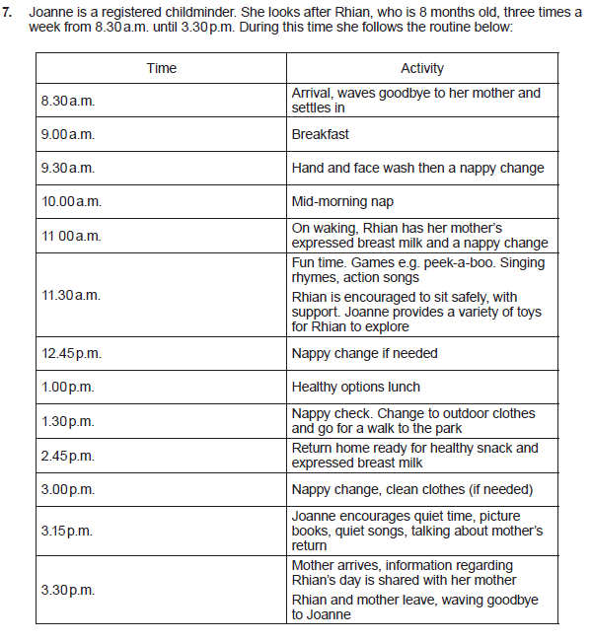
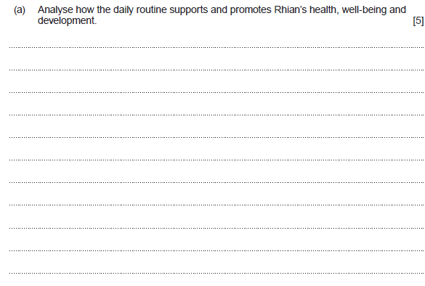
Question 7(a)
Command Verb: Analyse
Examine an issue in detail/how parts relate to whole, to explain and interpret

Slide 32
Question 7(a) mark scheme
Award 0 marks where response is not creditworthy.
Award 1-2 mark for a basic analysis which shows some knowledge and understanding of how the daily routine supports and promotes Rhian’s health, well-being, and development.
Award 3-4 marks for a good analysis which shows good knowledge and understanding of how the daily routine supports and promotes Rhian’s health, well-being, and development.
Award 5 marks for a very good analysis which shows sound knowledge and understanding of how the daily routine supports and promotes Rhian’s health, well-being and development
Response may refer to:
Settling in and waving to mother supports emotional development. Smooth transition
Appropriate nappy changing at regular intervals supports care needs
Feeding expressed breast milk supports healthy growth and development
Healthy snacks and lunch support growth and development
Playing appropriate games promotes holistic development
Age and stage development supported with games such as peek a boo
Singing rhymes promotes language development
Action songs encourages turn taking skills and language/cognitive understanding
Nap time supports healthy growth, cell repair and helps establish good sleep patterns
Changing clothes for outdoors supports cognitive skills, memory, anticipation as well as supporting care and health needs
Time outdoors supports the immune system and provides opportunity for developing observational skills and language
Quiet time, book time encourages social skills, language support
routines encourage a sense of security and understanding of what is going to happen
helps Rhian to trust Jo and understand her mother will return.
Developing a routine helps establish daily habits
Rhian will learn to recognise events through the day and begin to predict what will happen next
This list is not exhaustive.
Credit any other relevant response.

Slide 33
Question 7(a) Candidate’s answer with Principal Examiner’s comments
The daily routine helps support and promote Rhians health, well-being, and development because, routines provide children with a sense and security and comfort, this is because they know exactly what is happening and when it is happening. Having a daily routine provides structure, which supports Rhian's health, well-being and development because she is able to fine a sense of stablitly from her routine as it happens everyday. A daily routine also helps support positive behaviour as their is no uncertainty of what is going to happen next, this promote her well-being and development as she feels calm and safe. Keeping to a daily routine can also help identify any changes in behaviour or things like how many times she has a wet nappy or how oftern she is sleeping; this supports her health because sticking to a daily routine can help sort changes as i have previously stated, that can be an idicator of a health issue.
Principal Examiner feedback
This response is a good analysis meeting middle band requirements.
Further marks were not awarded as the response focusses on a daily routine and not this routine and the content provided.
The learner makes reference to the child in the scenario but does not develop in line with the question requirements. It is also repetitive in places.
Marks awarded 3/5

Slide 34
Question 7(a) Candidate’s answer with Principal Examiner’s comments
This routine supports Rhian's health and well-being by making sure that she is getting her nappy changed regularly which helps keep her from getting uncomfortable or upset. Joanne also ensures to feed Rhian her mothers expressed breastmilk which allows the child to get the normalcy of her mothers milk away from home, this allows her to get the nutrients that she needs and feels comforted at the same time. Joanne has also arranged the day as such so that the child can get the chance to have the loud play in the morning which gets Rhian exciteded and happy and then progresses to the quiet time where it gives the child a chance to unwind and relax, thinking and listening time before then going back home to her parent.
Principal Examiner feedback
This response has gained 4 marks.
As can be seen the learner has understood the requirements of the question and has developed a response based on the information provided. Both Joanne and Rhian are mentioned throughout and links to the importance of times and activities are referred to. This is clear where the learner refers to expressed breastmilk and its importance as well as loud and quiet times. The extra mark may have been awarded if the learner had progressed through the routine and included the importance of transition on arrival and activities that support cognitive development as identified.
Marks awarded 4/5

Slide 35
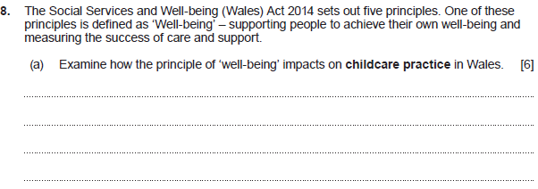
Question 8(a) and mark scheme
Command Verb: Examine
Investigate closely, in detail
Response may refer to:
Childcare settings must understand that some children/families may need help to achieve well-being
Services for children and families will need to work together to support those in need.
Community groups and health services need to support families in every area of life
Those working with children and families should enable them to feel safe
Services for families should enable children and families to safely take part in community life
Services should provide opportunities for everyone to feel good about themselves and their achievements
Childcare settings should encourage families to make decisions for themselves about their well-being.
Friendships and positive relationships should be encouraged and supported
Education providers should ensure all children and young people have an equal chance at achieving in education and training
Service providers should ensure consideration is given to language preference and encourage the use of the Welsh language
This list is not exhaustive.
Credit any other relevant response.
Award up to 6 marks
Award 0 marks where response is not creditworthy.
Award 1- 2 marks for a basic examination which shows some knowledge and understanding of how the principle of Well-being impacts on childcare practice in Wales.
Award 3-4 marks for a good examination which shows good knowledge and understanding of how the principle of Well-being impacts on childcare practice in Wales.
Award 5-6 marks for a very good examination which shows detailed knowledge and understanding of how the principle of Well-being impacts on childcare practice in Wales.

Slide 36
Question 8(a) Candidate’s answer with Principal Examiner’s comments
Well-being impacts childcare in Wales because, childcare settings have more provisions out that help children learn about their feelings, and learn how to deal with them in a healthy way. The principle 'well-being' impacts child care because they have to make sure that their envirnoments support their well-being positively, meaning it needs to be stimulating and challenging, but not too challenging that they struggle a lot and doubt themselves. Well-being impacts child care by making the industry focus more on the child and what they want to do, in order to help them reach a postivie well-ebeing. Well-being has impacted thew work of a childcare setting because they have more tasks that promote independence to improve their self-esteem, their confidence ancd their independece skills.
Principal Examiner feedback
This leaner has thought carefully about what this question is asking and presented a good evaluation to gain these well-deserved 3 marks.
The focus is on what needs to happen in practice to support well-being. There is evidence of good understanding where the learner evaluates the importance of the environment positively and negatively. The final sentence also proves knowledge of how settings need to plan to support independence skills.
Marks awarded 3/6

Slide 37
Question 8(a) Candidate’s answer with Principal Examiner’s comments
Ensuring peoples well being is met allows everyone to enjoy themselves and make the most of every situation, that people are not hindered by poverty or disability and are felt included in society. This rule ensures that no one is looked over and all children are under suitable care and protection. Well-being makes sure that everyone is healthy and happy and getting the best education they deserve as well as being treated equally without discrimination and good care.
Principal Examiner feedback
This is a very general answer where the examiner would have applied the “Credit any other relevant response” option available, allowing the 3 marks to be awarded.
The response shows an understanding of the importance of well-being and how this might be achieved through enjoyment, happiness and best available education. The over reliance on equality of opportunity may have hindered development.
Marks awarded 3/6

Slide 38
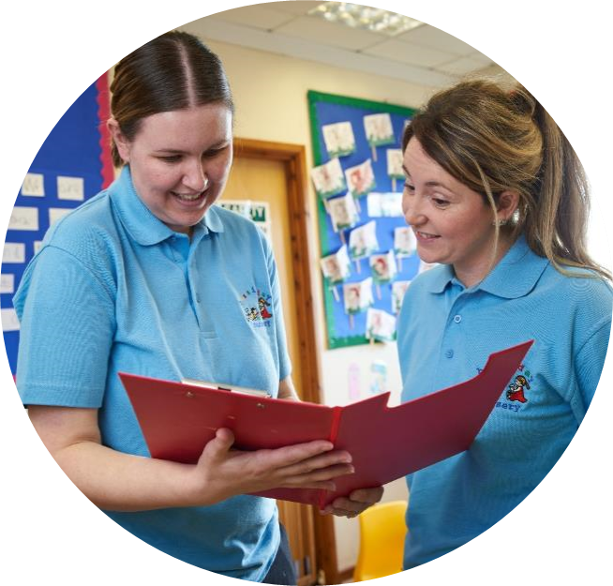
Level 2 Delivery - Working group

Slide 39
Concerns
Solutions

Slide 40

Unit 216 - EXAM
17th January 2024 AM

Slide 41

Event Evaluation
https://www.surveymonkey.co.uk/r/WJEConline2023-24

Slide 42

Diolch
Thank you

Slide 43
Contacts:
Contact our specialist Subject Officers, Technical Adviser and administrative support team for your subject with any queries.
WJEC
Amy Allen-Thomas - Subject Officer
Tania Lucas – Subject Support Officer
e-mail: ccpld@wjec.co.uk
City & Guilds
Suzi Gray – Technical Adviser
Quality: hclw.quality@cityandguilds.com
General/Customer Support: hclw.customer@cityandguilds.com

