Slide 1
Online Exam Review
Level 2 Health and Social Care: Principles and Contexts
Unit 1: Promoting health and well-being throughout the life stages (January 2022)

Slide 2
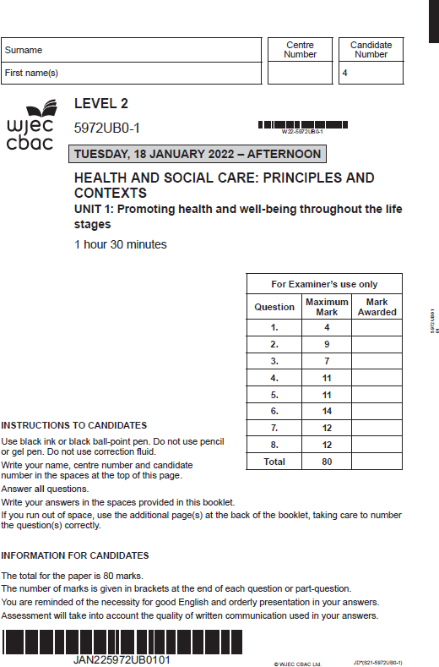
Unit 1: Promoting health and well-being throughout the life stages
Online examination review (OER)

Slide 3
General points on exam technique
Read through the whole question before starting to answer. This will help you understand what is required of you.
Use a highlighter to pick out key words.
Look at the command words and the number of marks available for each question, which will help you decide how much detail is needed.
If a word is bold, it is important.
Keep your exam paper open at the double page spread, do not fold it in half.
Read your answers to check they make sense.

Slide 4
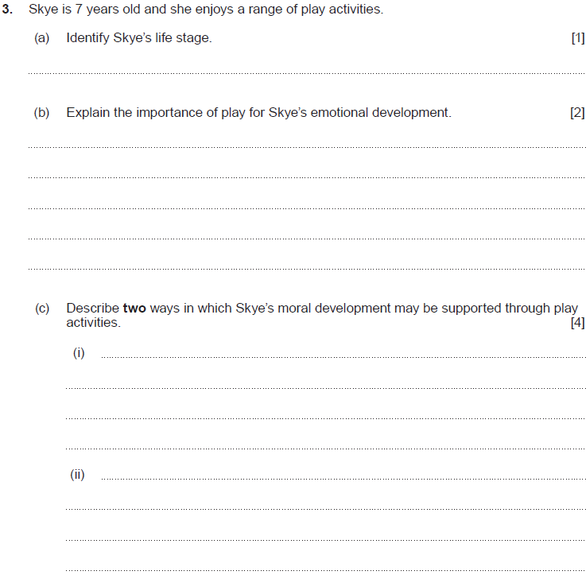
Question 3 (a), (b), (c)

Slide 5
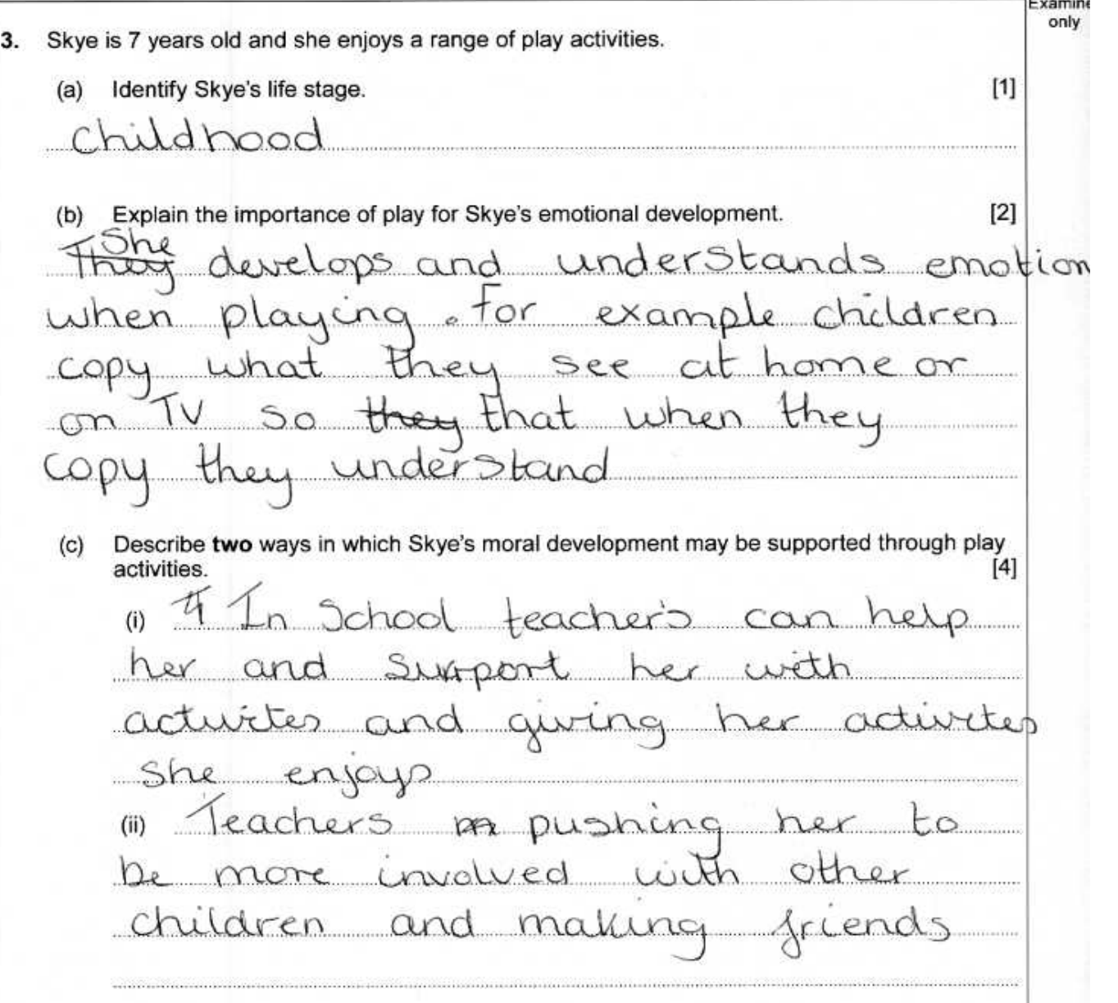
Question 3 (a), (b), (c) Candidate 1 answer

Slide 6
Question 3 (a), (b), (c) Candidate 1 answer with examiner’s comments
This candidate was awarded 1 mark
for identifying the correct life stage.
This candidate was awarded 1 mark
for a basic explanation of understanding
and developing emotions through copying.
No marks awarded, as the candidate is
referring to social development.
Total marks awarded
2/7

Slide 7
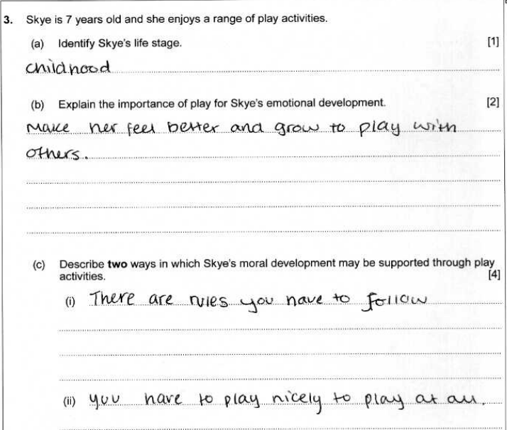
Question 3 (a), (b), (c) Candidate 2 answer

Slide 8
Question 3 (a), (b), (c) Candidate 2 answer with examiner’s comments
1 mark awarded for correctly identifying
the correct life stage.
1 mark awarded for a brief reference to
feeling better through play.
2 marks awarded for giving two brief points
describing how play supports moral
development.
Total marks awarded
4/7

Slide 9
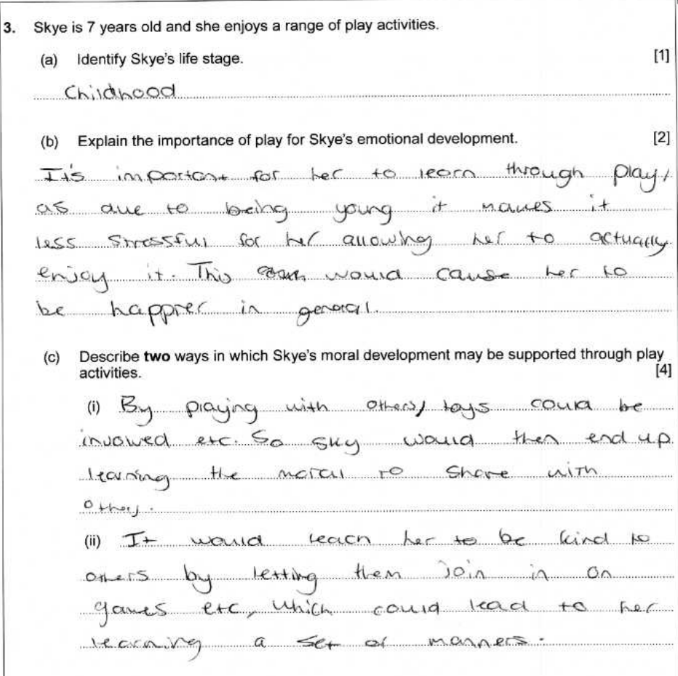
Question 3 (a), (b), (c) Candidate 3 answer

Slide 10
Question 3 (a), (b), (c) Candidate 3 answer with examiner’s comments
1 mark awarded for correctly identifying the
childhood life stage.
1 mark awarded for briefly explaining
that play is important for
Skye’s happiness and enjoyment
4 marks awarded for clearly describing
moral development
Total marks awarded
6/7

Slide 11
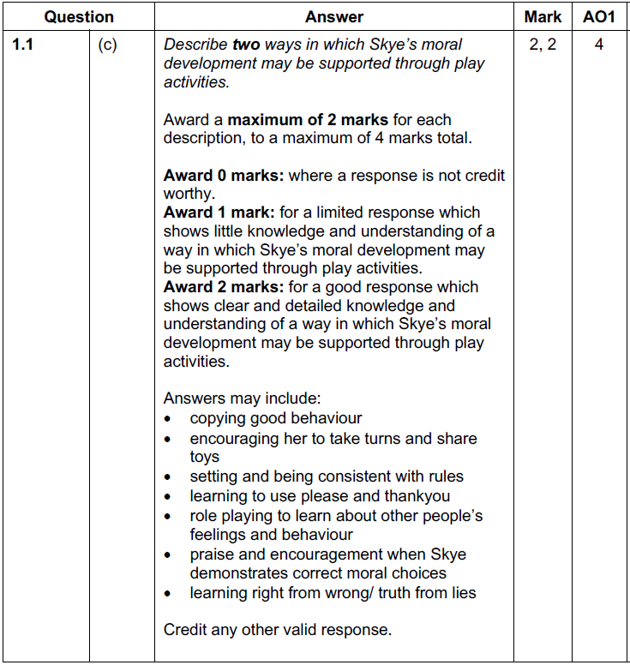
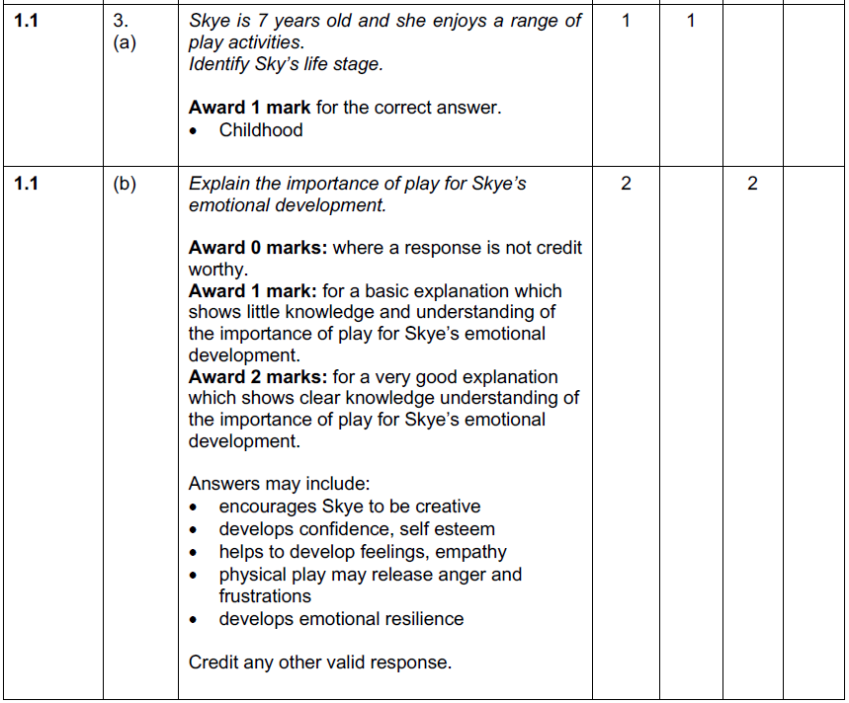
Question 3 (a), (b), (c) Mark scheme

Slide 12
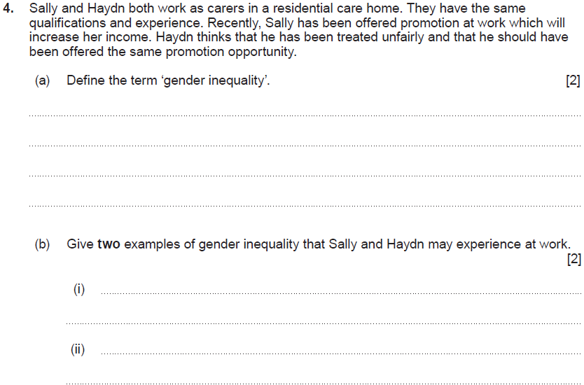
Question 4 (a), (b)

Slide 13
Question 4 (a), (b) Candidate 1 answer

Slide 14
Question 4 (a), (b) Candidate 1 answer with examiner’s comments
1 mark awarded
because the definition is unclear,
lacking understanding.
1 mark awarded because both
points are the same.
Total marks awarded
2/4

Slide 15
Question 4 (a), (b) Candidate 2 answer

Slide 16
Question 4 (a), (b) Candidate 2 answer with examiner’s comments
2 marks awarded for clearly defining
gender inequality
No marks awarded.
The candidate is referring to
a client’s choice to be treated by a
male or female care worker. Gender inequality refers to being treated unfairly because of an individual’s sexuality, e.g. men being paid
more money than women for doing the same job.
Total marks awarded
2/4

Slide 17
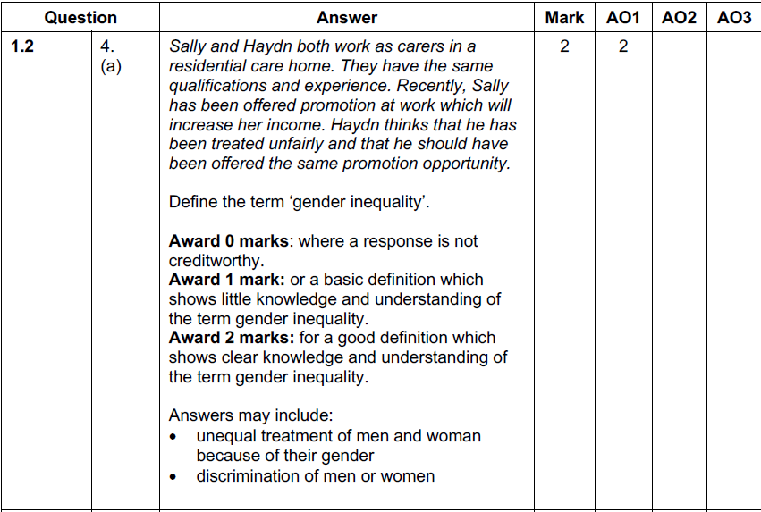
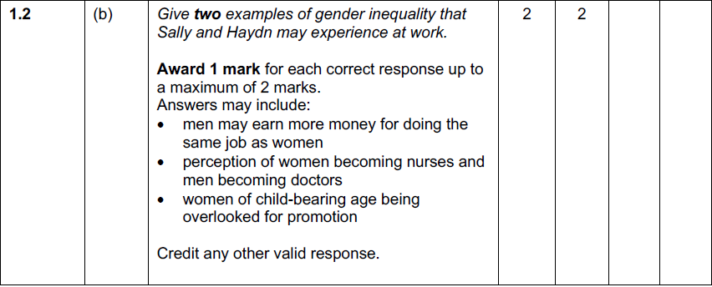
Question 4 (a), (b) Mark scheme

Slide 18
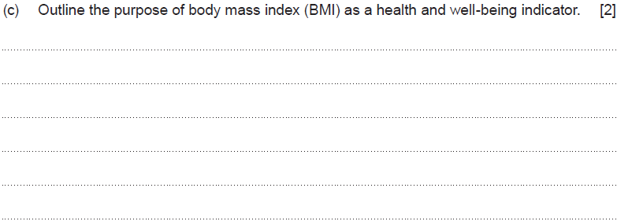
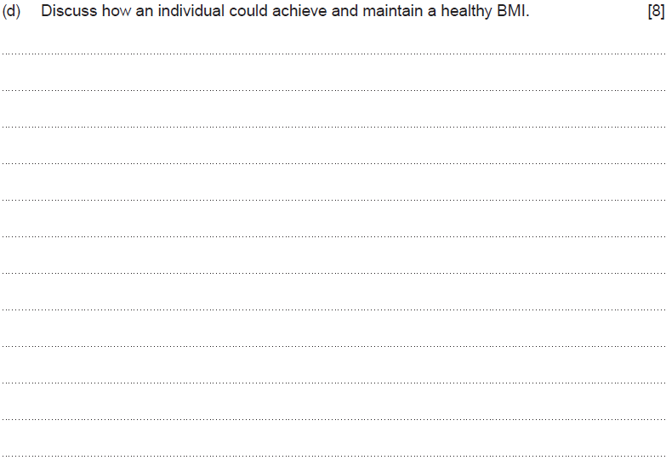
Question 6 (c), (d)

Slide 19
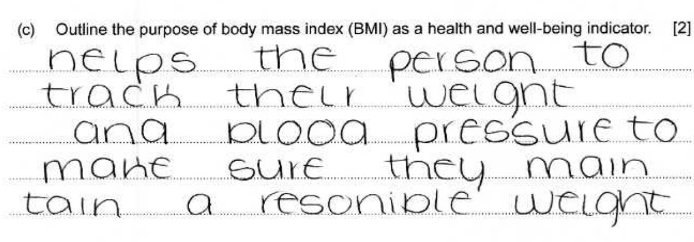
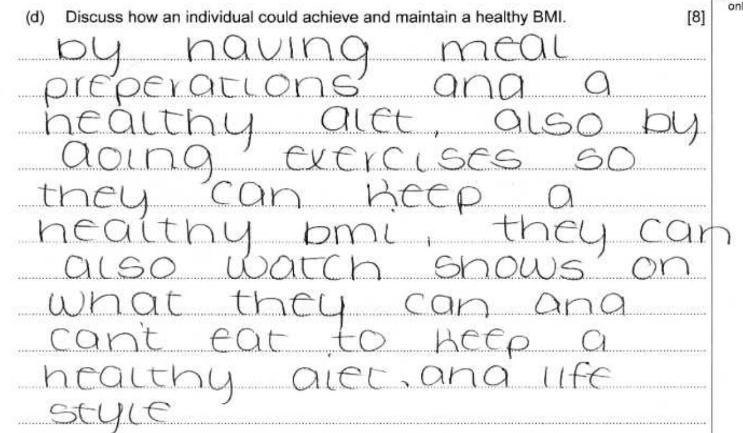
Question 6 (c), (d) Candidate 1 answer

Slide 20
Question 6 (c), (d) Candidate 1 answer with examiner’s comments
1 mark awarded for outlining that BMI
may be used to track weight.
3 marks awarded for a basic
discussion including diet and
exercise only. The response does not
discuss ways/methods to maintain a
healthy BMI.
Total marks awarded
4/10

Slide 21
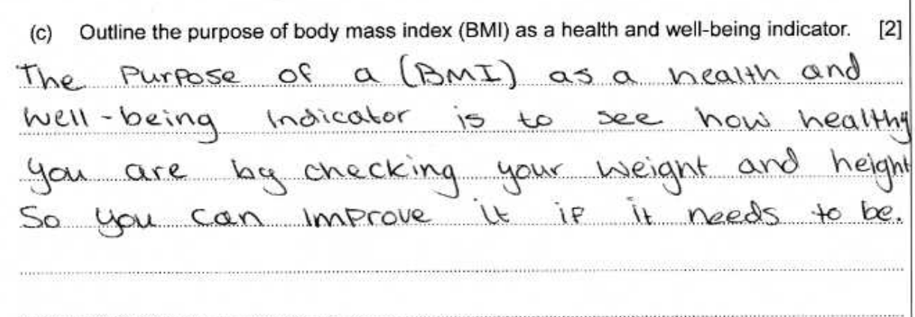
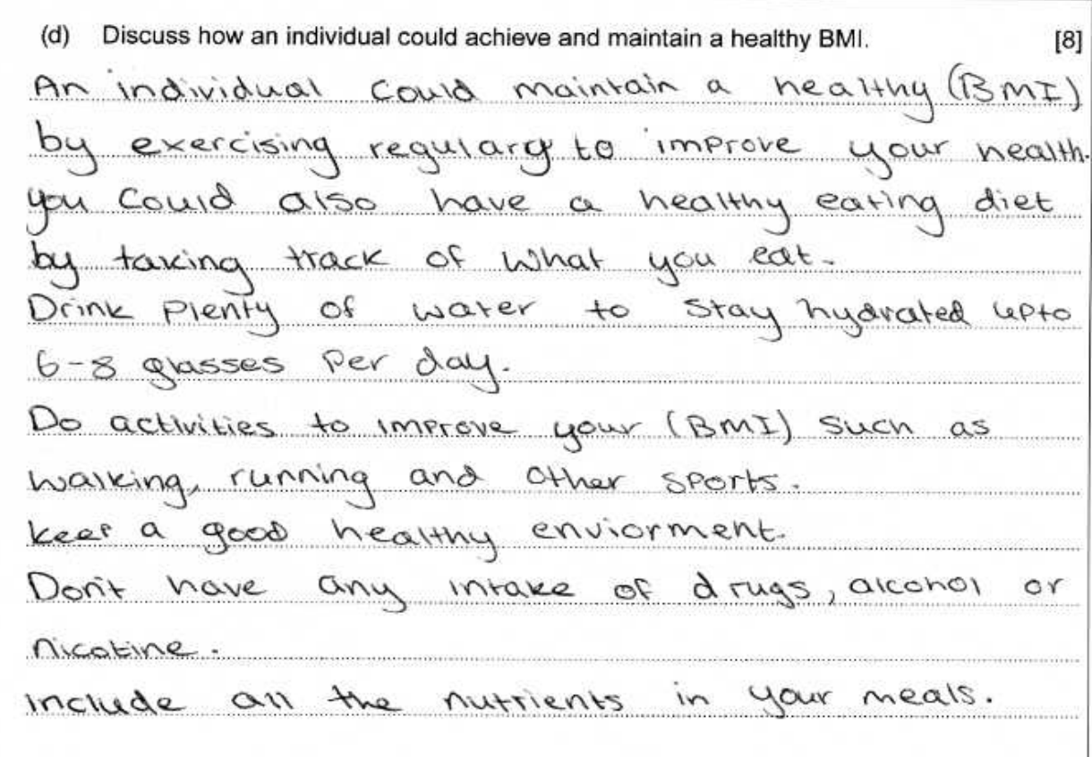
Question 6 (c), (d) Candidate 2 answer

Slide 22
Question 6 (c), (d) Candidate 2 answer with examiner’s comments
1 mark awarded for outlining that both
weight and height are measurements used
for calculating BMI.
6 marks awarded for a very good
discussion of ways to achieve and
maintain a healthy BMI.
Total marks awarded
7/10

Slide 23
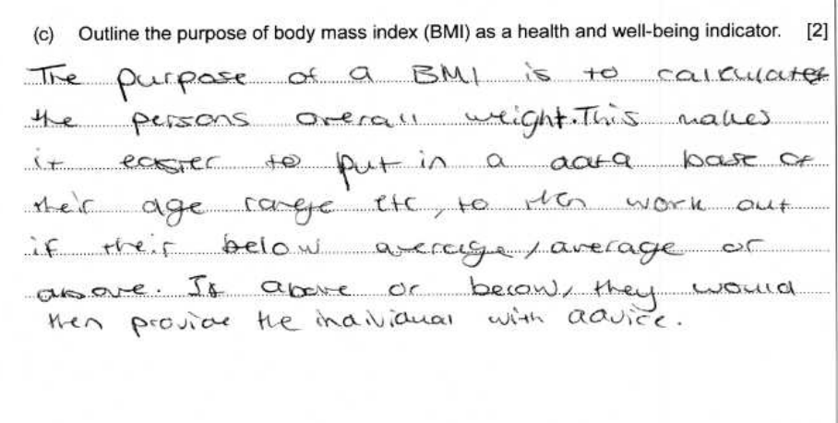
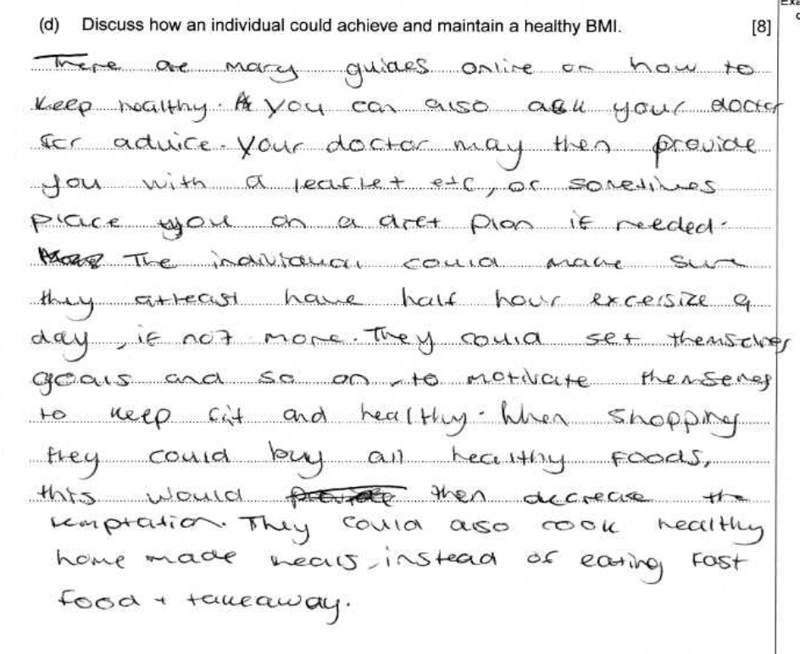
Question 6 (c), (d) Candidate 3 answer

Slide 24
Question 6 (c), (d) Candidate 3 answer with examiner’s comments
2 marks awarded for
a clear outline of the purpose of BMI
7 marks awarded for a detailed response
discussing a variety of ways to achieve
and maintain a healthy BMI
Total marks awarded
9/10

Slide 25
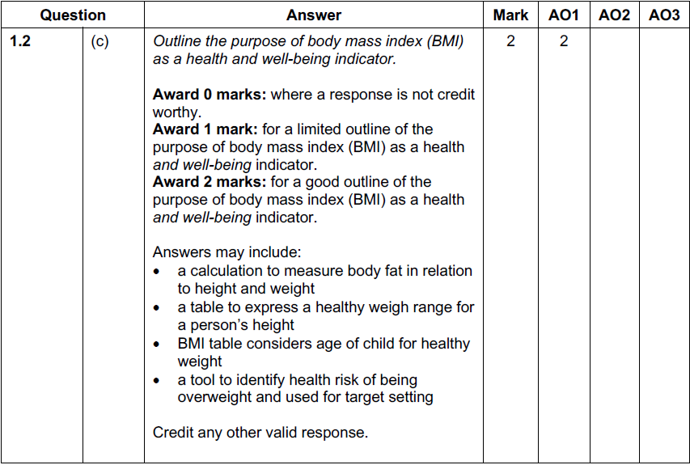
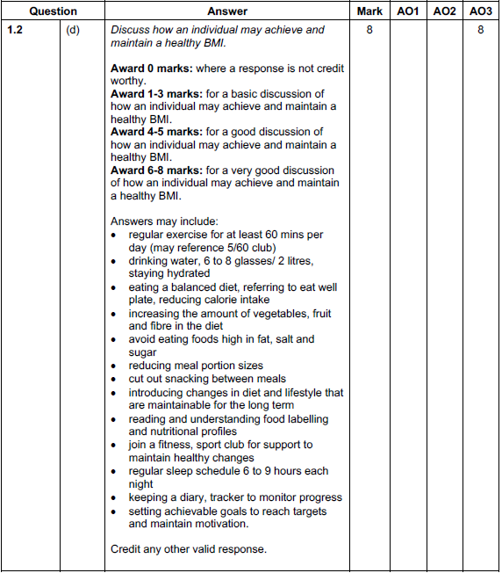
Question 6 (c), (d) Mark scheme

